Slide 1
Convection Currents

Slide 2
Essential Questions:
How does the Suns energy drive convection within the atmosphere and oceans, producing winds and ocean currents?

Slide 3
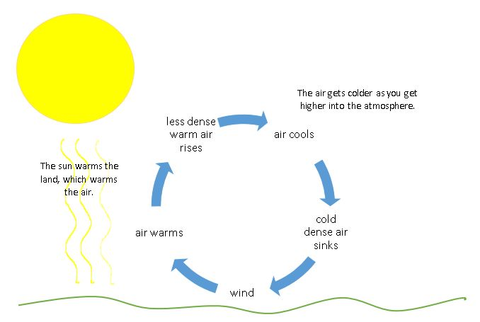
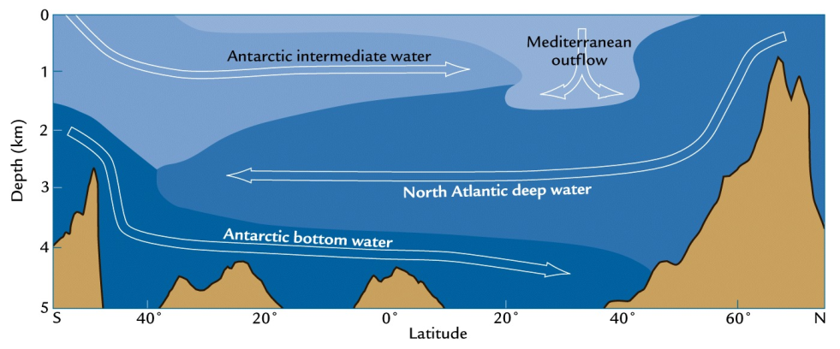
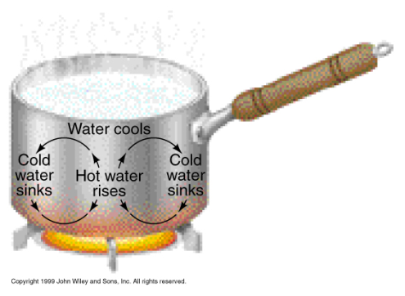
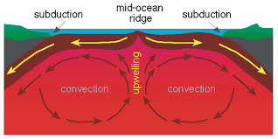
Convection Currents
Convection Currents
Heat energy transfer between two parts of a fluid of different temperatures
When hot fluids rise and cold fluids sink
Occurs in the atmosphere (A)
Occurs in the oceans (B)
Occurs in planetary mantles(C)
It also occurs in soup (D)
A
B
D
C

Slide 4
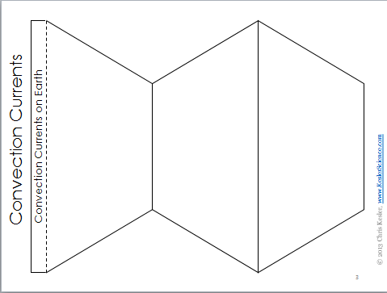
Quick Action – INB Template
Title INB Template
Cut out the Template
Glue along narrow tab into notebook
Add notes on Earth’s mantle, Earth’s Oceans and Earth’s Atmosphere

Slide 5
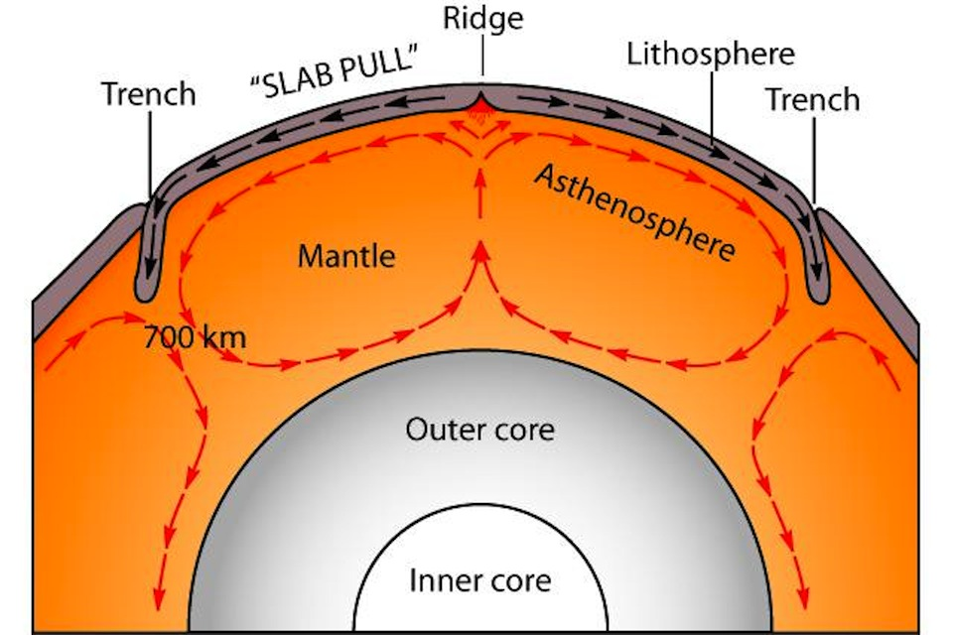
Convection Currents
Earth’s Mantle
Convection currents flow within the mantle
Causes the tectonic plates to move
Less dense hot magma moves upward
More dense cooler magma moves downward

Slide 6
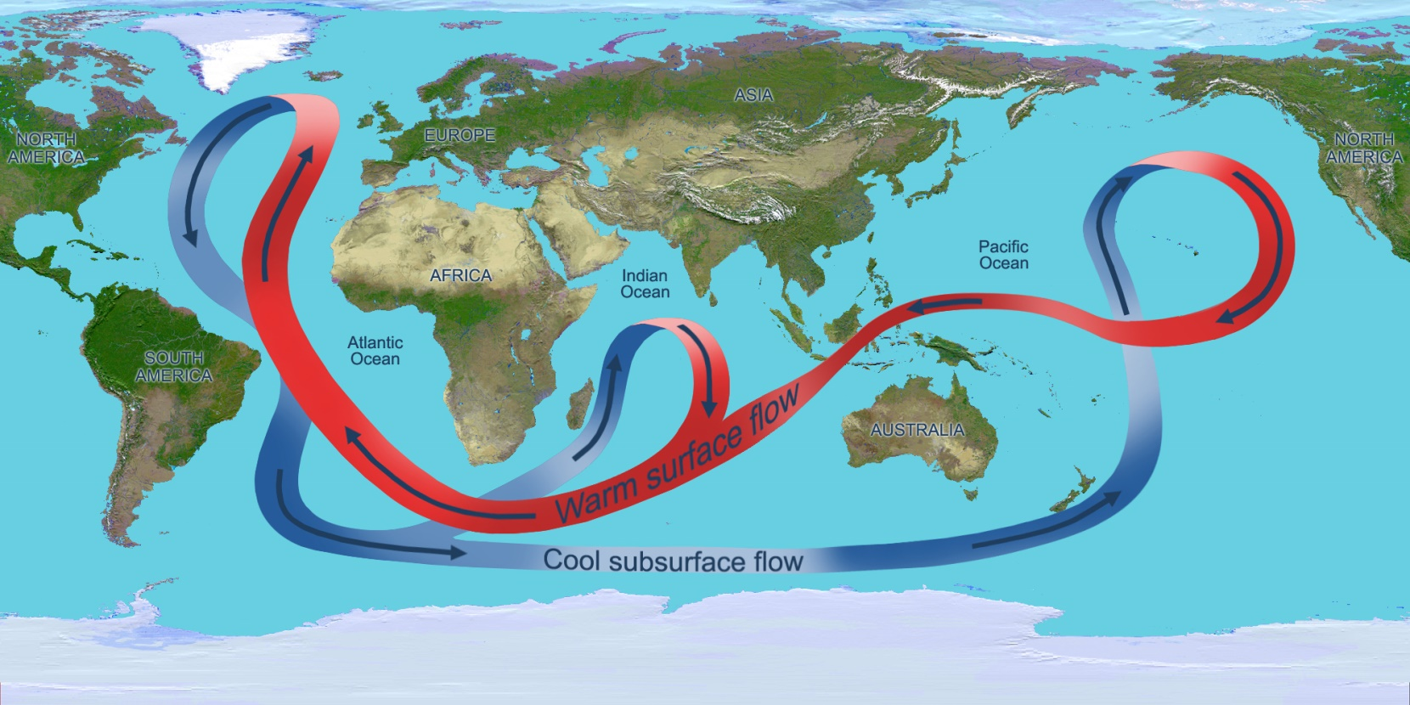
Convection Currents
Earth’s Oceans
Convection currents flow within the oceans
Temperature (solar heating) and salinity affects the density of water creating global currents.
More dense water sinks
Less dense water rises

Slide 7
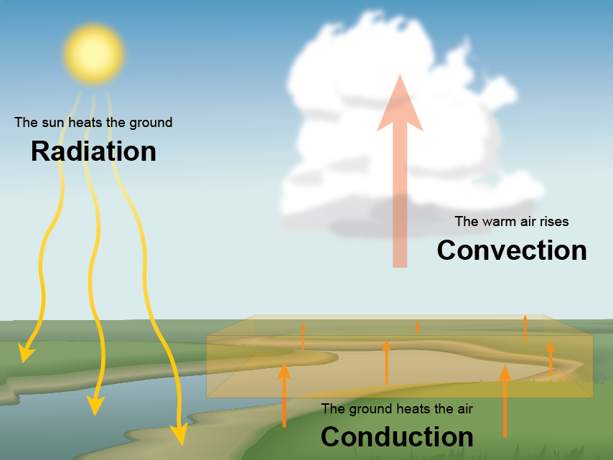
Convection Currents
Earth’s Atmosphere
Solar radiation heats the Earth’s surface
That heat is transferred to the air by conduction
Air touching the Earth’s surface expands, becomes less dense and rises.

Slide 8
Convection Currents
Earth’s Atmosphere
Air cools as it gets higher into the atmosphere.
Cool air becomes more dense and sinks.
Wind is created as the cool air moves in to replace the warm air.

Slide 9
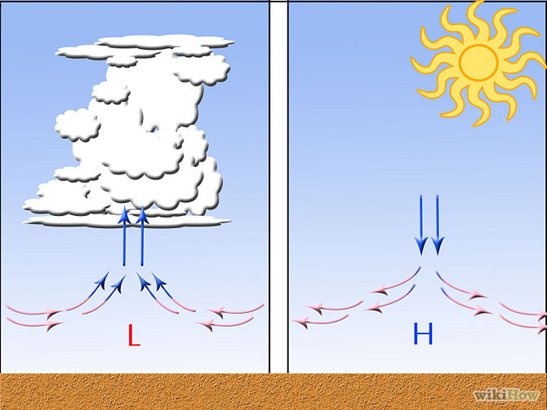
Convection Currents
High pressure (H)
As air masses cool, they becomes more dense and sinks toward the Earth’s surface.
Low pressure (L)
As air masses warm, they becomes less dense and rises above the Earth’s surface

Slide 10
Convection Currents
Wind
The pressure difference between a high pressure area and its lower pressure surroundings cause a wind to develop
Flows from higher to lower pressure

Slide 11
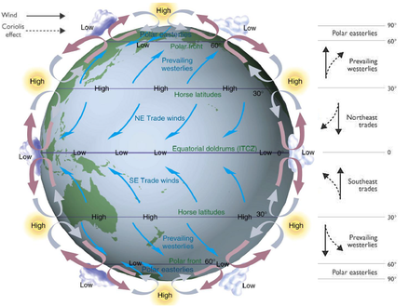
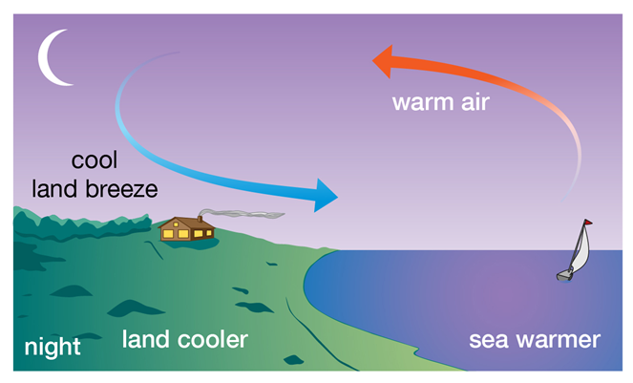
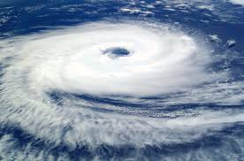
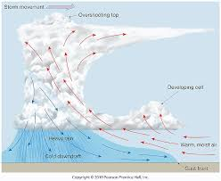
Convection Currents
Earth’s atmospheric convection currents cause
Global winds (A)
Local breezes (B)
Cyclones
(Hurricane/Typhoon) (C)
Thunderstorms (D)
A
B
C
D

Slide 12
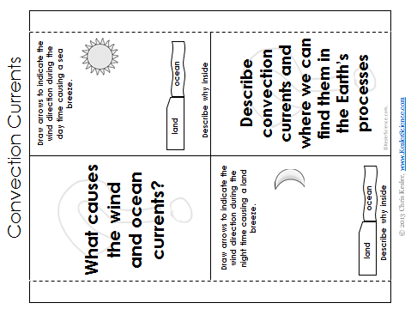
Quick Action – INB Template
Title INB Template
Cut out the Template
Glue along both narrow tabs so it opens like windows
Answer the questions under each window.

Slide 13
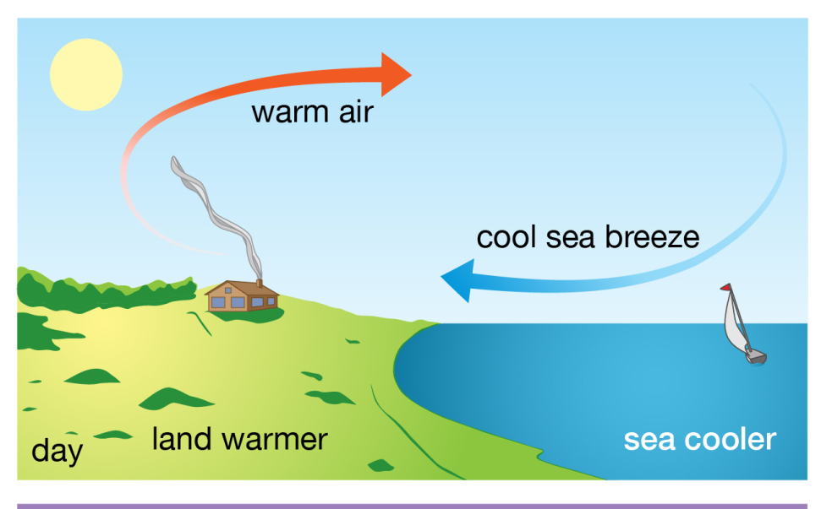
Convection Currents
Local Breezes
Sea breeze
Gentle wind that flows from the cool air over the water(high pressure) toward the warm air over the land (low pressure).
During the day solar radiation heats the land more quickly than water.

Slide 14
Convection Currents
Land breeze
Breeze that flows form the cool air above land (high pressure)toward the warmer air above the water (low pressure).
Caused by land cooling more quickly than water in the evening.

Slide 15
Convection Currents
Valley breeze
During the day, the surface of the mountain heats the air high up in the atmosphere, quicker than the valley floor heats.
This attracts the air from the valley, creating a breeze that blows from the valley floor(high pressure) up towards the top of the mountain (low pressure).

Slide 16
Convection Currents
Mountain breeze
In the evening, the mountain slopes cool the surrounding air more quickly than the air found lower in the atmosphere.
This causes winds to blow down the mountain (high pressure)towards the valley floor (low pressure).

Slide 17
Quick Action – Convection Currents
Write About
Look back over your notes so far and think about the energy source for convection currents.
Write a description of ocean currents and atmospheric currents using these words: solar, density, warm, cold, rise, fall or sink, convection.

Slide 18
Check for Understanding
Can you…
Recognize that the Sun provides the energy that drives convection within the atmosphere and oceans, producing winds and ocean currents?
Notes:
Clear up any confusion and answer questions.

