Slide 1
Earth’s Spheres and their Interactions! Topic 3 Lesson 1
SC.6.E.7.4 Differentiate and show interactions among the geosphere, hydrosphere, cryosphere, atmosphere and biosphere.

Slide 2
5 Spheres
Notes:
Have the students make this organizer in their science notebooks. They may choose to color the pictures at a later time. For now, make sure they have the words in boxes. They will also need to include the information about each sphere on the following slides so suggest they use a whole sheet of paper for this organizer.
Photos:
Biosphere – Charlie Watson, http://www.pixnio.com/fauna-animals/birds/toucan-bird-the-maya-biosphere-reserve-is-central-americas-most-biologically-diverse-ecosystem (CC0)
Cryosphere – Luca Galuzzi, https://commons.wikimedia.org/wiki/File:Perito_Moreno_Glacier_Patagonia_Argentina_Luca_Galuzzi_2005.JPG (CC BY-SA 2.5)
Hydrosphere – Unsplash, https://pixabay.com/en/water-blue-ocean-sea-sky-waves-945409/ (CC0)
Geosphere – Chris Janda, https://www.pexels.com/photo/nature-national-park-arches-national-park-62600/ (CC0)
Atmosphere –Bobbi Jones Jones, http://www.publicdomainpictures.net/view-image.php?image=23336&picture=above-us-only-sky (CC0)

Slide 3
What on Earth?
What is the Earth system?
A group of related objects or parts that work together to form a whole. Ex: the planets that make up the solar system.
The Earth system is all of the matter, energy, and processes within Earth’s boundary.
Earth is a complex system full of living and nonliving things and the matter and energy that continuously cycle through the smaller systems.

Slide 4
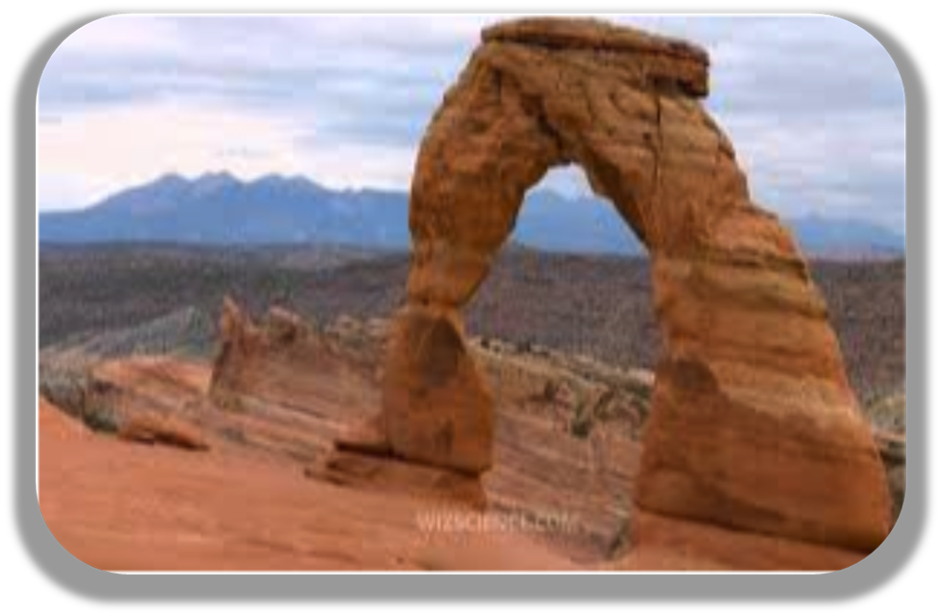
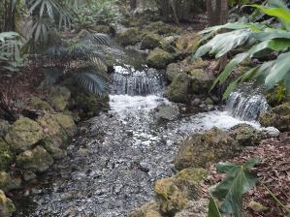
What is the GEOSPHERE?
The geosphere is the mostly solid, rocky part of Earth. It extends from the center of Earth to the surface of Earth.
The crust is the thin, outermost layer of the geosphere.
THE ROCKY, TERRESTRIAL PARTS OF THE EARTH
CAN YOU DIG IT????
Includes NON-living soil, rocks, and
“Geo” means ground

Slide 5
What is the Hydrosphere?
The hydrosphere is the part of Earth that is liquid water – H2O
Oceans, lakes, rivers, marshes, and groundwater are part of the hydrosphere.
Water is moving through Earth and even into and out of living things at all times!
“Hydro” means water
Notes:
Hydrosphere includes all of the rivers, lakes, streams, oceans, groundwater, and moisture in the air (like rain and snow). The hydrosphere is found on the surface of Earth, but also extends down several miles below, as well as several miles up into the atmosphere. Most of Earth's water, about 97%, is salty and in the oceans. Two-thirds of the remaining 3% is frozen in glaciers and polar ice caps. Only 1% of the hydrosphere is liquid freshwater, and even most of this exists as groundwater down in the soil.

Slide 6
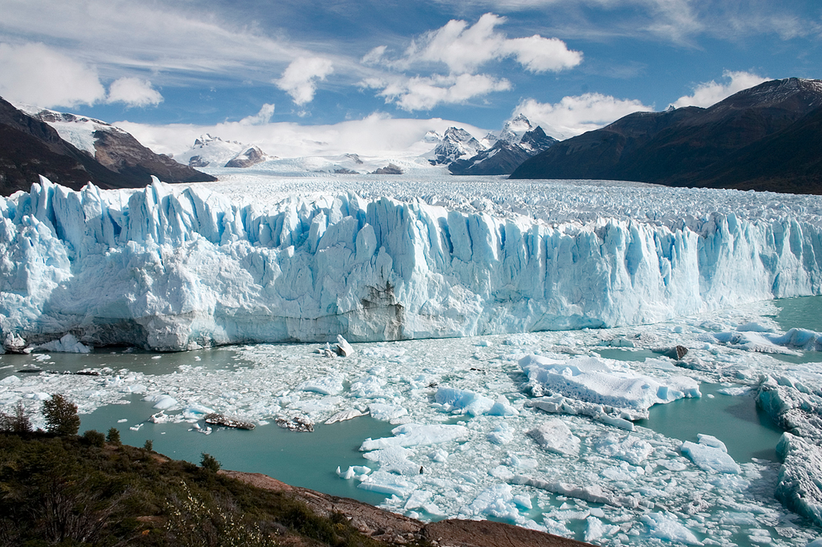
What is the cryosphere?
The cryosphere is made up of all of the frozen water on Earth. – “Cryo” means ice
Ice, snow, sea ice, glaciers, ice shelves, icebergs, and frozen ground are all part of the cryosphere.
Changes in the cryosphere can play an important role in Earth’s climate.
Ice, ice baby!

Slide 7
What’s the Atmosphere?
The atmosphere is a combination of mostly invisible gases that surrounds Earth.
“Atmo” means air
About 78 % of the atmosphere is nitrogen. Oxygen makes up 21 % of the atmosphere.
Notes:
There are 5 layers of the Earth’s atmosphere: troposphere, stratosphere, mesosphere, thermosphere, and exosphere.

Slide 8
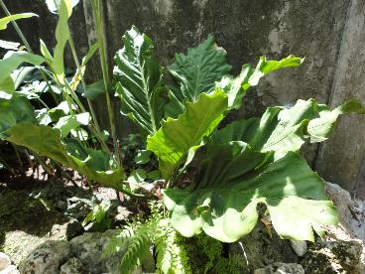
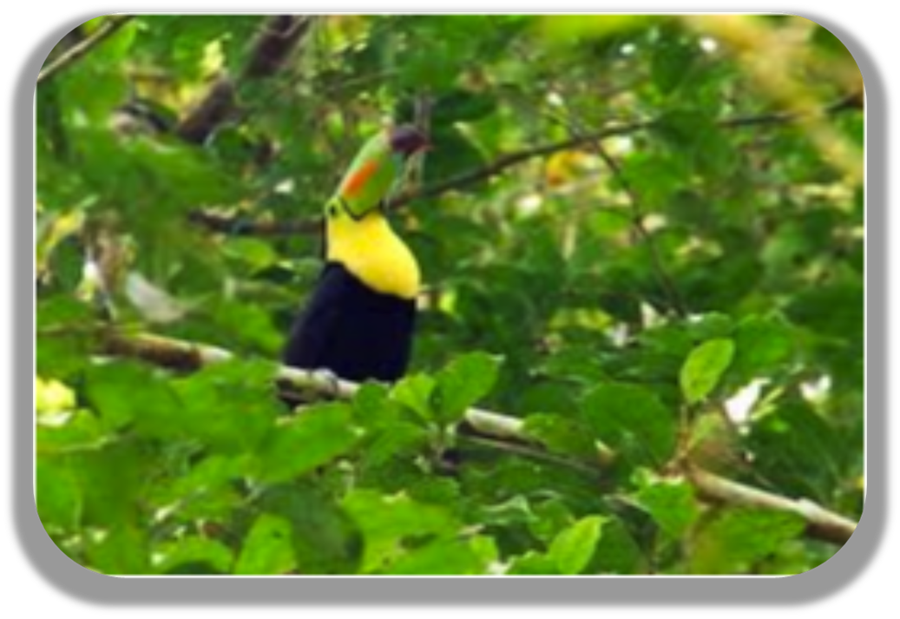
What is the Biosphere?
The biosphere is made up of all living things. “BIO “ means life
Organisms usually need oxygen or carbon dioxide to carry out life processes.
Liquid water, moderate temperatures, and a stable source of energy are also required for most living things.

Slide 9
How do Earth’s spheres interact?
All of the five spheres of Earth interact as matter and energy change and cycle through the system.
Matter moves between Earth’s spheres.
Sometimes, matter moves through many spheres before returning to a sphere.
Energy moves between spheres. Energy also moves back and forth between spheres.

Slide 10
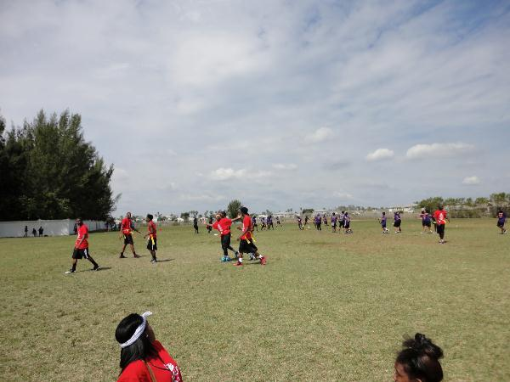
Which of Earth’s spheres are Interacting? Can you explain?
1. Atmosphere
2. Biosphere
3. Cryosphere
4. Geosphere
5.Hydrosphere

Slide 11
Which of Earth’s spheres are interacting in the picture?
1. Atmosphere
2. Biosphere
3. Cryosphere
4. Geosphere
5.Hydrosphere

Slide 12
Which of Earth’s spheres are interacting in the picture?
1. Atmosphere
2. Biosphere
3. Cryosphere
4. Geosphere
5.Hydrosphere

Slide 13
Which of Earth’s spheres are interacting in the picture?
1. Atmosphere
2. Biosphere
3. Cryosphere
4. Geosphere
5.Hydrosphere

Slide 14
Which of Earth’s spheres are interacting in the picture?
1. Atmosphere
2. Biosphere
3. Cryosphere
4. Geosphere
5.Hydrosphere

