Slide 1
12.3: Inscribed Angles

Slide 2
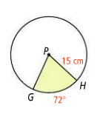
So far, angles in circles…
Are there any other ways we could form an angle in this circle?

Slide 3
An inscribed angle is one whose vertex is on the circle (not the center)
The endpoints of the rays of an inscribed angle form the intercepted arc for that angle

Slide 4
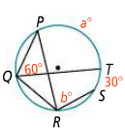
What are the values of a and b?

Slide 5
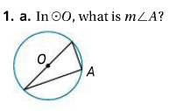
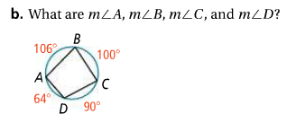

Slide 7
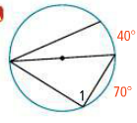
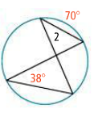
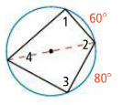
Find the values of the numbered angles

Slide 9
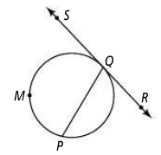
If arc PMQ=212, what is the measure of angle PQR?

Slide 10
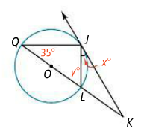
If KJ is a tangent line, what are the values for x and y?

Slide 11
12.4: Angle Measures and Segment Lengths

Slide 13
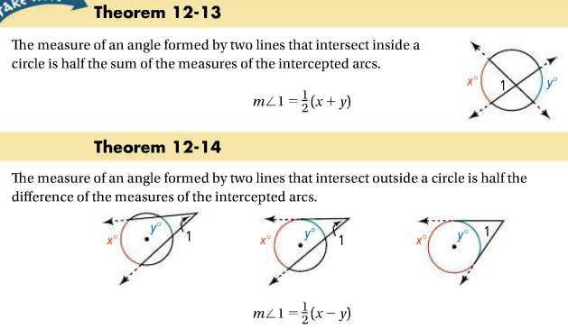
A secant is a line that intersects a circle at two points

Slide 15
What is the value of each variable?

Slide 16
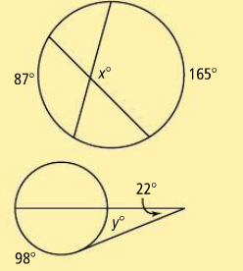
What is the value of each variable?

Slide 17
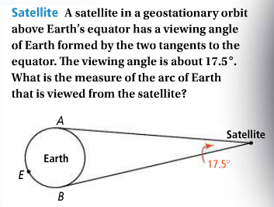

Slide 18
In other words, for any two line segments drawn, if you multiply the segments of the line together, it will be equal to the product of the other line segments

Slide 19
Find the value of each variable

Slide 20
Find the value of each variable

Slide 21
Homework:
Section 12.3, pages 784: 6, 9, 11, 12, 18
Section 12.4, pages 794-795: 8, 10, 13, 15-18
Honors: Add 24, 32, 33
Quiz on Monday (Area)

