Slide 1
Write name, date, and period on a blank sheet of paper.
Answer the following questions, due by the end of morning announcements:
What are the four courts that make up the Florida Judicial Branch?
1.
2.
3.
4.
2. How many Supreme Court Justices does Florida have?

Slide 2
The Florida Constitution

Slide 3
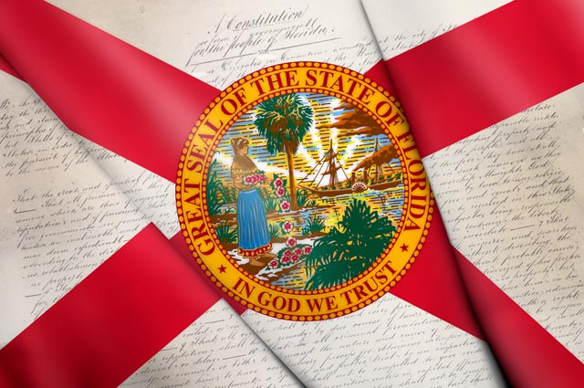
The Florida State Constitution
The State Constitution comes from the people rather than only the Legislature
It sets up rules and basic rights as the framework for state laws

Slide 4

The Florida State Constitution
Florida law touches every aspect of daily life:
Where and how we build our houses
Our safety and health
The taxes we pay
Our ability to vote and participate in government
The quality of our air, water, roads and environment

Slide 5
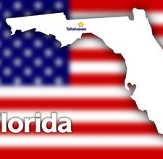
The Articles of the Florida Constitution
Twelve Articles
  Sections that deal with different subjects
  Together they outline the state government and citizens' rights

Slide 6
Differences:
Length
U.S. Constitution:
Florida Constitution:
The shorter of the two.
7 Articles
1 (large) page.
27 Amendments
The longer of the two.
12 Articles
80 pages
MANY Amendments!

Slide 7
Differences:
Structure of Government Established.
U.S. Constitution:
Florida Constitution:
Legislative Branch
US Congress
Executive Branch:
President
Judicial Branch:
US Supreme Court
Legislative Branch:
State House and Senate
Executive Branch:
Governor
State agencies
Judicial Branch:
County Courts, Circuit Courts, Appeal Court, and Florida Supreme Court
Notes:
While they both establish the three branches of government, the Florida Constitution does not leave things to be later decided.

Slide 8
Differences:
Powers Established.
US Constitution
FL Constitution
Establishes the federal system. Within this there are three types of powers:
  Expressed, enumerated, or delegated
  Concurrent
  Reserved
Based on the reserved powers, the Florida Constitution deals with:
  Local Governments
  Administering Elections
  Etc.
They give power to local governments to govern their citizens, kind of like the federal system between US and States.

Slide 9
Differences :
Specific topics
US Constitution
Florida Constitution
More Generalized, leaves a lot to be determined by Congress later.
Contains Supremacy clause!
Which Article discusses Supremacy? Six
Addresses public education, motor vehicles, and elections
Deals with day-to-day issues that citizens of the state may be involved in.

Slide 10

Article I – Declaration of Rights
Some of Florida's Bill of Rights
Freedom of speech
Freedom of the press
Equal protection of the laws
Right of a jury trial
Right to bear arms
Freedom of worship

Slide 11
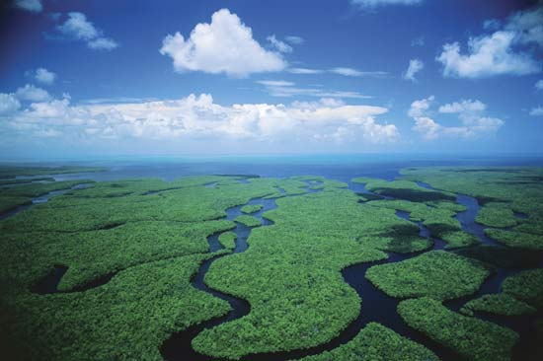
Article II — General Provisions
Creates the state's boundaries, seal, flag, and three branches of government
Makes Tallahassee the state capital and English the official language in Florida
Protects and conserves Florida's natural resources .

Slide 12

Article III — Legislature
Establishes a House and a Senate
Requires that states budget and plan how to spend their money
Requires a "rainy day" fund for emergencies

Slide 13

Article IV — Executive
Creates Florida's Cabinet and executive departments
Requires the establishment of:
  the Fish and Wildlife Conservation Commission
  Department of Veteran Affairs
  Department of Elderly Affairs

Slide 14
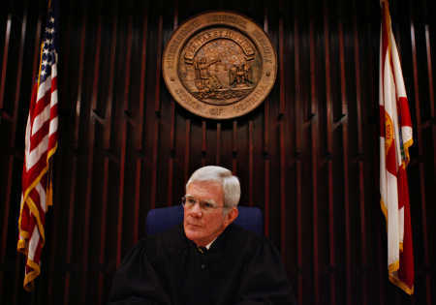
Article V — Judiciary Appeals
Establishes four levels of state courts
Tells how judges will be chosen
This Article is where the state courts derive (get) their power from.

Slide 15

Article VI — Suffrage and Election
Specifies dates of general elections and qualifications to vote
Disqualifies convicted felons and the mentally incompetent from voting
Limits certain state officials terms

Slide 16

Article VII — Finance and Taxation
All taxes are created by the Legislature
Doesn’t allow state income tax and limits inheritance taxes

Slide 17
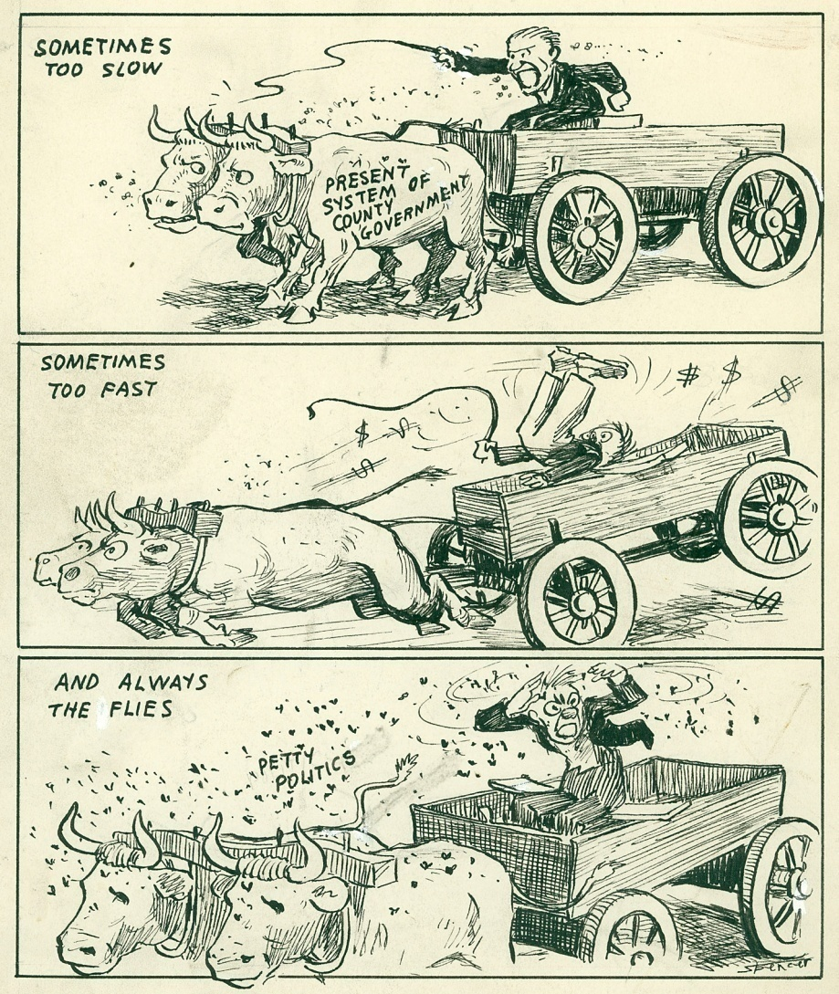
Article VIII — Local Government
Allows the state to create, change or eliminate local governments
Lists their powers and requires that county officials include:
  County commissioners and a separately elected clerk, sheriff
  Tax appraiser
  Tax collector
  Supervisor of elections

Slide 18

Article IX — Education
Creates a system of public schools, colleges and other public education programs
The Board of Education, appointed by the governor, supervises this system
Specifies one school district per county and district leadership.

Slide 19
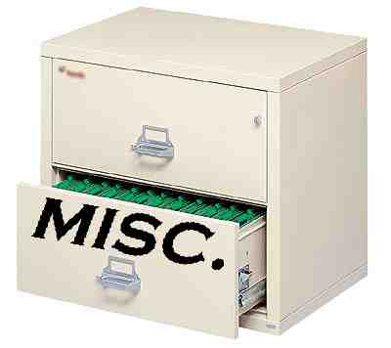
Article X — Miscellaneous
Carries 27 sections including:
Authority to have a state militia
Protection from court seizure of one's home
State lottery
Public ownership of lands under navigable waters
Workplaces without tobacco smoke
Prohibition of medical licenses after repeated medical malpractice

Slide 20
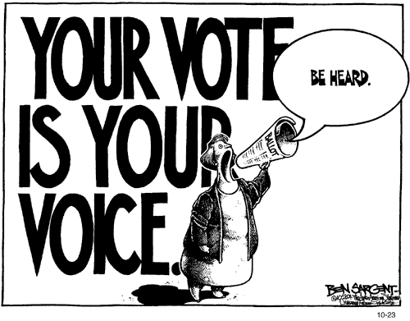
Article XI — Amendments
Creates five ways to amend Florida's Constitution
Reviews the state's tax and budget laws
How does this differ from how we amend the US Constitution?

Slide 21
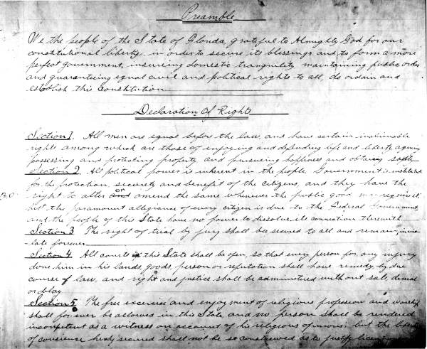
Article XII — Schedule
Provides for the transition from the 1885 Constitution to the current one

Slide 22
Florida Constitution
Scavenger Hunt!
Work together
and use your Florida Constitutions to
find the answers to the following
questions.
Write the answer to the question and where you found it in the Constitution (both Article and Section).
The team that gets the most right wins!
Notes:
22

Slide 23
Question 1
What is the mandatory period of time between the purchase and delivery at retail of any handgun?
Notes:
23

Slide 24
Answer 1
Three Days
Article 1
Declaration of Rights
Section 8
Notes:
24

Slide 25
Question 2
Patients have a right to have access to any records relating to any __________ medical incident.
Notes:
25

Slide 26
Answer 2
Adverse
Article 10
Miscellaneous
Section 25
Notes:
26

Slide 27
Question 3
All elections by the people shall be by direct and __________ vote.
Notes:
27

Slide 28
Answer 3
Secret
Article 6
Suffrage and Elections
Section 1
Notes:
28

Slide 29
Question 4
The income derived from the state school fund shall be appropriated, but only to the support and maintenance of ________ _________ schools.
Notes:
29

Slide 30
Answer 4
Free Public
Article 9
Education
Section 6
Notes:
30

Slide 31
Question 5
The state boundaries begin at the mouth of what river?
Notes:
31

Slide 32
Answer 5
The Perdido River
Article 2
General Provisions
Section 1
Notes:
32

Slide 33
Question 6
Who is the successor to the governor if the office of governor becomes vacant?
Notes:
33

Slide 34
Answer 6
Lieutenant Governor
Article 4
Executive
Section 3
Notes:
34

Slide 35
Question 7
In Florida, each district court of appeals consists of at least how many judges?
Notes:
35

Slide 36
Answer 7
Three
Article 5
Judiciary
Section 4
Notes:
36

Slide 37
Question 8
What is the last word of the oath that each eligible citizen must make upon registering?
Notes:
37

Slide 38
Answer 8
Florida
Article 6
Suffrage and Elections
Section 3
Notes:
38

Slide 39
Question 9
How many votes from the House of Representatives are required in order to impeach an officer?
Notes:
39

Slide 40
Answer 9
Two-thirds Vote
Article 3
Legislature
Section 17a
Notes:
40

Slide 41
Question 10
How many members are part of the Constitution Revision Commission?
Notes:
41

Slide 42
Answer 10
Thirty-Seven
Article 11
Amendments
Section 2
Notes:
42

Slide 43
Question 11
All property owned by a ________ and used exclusively by it for public purposes shall be exempt from taxation.
Notes:
43

Slide 44
Answer 11
Municipality
Article 7
Finance and Taxation
Section 3
Notes:
44

Slide 45
Question 12
How long is the term of a county officer?
Notes:
45

Slide 46
Answer 12
Four Years
Article 8
Local Government
Section 1
Notes:
46

Slide 47
Question 13
The Constitution of ________ is superseded by the Florida Constitution’s revisions
Notes:
47

Slide 48
Answer 13
1885
Article 12
Schedule
Section 1
Notes:
48

Slide 49
Question 14
How many judges are there to be in each county court?
Notes:
49

Slide 50
Answer 14
One or more
Article 5
Judiciary
Section 6
Notes:
50

Slide 51
Question 15
No tax upon estates or ________ or upon the income of natural persons who are residents or citizens of the state shall be levied by the state.
Notes:
51

Slide 52
Answer 15
Inheritances
Article 7
Finance and Taxation
Section 5
Notes:
52

Slide 53
Question 16
The people hereby enact limitations on marine net fishing in Florida waters to protect saltwater ___________, shellfish, and other marine creatures.
Notes:
53

Slide 54
Answer 16
Finfish
Article 10
Miscellaneous
Section 16
Notes:
54

Slide 55
Question 17
Treason against the state shall only consist in ______ ______ against it.
Notes:
55

Slide 56
Answer 17
Levying war
Article 1
Declaration of Rights
Section 20
Notes:
56

Slide 57
Question 18
English is the ________ ________ of the State of Florida.
Notes:
57

Slide 58
Answer 18
Official Language
Article 2
General Provisions
Section 9
Notes:
58

Slide 59
Question 19
No office shall be created the term of which shall exceed ________ years except as provided herein.
Notes:
59

Slide 60
Answer 19
Four
Article 3
Legislature
Section 13
Notes:
60

Slide 61
Question 20
Repeal or amendment of a criminal statute shall not affect prosecution or punishment for any crime ______ ______.
Notes:
61

Slide 62
Answer 20
Previously committed
Article 10
Miscellaneous
Section 9
Notes:
62

Slide 63
Who is the Winner?
Let's tally up the points and find out who the Florida Constitution Scavenger Hunt winner is!
Congratulations!
Notes:
63

