Slide 1
SENIOR CLASS MOTTO
“What lies behind us and what lies before us are small matters compared to what lies within us.”
Ralph Waldo Emerson

Slide 2
SENIOR CLASS SPONSORS
Mrs. Stacy Fabrega – English Dept
room 307
Mrs. Kim Garcia – Math Dept room 319
Ms. Amanda Geiger – Social Studies Dept
room 208
Mrs. Susan Merlau – Main Office

Slide 3
SENIOR OFFICERS 2018
Christie Salters- President
Kayla Harris- Vice President

Slide 4
REMIND
To enroll in the Class of 2018 group, text:
Text @9364b to 81010

Slide 5
JOIN LISTSERV

Slide 6
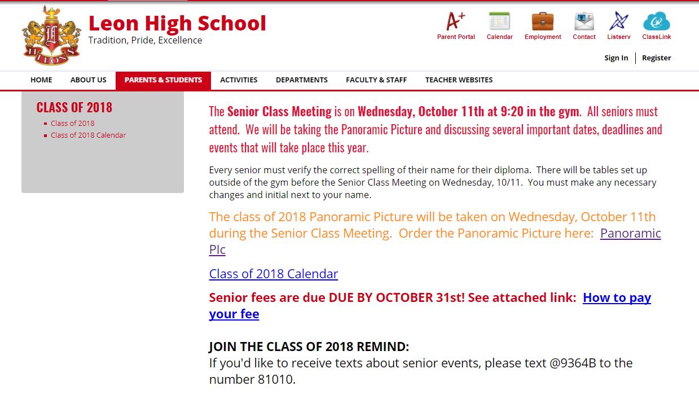
SENIOR WEBPAGE
http://www.leonschools.net/domain/4962

Slide 7
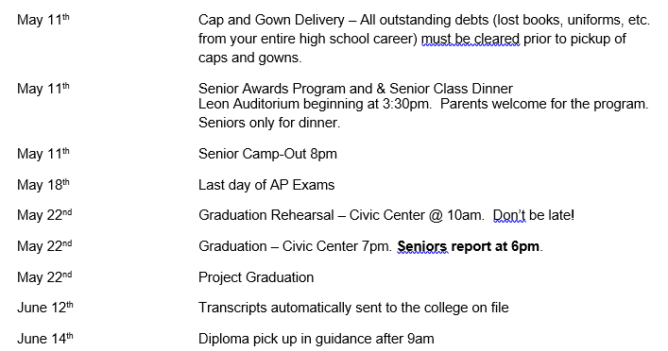
Class of 2018 Calendar

Slide 8
SENIOR FEES
$50 Due by October 31st
Fees may increase on November 1st
Subject to increase again on January 1st
NEED TO MAKE PAYMENT ARRANGEMENTS??????
SEE US BEFORE October 31st
SENIOR FEE MUST BE PAID PRIOR TO PURCHASING A GRAD BASH TICKET

Slide 9
Directions to Pay Senior Fee:

Slide 10
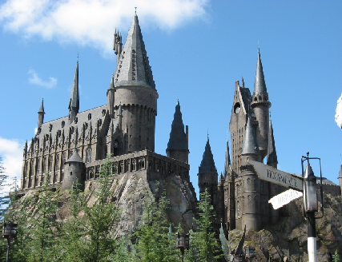
GRAD BASH 2018
April 13th – 14th
Approximately $130
TICKETS GO ON SALE
FEBRUARY 5th
SUPPLY LIMITED

Slide 11
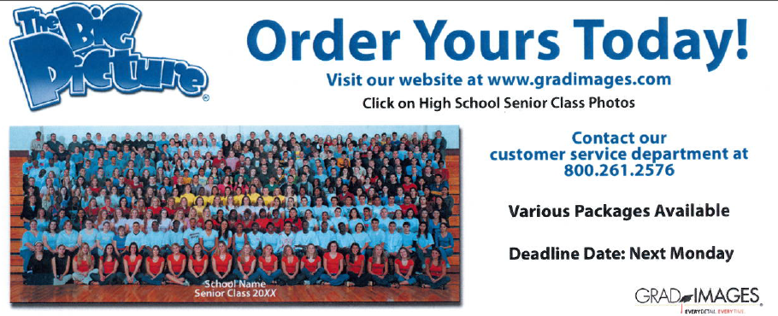
GRADIMAGES
Order your panoramic pic
Take pictures of you during graduation

Slide 12
BEFRIEND YOUR COUNSELOR
MAKE SURE YOUR CREDITS ARE IN ORDER
DOCUMENT YOUR VOLUNTEER HOURS
FOLLOW DIRECTIONS ABOUT BRIGHT FUTURES
MAKE SURE TO PRE-ARRANGE AND PRE-EXCUSE YOUR COLLEGE VISITS

Slide 13
LETTERS OF RECOMMENDATION
HAVE A COPY OF YOUR RESUME, LIST OF YOUR ACTIVITIES AND SCHOLASTIC RECORD READY WHEN YOU ASK AN ADULT FOR A LETTER OF RECOMMENDATION
ALLOW AT LEAST 2 WEEKS TO MEET A DEADLINE
SUPPLY A PRE-ADDRESSED, STAMPED ENVELOPE WITH YOUR REQUEST
FOLLOW UP WITH A THANK YOU NOTE!!!!

Slide 14
TRANSCRIPT DEADLINE
MAKE SURE ALL TRANSFER GRADES HAVE BEEN POSTED (INCLUDING, BUT NOT LIMITED TO ACE, FLVS) BY FEBRUARY 9, 2018
CORRECTIONS TO TRANSCRIPTS MUST BE MADE BY FEBRUARY 9, 2018
HONOR STATUS WILL BE DETERMINED BY THIS INFORMATION AS OF FEBRUARY 9, 2018

Slide 15
HONOR CORD CATEGORIES (unweighted)
SUMMA CUM LAUDE 3.90-4.00 UNWTD
BRIGHT GOLD CORD
MAGNA CUM LAUDE 3.80-3.89UNWTD
SILVER CORD
CUM LAUDE 3.70-3.79 UNWTD
ANTIQUE GOLD CORD
WITH HONORS 3.50-3.69 UNWTD
BLACK CORD
WITH DISTINCTION 3.00-3.49 UNWTD
WHITE CORD

Slide 16
HONOR CORD CATEGORIES (weighted)
SUMMA CUM LAUDE 4.5 & above
BRIGHT GOLD CORD
MAGNA CUM LAUDE 4.35 - 4.499
SILVER CORD
CUM LAUDE 4.2 – 4.349
ANTIQUE GOLD CORD
WITH HONORS 4.0 – 4.199
BLACK CORD
WITH DISTINCTION 3.8 - 3.999
WHITE CORD

Slide 17
ACADEMIC HONOR SOCIETY CORDS
Pierian National Honor Society
English Honor Society
Mu Alpha Theta
French National Honor Society
NJCL Latin Honor Society
Science National Honor Society
Sociedad Honoraria Hispánica
Rho Kappa Social Studies Honor Society

Slide 18
SENIORS LAST DAY May 11th
Cap & Gown Delivery
9am – 1pm
Awards Program
3:30 pm
In auditorium
Senior Class Dinner
Immediately following awards program
(SENIORS ONLY!)
Senior Camp Out
8 pm - 5am

Slide 19
SENIOR AWARDS PROGRAM
MAY 11, 2018 IN THE LEON AUDITORIUM AT 3:30 PM.
INVITE YOUR PARENTS AND OTHER FAMILY MEMBERS TO ATTEND
DRESS – BUSINESS CASUAL
DINNER FOR SENIORS ONLY FOLLOWING SENIOR AWARDS PROGRAM

Slide 20
DRESS CODE FOR GRADUATION
Dress whose length does not extend beneath the hem of the gown
Dress shoes….not flip flops
Girls need to be confident about walking in their shoes.
If she chooses to wear hosiery, select a tone which closely matches her skin color.
Dark or khaki dress slacks
White dress shirt and a tie
Dress shoes - no athletic shoes, hunting boots or combat boots.
Shoes should be freshly cleaned/polished and worn with dark dress socks.
GIRLS
BOYS
No adornments (flowers, medallions, jewelry) are worn on/with the caps and gowns with the exception of Leon High School issued honor cords and Pierian honor stoles.
Monogrammed caps or gowns will NOT be permitted into the Civic Center.

Slide 21
GRADUATION ACTIVITIES
Graduation Rehearsal (mandatory)
May 22nd at 10am (Tuesday)
Civic Center
Graduation Ceremony
May 22nd at 7pm (Tuesday)
Civic Center
Project Graduation
May 22nd after graduation
FSU Leach Center
More info to follow

