Slide 1
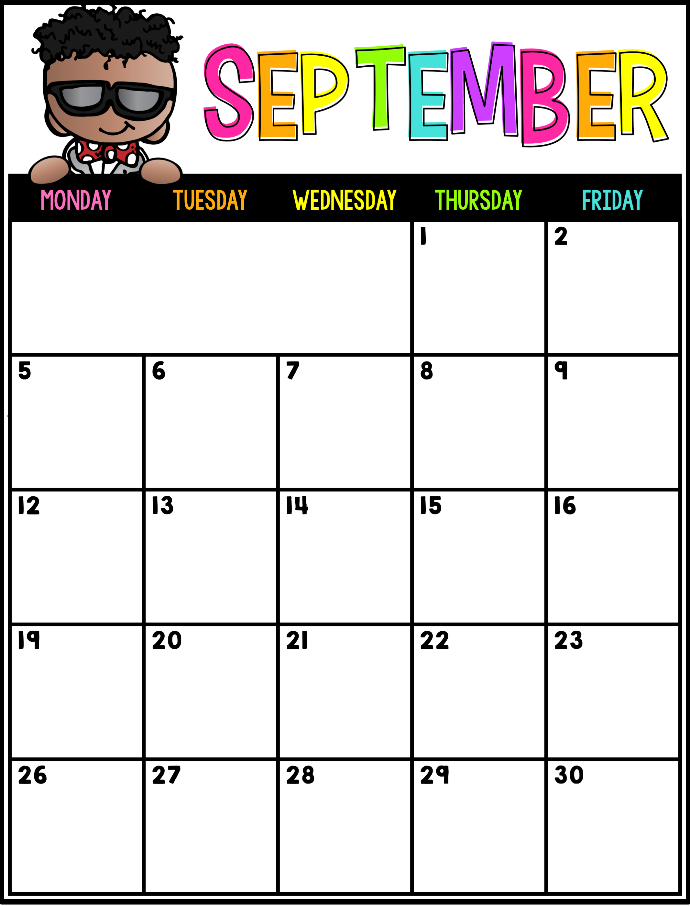
Mrs. Darden’s
Special Area Schedule
Day 5
P.E.
Day 6
Media Center
Labor Day
Holiday
(No School)
Day 1
Music
Day 2
P.E.
Day 3
Guidance
Day 4
Art
Day 5
P.E.
Day 6
Media Center
Day 1
Music
Day 2
P.E.
Day 3
Guidance
Day 4
Art
Day 5
P.E.
Day 6
Media
Center
Day 1
Music
Day 2
P.E.
Fall
Holiday
(No School)
Day 3
Guidance
Day 4
Art
Day 5
P.E.
Day 6
Media Center

