Slide 1
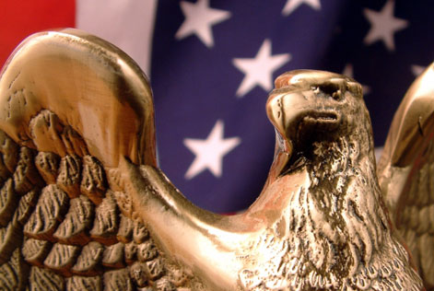
Chapter 9: The Judicial Branch

Slide 2
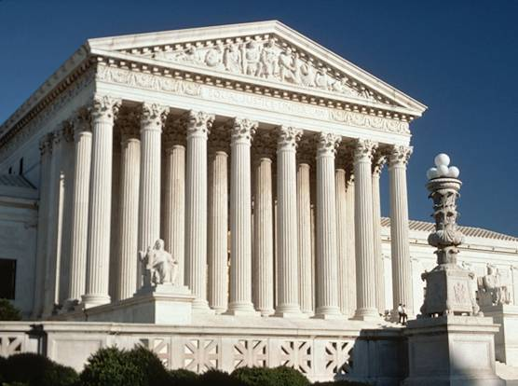
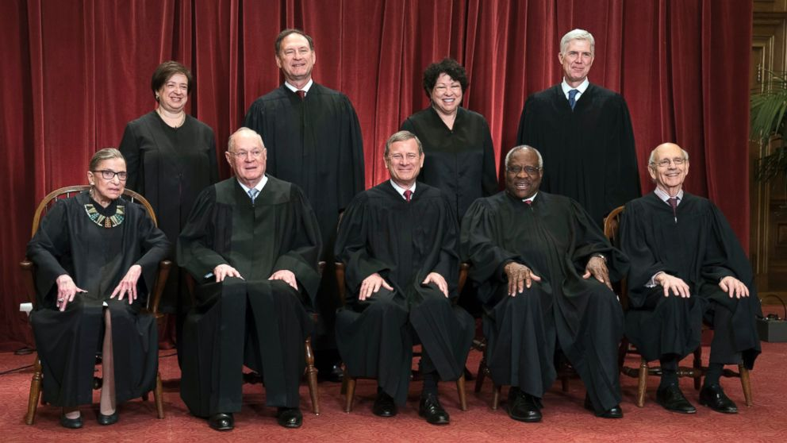
The U.S. Supreme Court

Slide 3
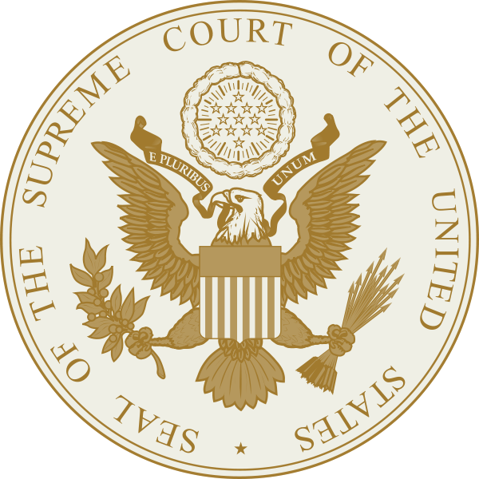
The Supreme Court Justices
The main job of the United States Supreme Court is to decide the “constitutionality of laws”
The Supreme Court stands above all other courts in the United States – it is the highest court in the land!
Judges who serve on the Supreme Court are called justices

Slide 4
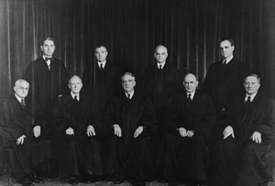
The Supreme Court Justices
The Supreme Court only has “original jurisdiction” in two (2) instances:
  Cases involving diplomats from foreign nations
  Cases in which a state is involved.
  *** The Supreme Court is an appellate court in all other cases.

Slide 5
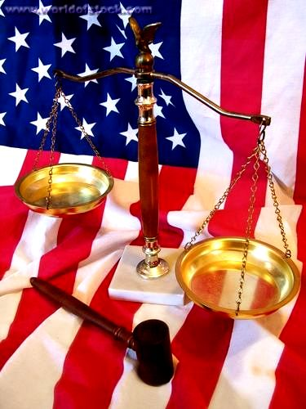
The Supreme Court Justices
The decisions of the Supreme Court are binding in all cases and is the final authority in every case.
Once a decision is made the justices write “opinion” detailing what their ruling was and why.

Slide 6
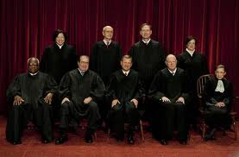
The Supreme Court Justices
The Supreme Court is made up of nine justices (1 Chief Justice and 8 Associate Justices)
Our current Chief Justice is John Roberts
The main duty of The Court is to hear and rule on cases
  (thousands are appealed to them each year, but they decide which few ones to hear)

Slide 7
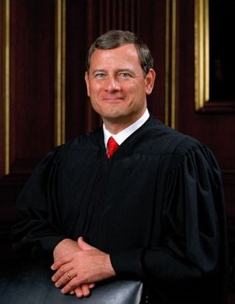
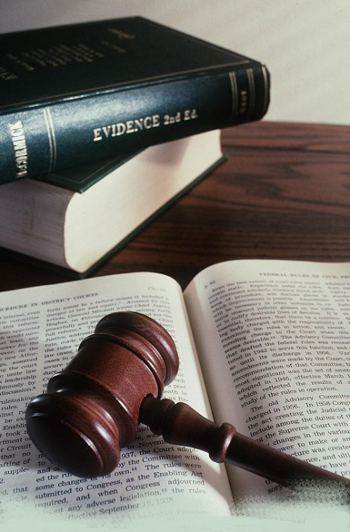
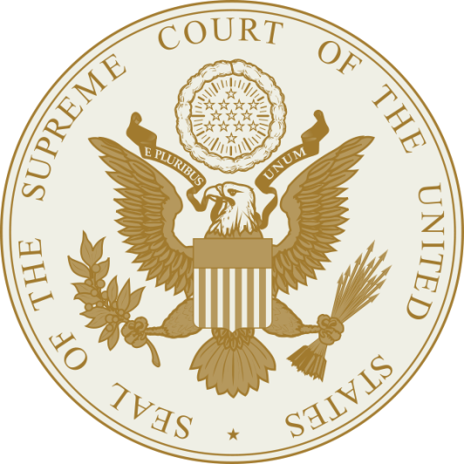
Chief Justice
John Roberts

Slide 8
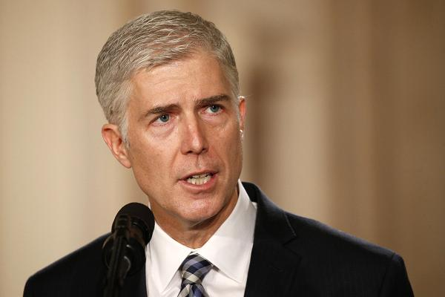
Associate Justice
Neil Gorsuch
?

Slide 9
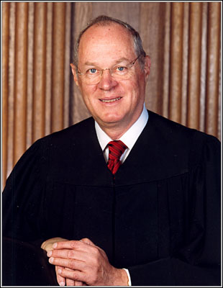
Associate Justice
Anthony Kennedy

Slide 10
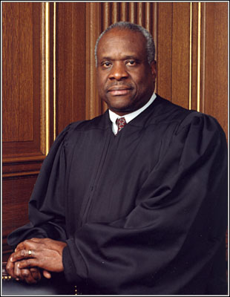
Associate Justice
Clarence Thomas

Slide 11
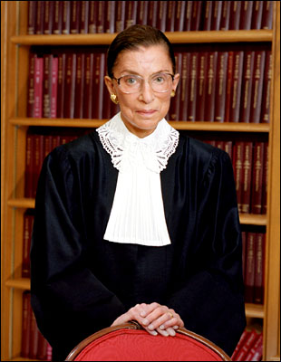
Associate Justice
Ruth Bader Ginsburg

Slide 12
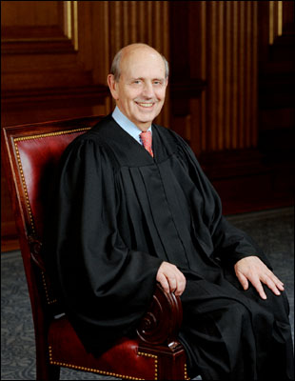
Associate Justice
Stephen Breyer

Slide 13
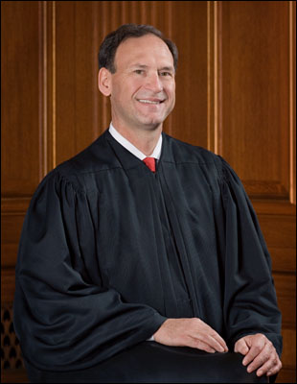
Associate Justice
Samuel Alito

Slide 14
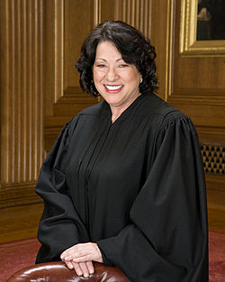
Associate Justice
Sonia Sotomayer

Slide 15
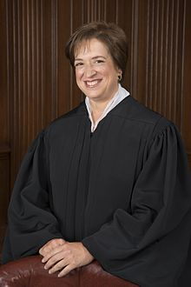
Associate Justice
Elena Kagan

Slide 16
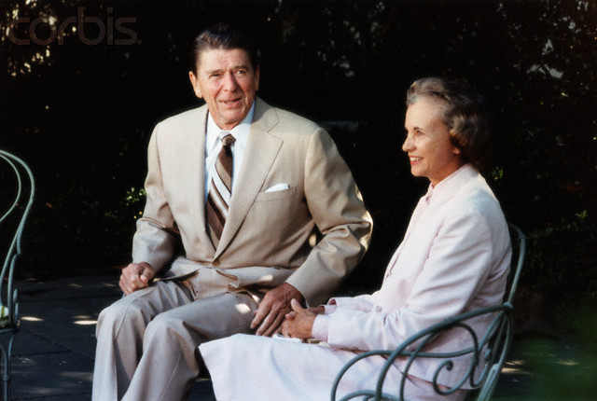
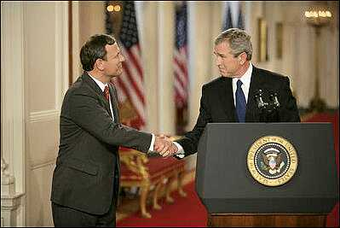
Selection of the Justices
As a part of checks and balances, the President has the task of appointing Supreme Court justices.
Once appointed, all justices must be confirmed by the Senate.

Slide 17
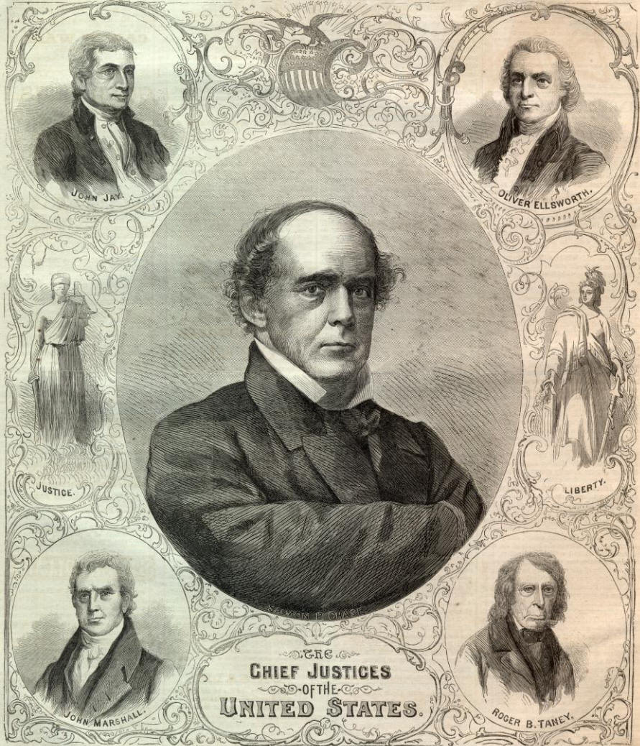
Background of the Justices
All Supreme Court justices have been lawyers (practicing or teaching law) or judges in lower courts.
There are NO actual Constitutional Qualifications to become a Supreme Court Justice though.

Slide 18
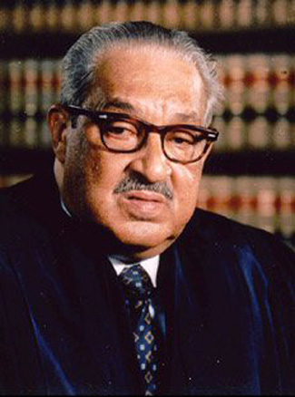
Supreme Court “Firsts”
The first African American justice of the Supreme Court was Thurgood Marshall
He was appointed in 1967 by President Johnson.

Slide 19
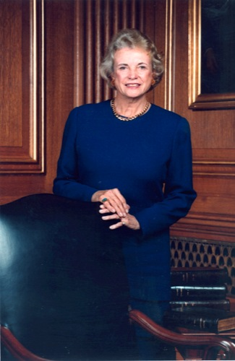
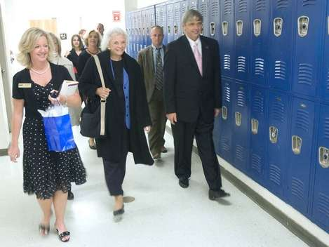
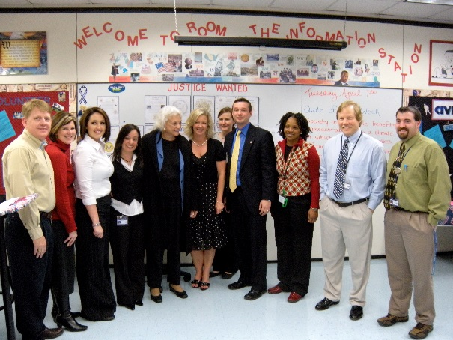
Supreme Court “Firsts”
The first woman justice of the Supreme Court was Sandra Day O’Connor
She was appointed in 1981 by President Reagan.

Slide 20
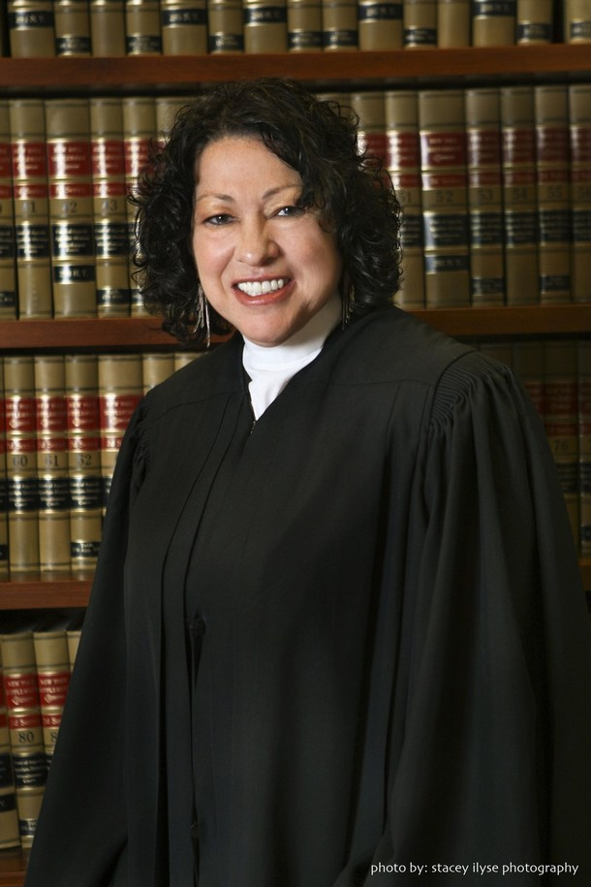
Supreme Court “Firsts”
The first Hispanic justice of the Supreme Court was Sonia Sotomayer.
She was appointed in 2009 by President Obama.

Slide 21
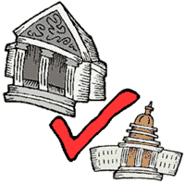
Powers of the Supreme Court
The Supreme Court has the power of “judicial review” (the power to decide if any local, state, or federal law goes against the Constitution)
  This allows them the power to “nullify” (or cancel) that law…

Slide 22
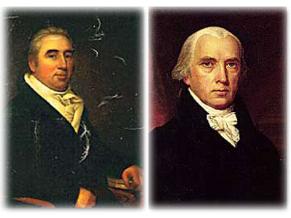
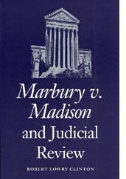
“Marbury vs. Madison”
(1803)
In 1803, the Supreme Court claimed this power of “judicial review” with the case of “Marbury vs. Madison”.
Prior to this case, this power was NOT granted to the Supreme Court and judicial review is not mentioned in the Constitution.

Slide 23

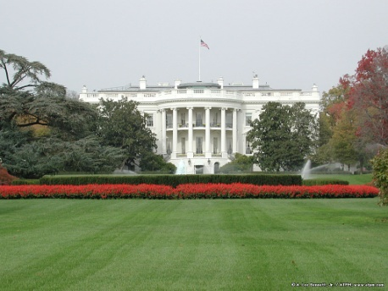
“Checks & Balances”
The Supreme Court can “check” the power of the President by declaring executive orders or actions “unconstitutional” (going against the Constitution)

Slide 24
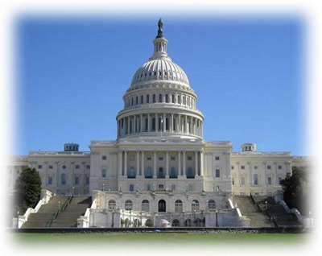
“Checks & Balances”
The Supreme Court can “check” the power of the Congress by declaring laws or legislative actions “unconstitutional” (going against the Constitution)

Slide 25
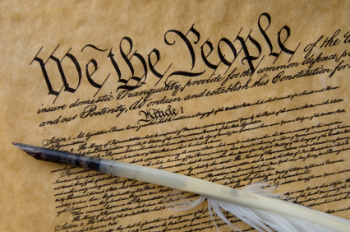
Judicial Interpretation
The Supreme Court has the final interpretation of the Constitution (what THEY say goes…)
They also interpret laws created by Congress (who often write very “vague” laws…)

Slide 26
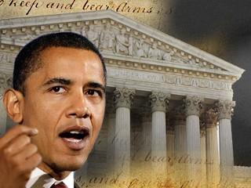
Limits to the Supreme Court
The Supreme Court must rely on the President and to enforce their rulings… or Congress to make laws that abide by their rulings
The court has no power to force the other branches to obey their ruling…
As a part of our system of limited government, no one branch can force the other into doing one thing or another. (because no branch is more powerful than another and no one is above the law…)

Slide 27
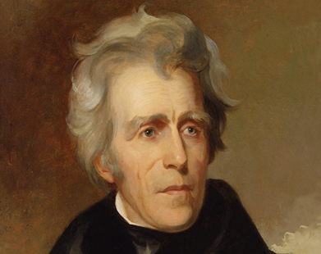
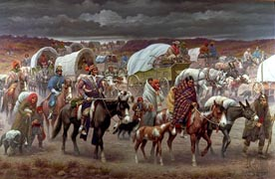
Limits to the Supreme Court
In 1832, President Andrew Jackson refused to enforce the ruling in the case of “Worcester vs. Georgia”.
The Supreme Court ruled that Georgia could not regulate the Cherokee Nation as a result of laws and treaties – but Jackson refused to acknowledge their ruling.
The Supreme Court was powerless to do anything more…

Slide 28
Limits to the Supreme Court
Congress can also create new laws to “get around” court decisions.
As well, Congress and state legislatures can also try to add amendments to alter the Constitution and their ruling…

Slide 29
Limits to the Supreme Court
Congress also has the power to “impeach” and remove justices from the Supreme Court (if warranted)

Slide 30
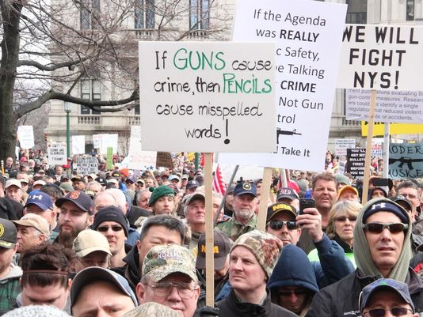
Limits to the Supreme Court
Another major limitation of the Supreme Court is that they can only hear and make rulings on cases that come to it via the appeals process.

Slide 31
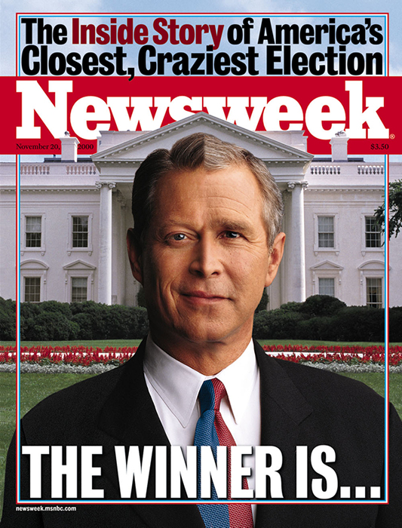
Limits to the Supreme Court
Traditionally, the Supreme Court has stayed out of political issues (believes they are executive and legislative issues)
One exception was the 2000 presidential election…
Bush v. Gore (2000) was sent to the Supreme Court after the recount of presidential election votes during the 2000 Election……….the recount was eventually stopped and Bush became the President

Slide 32
“Deciding Cases at the Supreme Court”

Slide 33
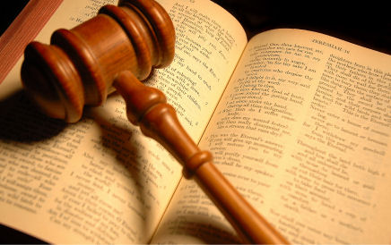
Supreme Court in Action
The Supreme Court is in session from October to June or July.
During this time, they listen to oral arguments on cases.
Every two weeks, they take “recess” (to write opinions and study new cases)

Slide 34
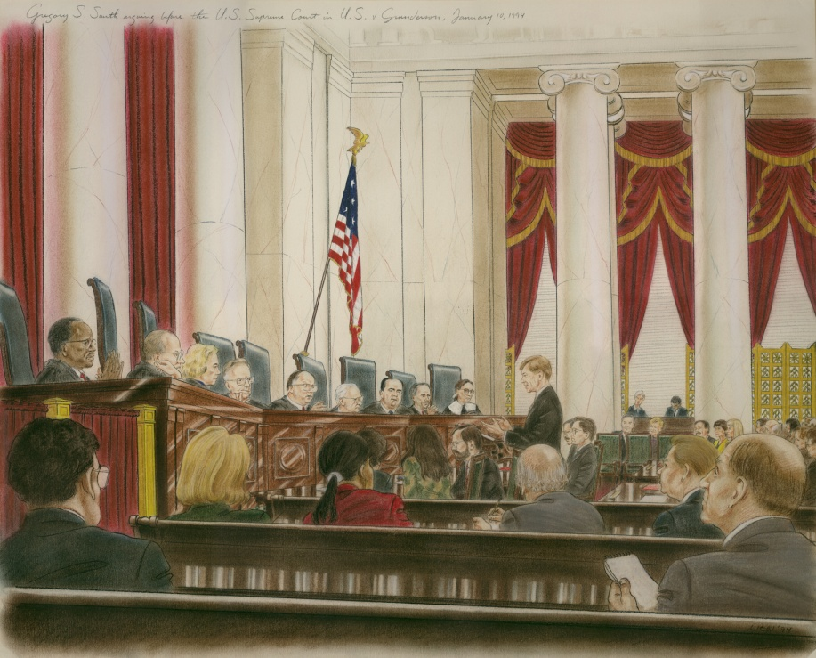
Supreme Court in Action
The Supreme Court is both a trial court and an appellate court
The disputes that have their original trials heard here are:
  Where foreign diplomats are involved
  Cases involving states

Slide 35
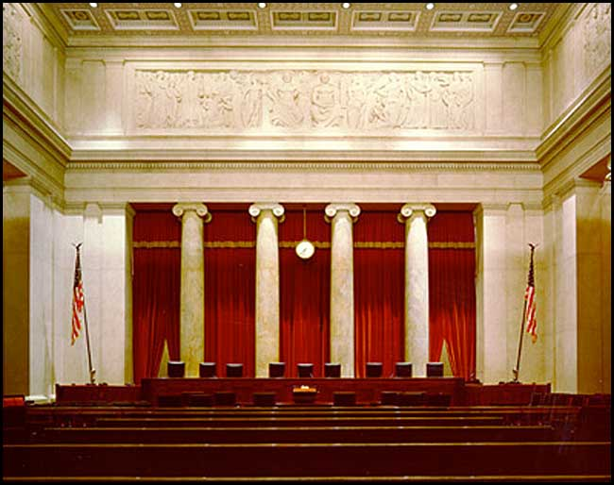
Accepting a Case
To accept a case, four (4) of the nine (9) justices must agree to hear the case (less than 200 out of over 7,000 are accepted each year)
An attorney will file a “Cert Petition” to request that their case be heard.
If the Supreme Court agrees to hear the case, a writ of certiorari is issued.
Once the writ the issued, the case goes on the “docket” or court calendar.

Slide 36
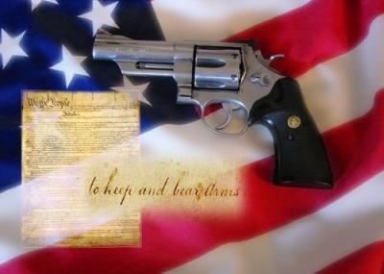
Accepting a Case
Most cases that are accepted involve important constitutional issues (freedom of speech, equal protection, etc)
Most also deal with legal issues, not political issues…

Slide 37
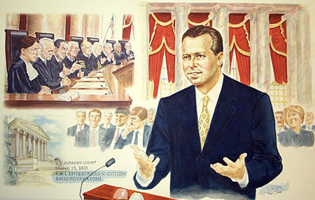
Steps in Decision Making
Once a case is accepted, each side prepares a “brief”-a written document explaining their position.
Next, lawyers from each side present “oral arguments” that are 30 minutes long to summarize their case

Slide 38
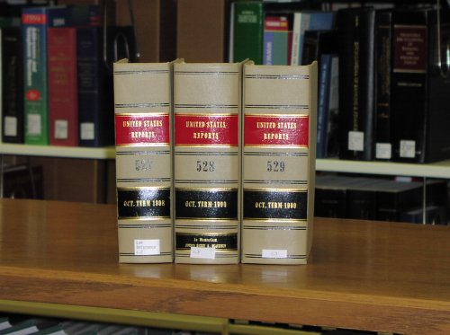
Steps in Decision Making
On Fridays, the justices get together to make their first decisions about the case (must have a “quorum” – 6 out of 9 are required to hear a case.)
They meet in secret (with no audience or records kept)
All cases are decided by a majority vote.

Slide 39
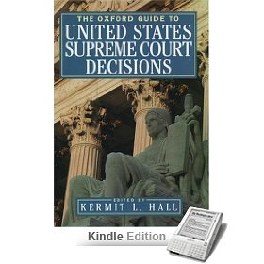
Steps in Decision Making
“Opinions” state the facts of the case, announces the ruling, and explains the reasoning:
  Majority Opinion
  Dissenting Opinion
  Concurring Opinion

Slide 40
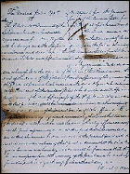
Steps in Decision Making
“Majority Opinion” presents the views of the majority, states the facts of the case, announces the ruling, and explains the Court’s reasoning in reaching the decision.
“Dissenting Opinions” disagree with the majority.
“Concurring Opinions” vote with the majority, but for a different reason.
After the opinions are written, the court announces its decision.
U.S. vs. the Amistad (1841)

Slide 41
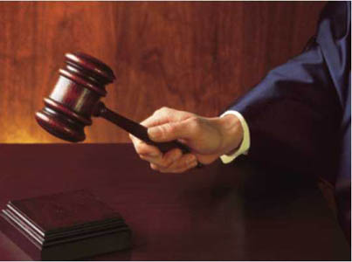
Supreme Court Reasoning
The law is supposed to be the most important influence on a justice’s decision.
“Stare decisis” which means let the decision stand,is the guiding principle for all judges…

Slide 42
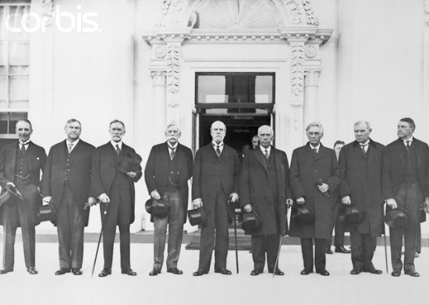
Supreme Court Reasoning
Justices must understand that they:
  The law must adapt to fit the times
  Consider precedent when making a decision
  Sometimes need to clarify the “meaning” of the Constitution
  In Bush v Gore, some of the justices argued that it did not have the jurisdiction(power) to hear cases based on state elections since the states have power over their own state’s elections (reserved powers/federalism)

Slide 43
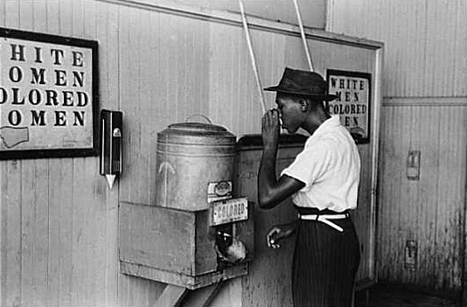
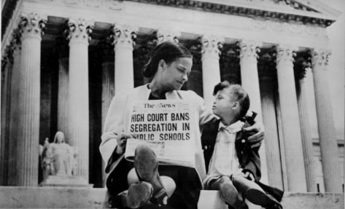
Supreme Court Reasoning
Decisions often deal with social conditions and how laws are interpreted:
  “Plessy v. Ferguson” (1896) permitted “separate but equal” facilities for whites and African Americans
  http://wn.com/plessy_v_ferguson
  “Brown v. Board of Education” (1954) overturned the “separate but equal” precedent as violating equal protection under the 14th Amendment.

Slide 44
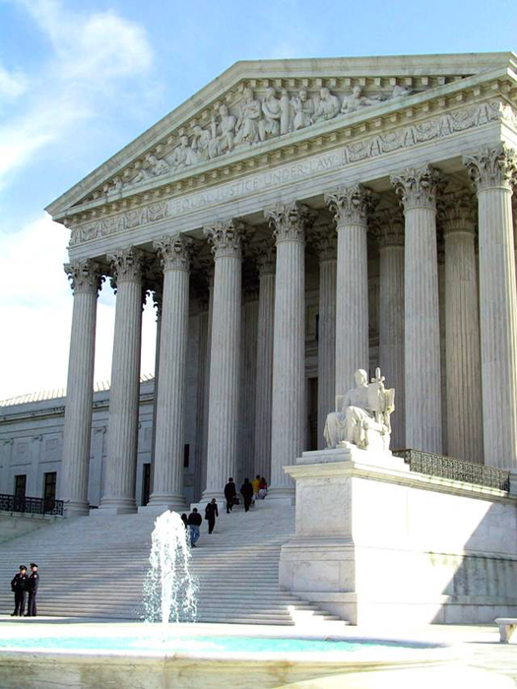
Supreme Court Reasoning
Justices differ on the role of the Supreme Court
Some believe in an active role reviewing many cases, others believe they should be hesitant in their reviews.
The Supreme Courts acts an independent judiciary, which means that their decisions are not influenced by the other two branches of government.

Slide 45
Supreme Court Reasoning
Despite their best efforts, justices are human beings and make decisions based on their own experiences.

