Slide 1
Review 13.1
What is a federal system?
This clause states that the laws Congress makes outweigh state laws. What is the clause?
What is the state military force called?
What are the states forbidden to do?
Powers set aside for the states are called what? And in which amendment are these discussed?
Powers shared by the state and federal government are called what? What is an example?
What are the three branches of the state government?
What is Florida’s Bill of Rights called?

Slide 2
Section 13.2:
The State
Legislative Branch
Section

Slide 3
Makeup of State Legislatures
Most every state has a bicameral (two house) legislature which includes the Senate (40 in FL), and the House of Representatives (120 in FL).
Nebraska is the only state with a unicameral (one house) legislature.

Slide 4
Makeup of State Legislatures
Usually, like in Florida - state senators have four-year terms and representatives have two-year terms.

Slide 5
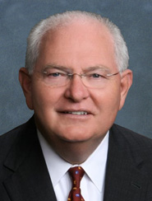
Local Legislators
Florida Senate
Senator
Bill Montford

Slide 6
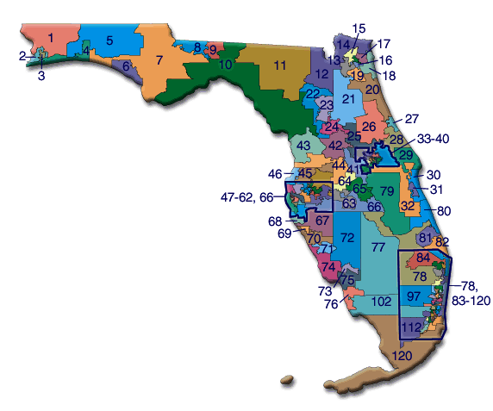
Local Legislators
Florida House
Representative
Halsey Beshears
Representative Ramon Alexander
Representative
Loranne Ausley

Slide 7
Makeup of Legislatures
Qualifications for Florida legislators:
American Citizens
2. Live in the district they plan to represent
3. Must be at least 21 years old
4. Live in Florida for at least 2 years

Slide 8
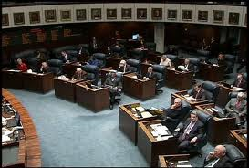
Makeup of State Legislatures
In Florida, the State Legislature is in session for 60 consecutive days. They can extend this with a 3/5th vote of both houses or can have a Special Session called by the Governor.
They usually start in March.

Slide 9
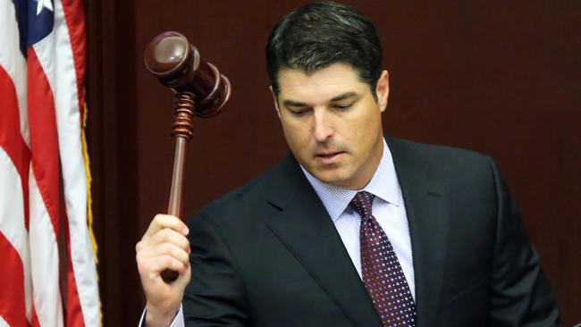
How State
Legislatures Function
State legislatures main job is to make laws which are called statutes.
The Speaker of the House directs business in the house of representatives
In some states, the Lieutenant Governor works with the senate.
In Florida, our Senate President directs the state senate.

Slide 10
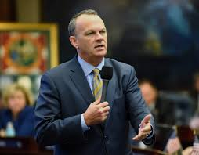
Florida’s Legislatures
Speaker of the Florida House of Representatives
Richard Corcoran

Slide 11
Florida’s Legislatures
Senate President
Joe Negron

Slide 12
How State
Legislatures Function
Ideas for bills come from the governor, the executive branch, interest groups, individuals, and the legislatures themselves.
Those ideas have to be introduced by a member of the Legislature.

Slide 13
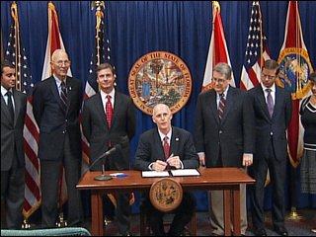
How State
Legislatures Function
Once they are Introduced, State legislatures have various committees similar to Congress to study bills, hold hearings, and change bills if necessary.
Both houses of the state legislature must vote to approve a bill
Once approved, the Governor must sign it before it becomes a law.

Slide 14
Amending the Florida
Constitution
In addition to creating bills and passing statutes, our legislature also has the power to amend our Constitution.

Slide 15
Amending the Florida
Constitution
There are five ways that the Florida Constitution can be amended.
1. Ballot Initiative Process
2. Constitutional Convention
3. Constitutional Revision Commission
4. Legislative Joint Resolution
5. Taxation and Budget Reform Commission
It is much easier to amend the Florida Constitution that the U.S. Constitution.

Slide 16
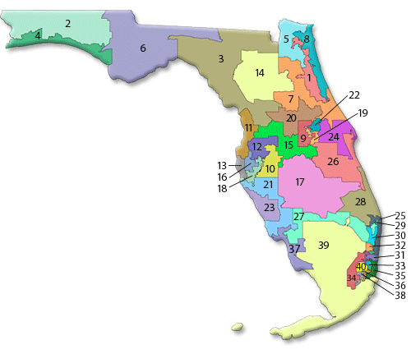
Legislative
Apportionment
In most states, legislatures draw boundary lines for each election district.
Both houses of state legislatures must be apportioned (divided) into districts based on equal population.
Senate – represents approximately 470,000 people each
House of Rep – represents about 120,000 people each

