Slide 1
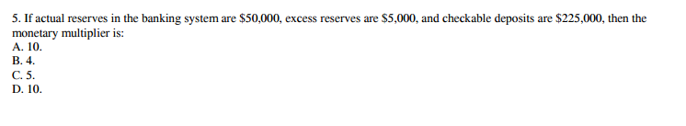
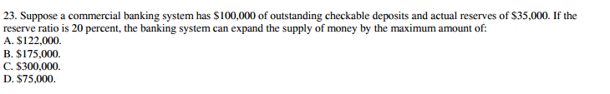
Wednesday, Oct. 26
Please get out your notes and something to write with
Review Questions – answer these in your notes:

Slide 2
Wednesday, Oct. 26
Happy Wednesday ☺
Please get out crayons/colored pencils if you have them.
CW/HW: Tonight’s HW is to read and complete the activity for 5.03. Please see me once we start working if you are having trouble signing in.
Tomorrow – you will be in the lab with the sub to read and take notes on 5.02 and complete the 5.02 activity. Your notes (one full page in length) will be due at the end of the class period. IF you finish before class is over, move ahead to the next activity.

Slide 3
Unit 4: The Federal Reserve System

Slide 4
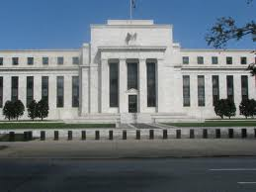
THE FEDERAL RESERVE SYSTEM
  The Federal Reserve System is the central bank of the United States.
  A central bank is a public authority that provides banking services to banks and regulates financial institutions and markets.
  The Fed’s main task is to regulate the interest rate and quantity of money to achieve low and predictable inflation and sustained economic growth. The FED controls the money supply.

Slide 5
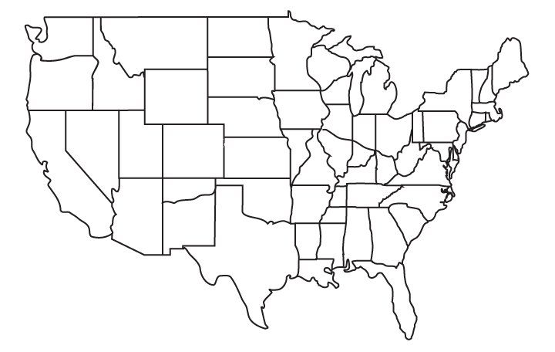
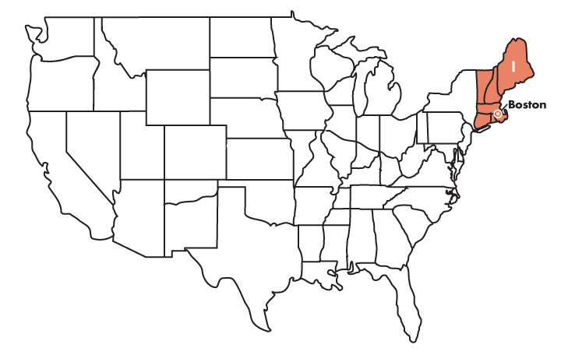
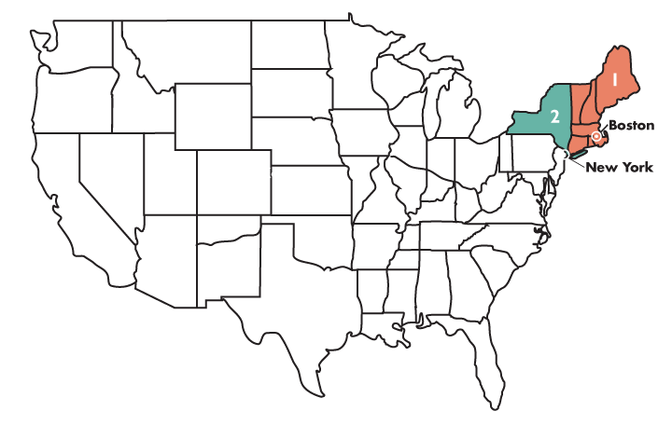
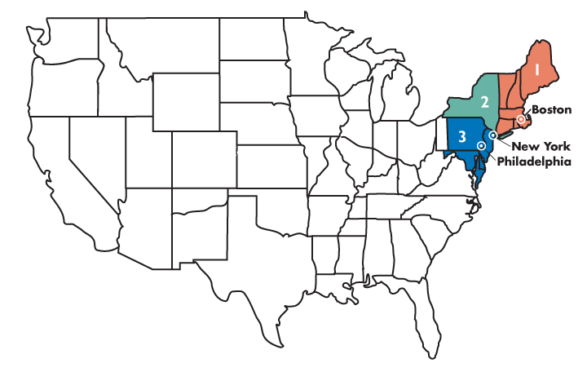
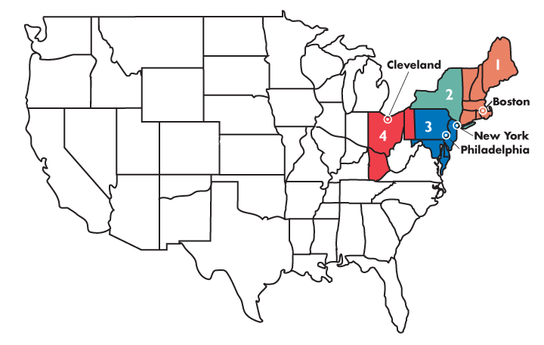
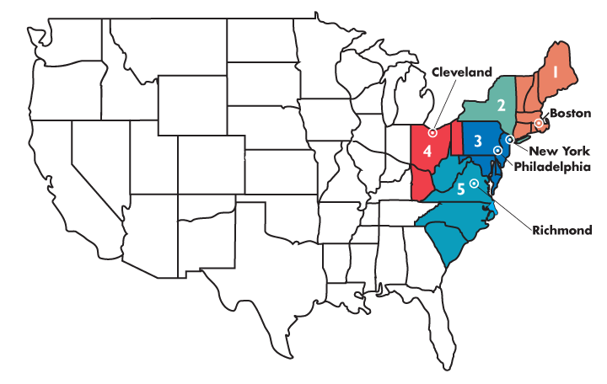
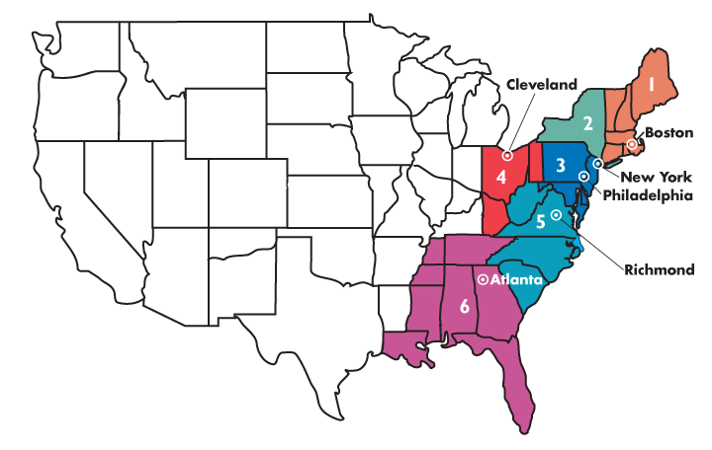
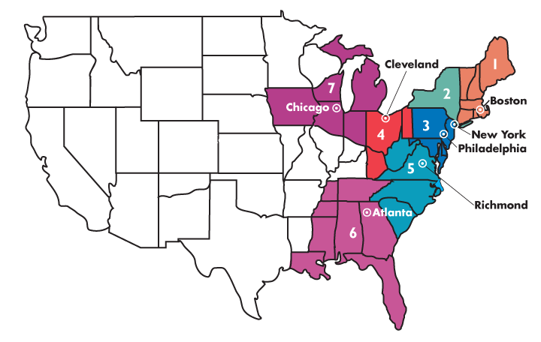
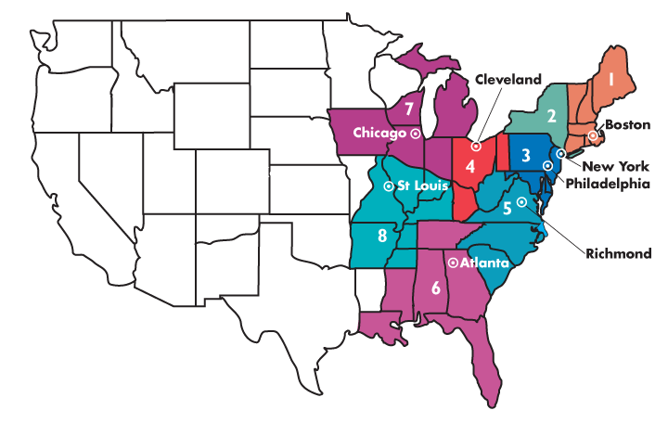
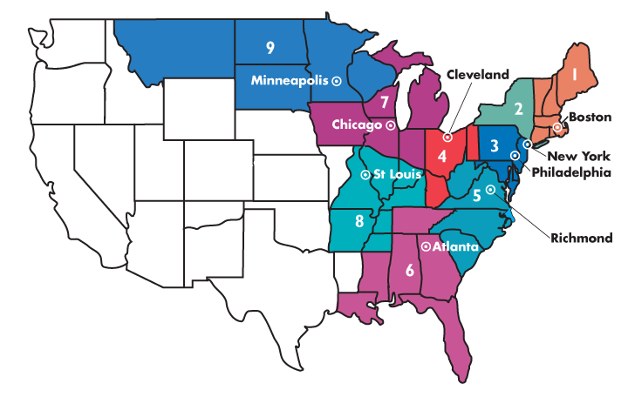
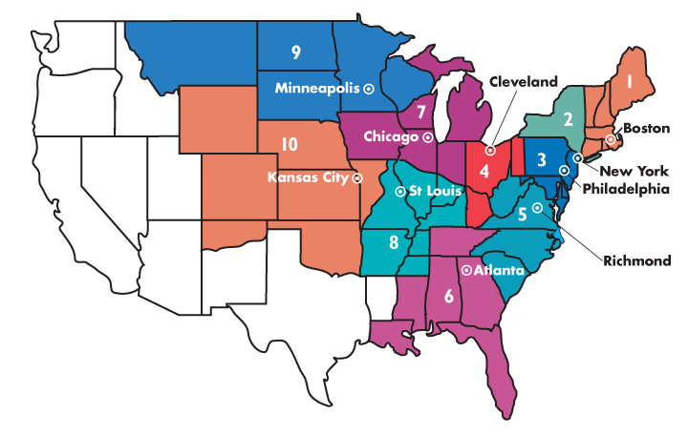
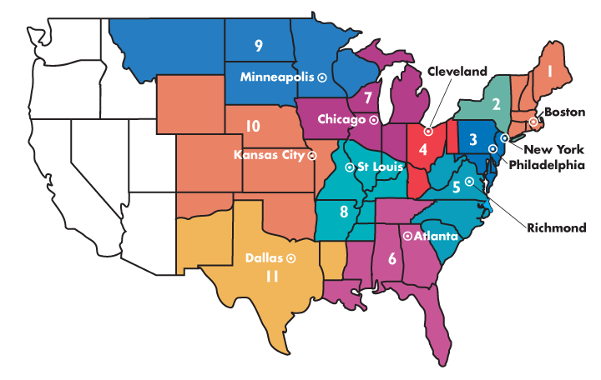
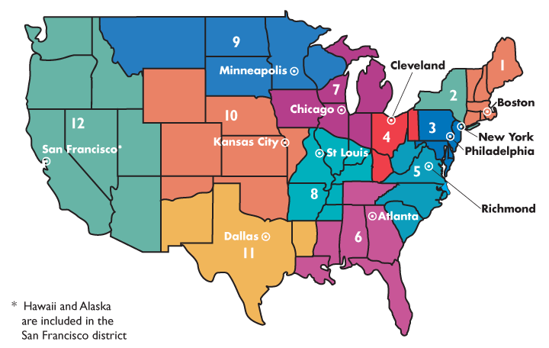

THE FEDERAL RESERVE SYSTEM
This figure shows the 12 Federal Reserve districts.
Each Federal
Reserve district has its own
Federal Reserve Bank.
The Board of Governors of the Federal Reserve System is
located in Washington, D.C.

Slide 6
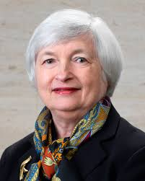
  The Chairman of the Board of Governors
  The chairman is the Fed’s chief executive, public face, and center of power and responsibility. The current chairman is Janet Yellen.
  The Board of Governors consist of
    Seven members, appointed by the President of the United States and confirmed by the Senate.
    Each for a 14-year term.
    Oversees the federal reserve system.
    The President appoints one of the board members as Chairman for a term of 4 years, which is renewable.

Slide 7
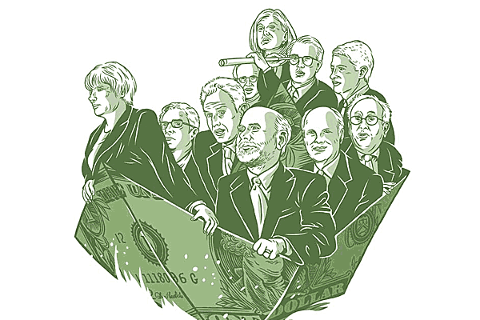
The Federal Open Market Committee
  The Federal Open Market Committee (FOMC) is the Fed’s main policy-making committee.
  The FOMC consists of
    The chairman and other six members of the Board of Governors.
    The president of the Federal Reserve Bank of New York.
    Four presidents of the other regional Federal Reserve banks (on a yearly rotating basis).
  The FOMC meets approximately every six weeks.
  They set the Fed’s monetary policy.

Slide 8
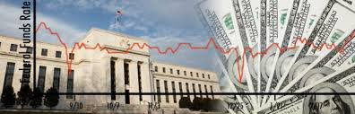
THE FEDERAL RESERVE SYSTEM
The Fed’s Policy Tools – Monetary Policy
  The Fed uses 4 main policy tools which we list in order of impact on the money supply from highest to lowest:
    Open Market Operations (OMO)-this is the buying and selling of securities (also called bonds, T-bills, T-notes)
    Required reserve ratios (changing the reserve requirement)
    Discount rate (the interest rate at which banks borrow from the FED)
    Federal Funds Rate (the interest rate at which banks borrow from banks )

Slide 9
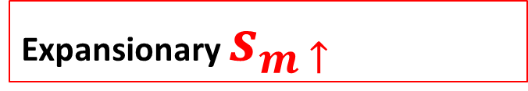
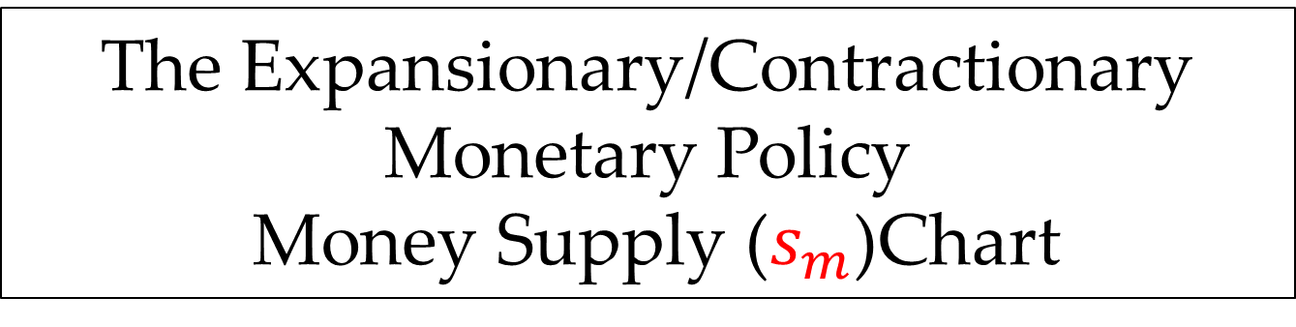
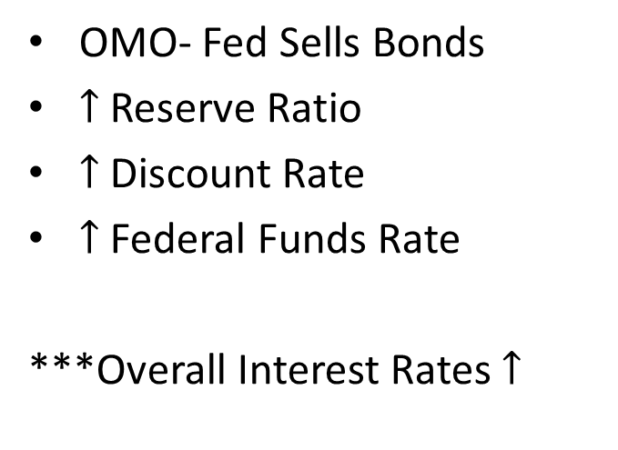
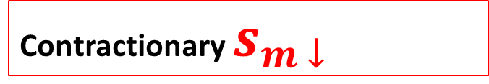
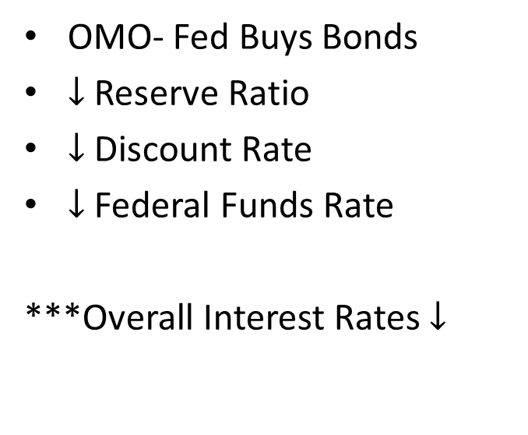
The Expansionary/Contractionary
Monetary Policy
Money Supply ($s_{m}$)Chart
Expansionary $s_{m ↑}$
Contractionary $s_{m ↓}$
OMO- Fed Buys Bonds
$↓$ Reserve Ratio
$↓$ Discount Rate
$↓$ Federal Funds Rate
***Overall Interest Rates $↓$
OMO- Fed Sells Bonds
$↑$ Reserve Ratio
$↑$ Discount Rate
$↑$ Federal Funds Rate
***Overall Interest Rates $↑$

Slide 10

How does Monetary Policy impact our economy?

Slide 11
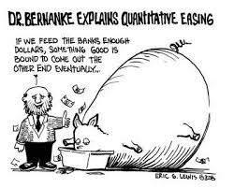
Extraordinary Crisis Measures
  Quantitative Easing
  When the Fed creates bank reserves by conducting a large-scale open market purchase at a low or possibly zero federal funds rate, the action is called quantitative easing.
  This action differs from a normal open market purchase in its scale and purpose, and it might require the Fed to buy any of a number of private securities rather than government securities.

Slide 12
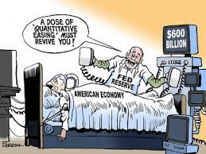
Extraordinary Crisis Measures
  Credit Easing
  When the Fed buys private securities or makes loans to financial institutions to stimulate their lending, the action is called credit easing.

Slide 13
Clifford - EconMovies

