Slide 1
Perfect Competition
Chapter 7 Section 1

Slide 2
Market Structures
Each market, or industry, belongs to one of four market structures:
1. Perfect Competition
2. Monopoly
3. Monopolistic Competition
4. Oligopoly
The main criteria by which one can distinguish between different market structures is the number and size of firms that compete within them.
Variety of goods, control over prices, and barriers to entry also help us distinguish between the markets.

Slide 3
What is perfect competition?
The simplest market structure is known as perfect competition (aka pure competition).
A large number of firms that produce essentially the same product.
No single firm can hope to influence prices, producers only decide how much to produce given their costs.
There are four conditions for perfect competition:
Many buyers and sellers in the market
Sellers offer identical products
Buyers and sellers are well informed about products
Sellers are able to enter and exist the market freely

Slide 4
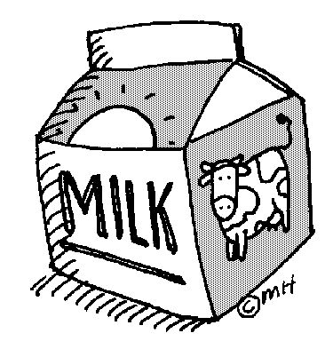
Four Conditions of PC
Many Buyers and Sellers
Perfectly competitive markets require lots of participants on both sides that are exchanging similar goods.
No one individual is powerful enough to change the market and influence prices.
The market determines price without influence from sellers.

Slide 5
Four Conditions of PC
Identical Products
There are no differences between the products sold by different suppliers
Ex: gasoline, milk, tomatoes, corn
A product that is considered the same regardless of who makes it is called a commodity.
Identical products are key for perfect competition – buyers will not pay extra for one company’s good, they simply buy the cheapest.

Slide 6
Four Conditions of PC
Informed Buyers and Sellers
Both must know enough about the market to find the best deal.
The market provides information for the buyers and the sellers about the features and price of the products.
Buyers can compare prices among sellers and find the best deal
Sellers can find out what competitors are charging and remain competitive.

Slide 7
Four Conditions of PC
Free Market Entry/Exit
Firms have to be able to come and go freely when they can’t make enough money to sustain the business.
Studies show that markets with more firms and competition have lower prices.
Firms will only stay in business if they can sell enough to stay afloat.
For firms to be able to enter freely, there cannot be many barriers to entry..

Slide 8
Barriers to Entry
Are the factors that prevent a business from entering the market.
Barriers can lead to imperfect competition
Barriers can include:
Start up costs
Technology
Government restrictions
Intellectual property

Slide 9
Barriers to Entry
Start-Up Costs:
The expenses that a new business must pay before the first product reaches the customer
For example: before a restaurant opens, you need to rent a store, buy refrigerators, freezers, stoves, ovens, tables, chairs, managers, waiters, dishes, menus etc. all before you sell your first dish.
Still, those costs are much less than starting your own lumber mill, or a nuclear power plant. So, entrepreneurs are much more likely to try their hand at opening a restaurant, or something with lower costs like a food cart.

Slide 10
Price and Output
Perfectly competitive markets are very efficient.
Competition keeps prices and production costs low.
Firms utilize all of their inputs (F of P) very efficiently and they maximize their production.
Prices are the lowest in a perfectly competitive market to sustain the business. Intense competition among commodities suppliers forces prices down.
Perfect competition exists in industries where the firm will supply just enough of their commodities to cover their costs and pay the owner – which is incentive to stay in business.

Slide 11
What is Perfect Competition?

Slide 12
Milk Market
The market for milk closely represents perfect competition.
All milk suppliers produce the same good and the price is controlled.
Milk farms rarely advertise…. And when they do it is industry wide, not for a specific farm.
This is shown by the “Got Milk” ad campaigns.

