Slide 1
Wednesday, February 21st
Good Morning!! ☺ Happy Wednesday!
Turn in last night’s homework in to the bin and get ready for notes today.
Don’t forget about your H&R Block Quiz due this week!

Slide 2
Gross domestic product
Identifying and calculating GDP

Slide 3
GDP Basics
GDP- (Gross Domestic Product) is the dollar value of all final goods and services produced within a country in a particular year.
Only final goods and services go toward GDP… NOT INTERMEDIATE GOODS.
Intermediate Goods- Products used in the production of final goods.
Final Goods- A good or service produced for its final user.
Example: The memory chips inside of a computer are a intermediate good, while the computer itself is a final good.

Slide 4
Lest break that down…
GDP: the dollar value of all final goods and services produced within a country in a particular year.
Total Value: Measured in dollars
What is Produced: final goods and services only
Where it is Produced: only products made within a country’s borders
When it was Produced: within a specific year of time.

Slide 5
How Do we find gDP? Method #1:
The Expenditure Approach: C + I + G + Xn(x-m)
In this approach, we take Consumer goods, Investment goods, Government goods, and Net EXports (exports minus imports).

Slide 6
Clifford on GDP

Slide 7
The four sectors
Consumption: MAIN SECTOR- Responsible for 2/3 of GDP
Spending by households on goods and services for personal use.
Examples: Cars, TV’s, clothes, Doctors visits, trips to Disneyworld, etc.

Slide 8
Sectors Cont’d
Investments: purchasing of capital goods- increasing our ability to provide consumer goods.
Examples: Machinery, buildings, tools
Government Expenditures: spending by the government on all types of goods or services.
Examples: Military goods, public schools, parks, roads

Slide 9
Sectors Cont’d
Net Exports: (X-M or Xn) The value of goods and services Exported minus the value of goods and services Imported. (Total Exports – Total Imports = Net Exports)
Export: Goods produced in the U.S. and sold in a foreign country.
Import: Goods produced in a foreign country and purchased by U.S. households.

Slide 10
What does not count in gdp?
Second hand sales (Used cars, garage sale items)
Non-Market Activity (Mowing the lawn, cooking dinner)
Illegal or black market goods
Public and Private Transfer payments (welfare, social security, birthday money)
Financial Assets (Stocks & Bonds)
Nothing new was created or produced in these transactions!

Slide 11
Does it count toward gdp!?
Is it a final good?
Does it apply to C-I-G-Xn?
Purchase of a new Supreme jacket?
Buying your friends Xbox One?
Buying a new tractor for Schrute farms?
The president buying a new tank from a private company?
Buying a new truck from Toyota headquarters in Japan?
The dividends you receive from your Apple stock?
Washing your neighbors car for $20?

Slide 12
How do we find Gdp? Method #2:
The Income Approach: Adds up all the incomes in the economy.
Takes (1) Wages and (2) Interest, Rent, & Profit to find National Income.
Wages + (Rents + Interest + Profits) = GDP
This method should give us the same answer as the Expenditure Approach.

Slide 13
WELCOME SLIDE for Day 2 of GDP

Slide 14
Two measures of GDp:
Nominal GDP: GDP measured in current prices.
Real GDP: GDP measured in constant, unchanged prices. (Adjusted for inflation)**

Slide 15
Nominal GDp:
Suppose our country only produces Jets and Helicopters.
To find Nominal GDP: Total goods X total current prices
Year 1: (Base Year)
5 jets at $100,000 each ($500,000)
5 helicopters at $50,000 each ($250,000)
Year 2:
5 jets at $110,000 each ($550,000)
5 helicopters at $60,000 ($300,000)
GDP Increased?
Nominal GDP = $750,000
Nominal GDP = $850,000

Slide 16
Real gdp:
Removes the influence of price change to adjust for inflation.
To find Real GDP: New Year Quantity X Base Year Prices
Year 1: (Base Year)
5 jets at $100,000 each ($500,000)
5 helicopters at $50,000 each ($250,000)
Year 2:
5 jets at $110,000 each ($550,000)
5 helicopters at $60,000 each ($300,000)
Year 1 Nominal GDP: $750,000
Year 2 Nominal GDP: $850,000
REAL GDP: $750,000

Slide 17
Practice!
Find the Nominal and Real GDP of Country A:
Year: 2007
Good Sector | Item | Quantity | Price (Dollars) | Expenditure
C | Polo Shirts | 10 | $5 | $50
I | Tractors | 5 | $20 | $100
G | Police Radios | 2 | $50 | $100
 |  |  | Total: | $250
Year: 2008
Good Sector | Item | Quantity | Price (Dollars) | Expenditure
C | Polo Shirts | 5 | $5 | $25
I | Tractors | 3 | $30 | $90
G | Police Radios | 5 | $55 | $275
 |  |  |  | $390
Notes:
Nominal 2007: $250
Nominal 2008: $390
Real 2007: $250
Real 2008: $335

Slide 18
Gross National Product (GNP)
Another measure of our Economy’s health is Gross National Product
GNP is the market value of all final goods and services produced anywhere in the world in a given year. The main difference is the factors of production are supplied by the residents of the host country.
Largest measure of a nation’s income.
Example: Ford’s Factory in Mexico.
Non-Example: French Tire company in South Carolina.
GNP does NOT account for depreciation.

Slide 19
Disposable Personal Income & Personal Income
How much Disposable income households have can also represent the health of an economy.
Disposable income is a households income minus personal taxes paid.
DI = PI – Taxes
You have two options with your disposable income…
Save it or Spend it

Slide 20
Factors that affect gdp: Aggregate supply & Aggregate Demand:
What do we do with GDP once we calculate it?
Take the sum of all goods & services (GDP) and compare it to average price level in the economy. Then determine Aggregates:
Aggregate Supply: all of the goods and services that every business produced at certain price levels.
Aggregate Demand: all of the goods and services purchased at certain price levels.

Slide 21
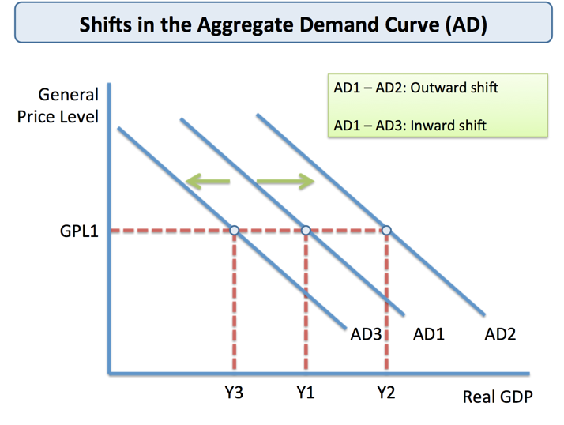
Aggregate Demand
STILL! Inverse Relationship to Price and Output.
Price Level on the Y; Real GDP on the X
Determinants:
Changes to any component of GDP (C+I+G+Xn)
Changes to expectations
Increase = Shift Right / Decrease = Shift Left
PRICE STILL DOES NOT AFFECT THE CURVE.

Slide 22
Aggregate supply
STILL! A direct relationship with Price and Output.
Price Level on the Y; Real GDP on the X
Determinants:
Government Regulations
Change in Input Cost
Change in Productivity
Increase = Shift Right / Decrease = Shift Left
PRICE STILL DOES NOT AFFECT THE CURVE.

Slide 23
Aggregate S & D: Equilibrium
Aggregate Demand and Aggregate Supply have an Equilibrium point just like we learned with market supply and demand!

