Slide 1
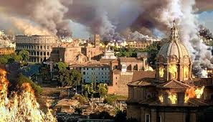
Lesson 12.2: Rome’s Decline

Slide 2
A Troubled Empire
A. Political Confusion
As Rome’s government grew weak, the army became very powerful. In the span of 50 years, Rome had 22 different emperors.
Many Romans no longer valued traditional values of duty, courage, and honesty.
Dishonest Government officials took bribes, support for education declined, many wealthy Romans stopped paying taxes and enslaved laborers now made up a large part of the empire’s population.

Slide 3
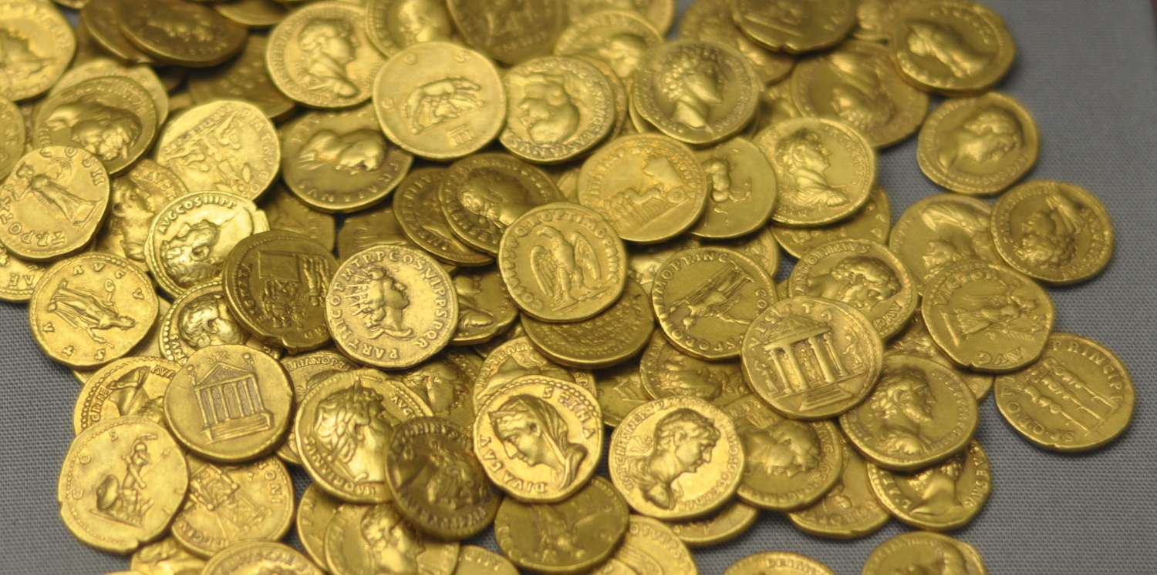
Economic Weakness
The weakened government led to a weakened economy.
To stop economic decline, the government produced more coins, however these new coins had less gold and silver which reduced their value.

Slide 4
Economic Weakness
In order to get the same profit for their goods, farmers and merchants continued to raise their prices and these actions led to inflation-a steep rise in prices with the matching decline in the value of money.
As the value of Roman coins decreased, people began to barter, or to exchange goods instead of money.

Slide 5
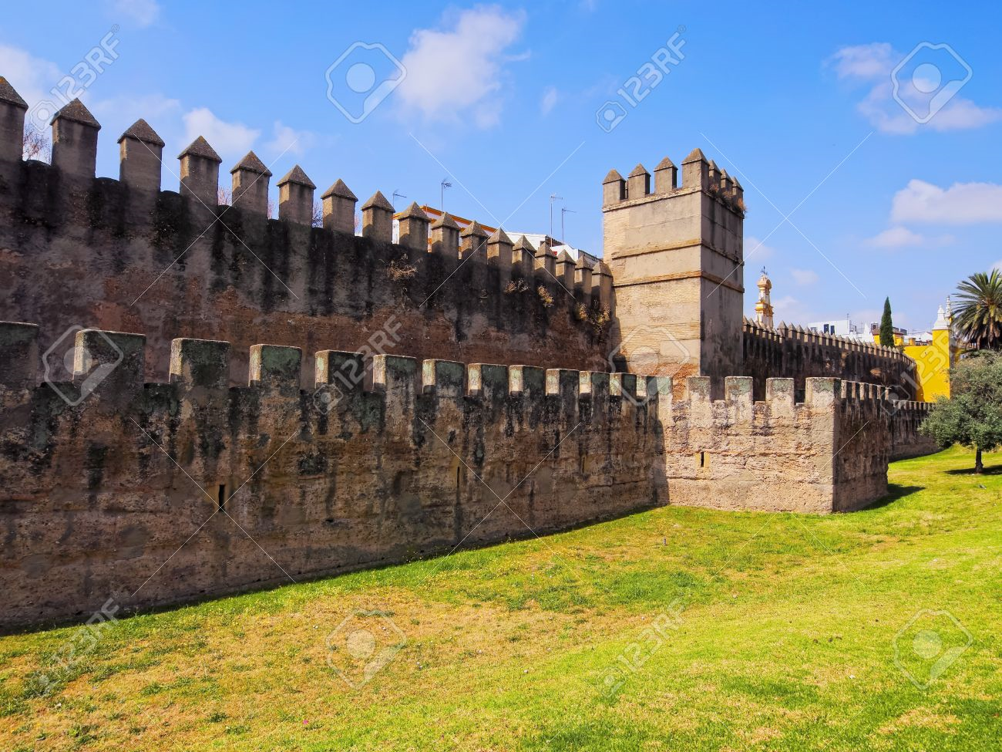
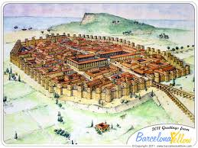
C. Invasions
While Rome struggled, Germanic tribes raided the Western Empire, and Persian armies invaded the East.
People in cities started to build protective walls around them.

Slide 6
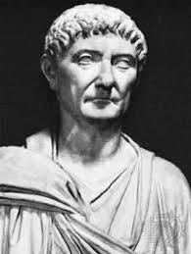
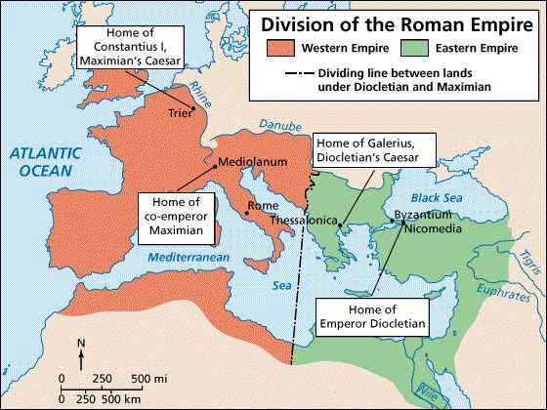
D. Who Was Diocletian?
When Diocletian became emperor, he introduced reforms. He built forts along frontiers, divided the large empire into four sections, set maximum prices for wages and goods, and ordered workers to remain at the same job until they died.
Despite his efforts, Diocletian’s reforms did not succeed. People ignored his rules and he was not a strong enough emperor to enforce them.

Slide 7
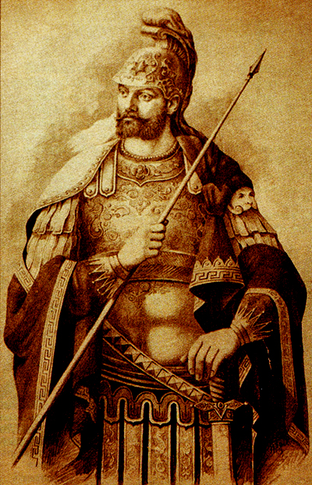
The Fall of Rome
A. Constantine’s Rule
Although Constantine issued several orders to reinforce the rules of Diocletian, the empire continued to decline.
Constantine moved the capital from a failing Rome to the Greek city of Byzantium, Which later became known as Constantinople.

Slide 8
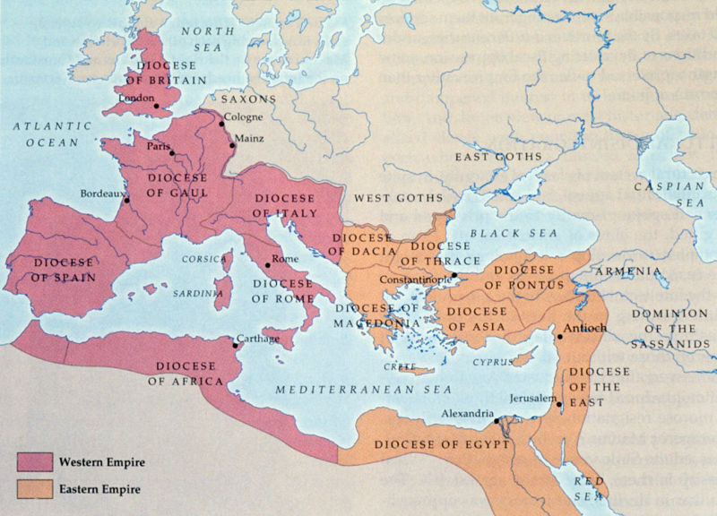
The Fall of Rome
After Constantine’s death, Theodosius took power but found the empire difficult to govern. Because he felt the empire had grown too large, so he decided that when he died, the Eastern and Western parts would become separate empires - the Eastern and Western Roman Empires.

Slide 9
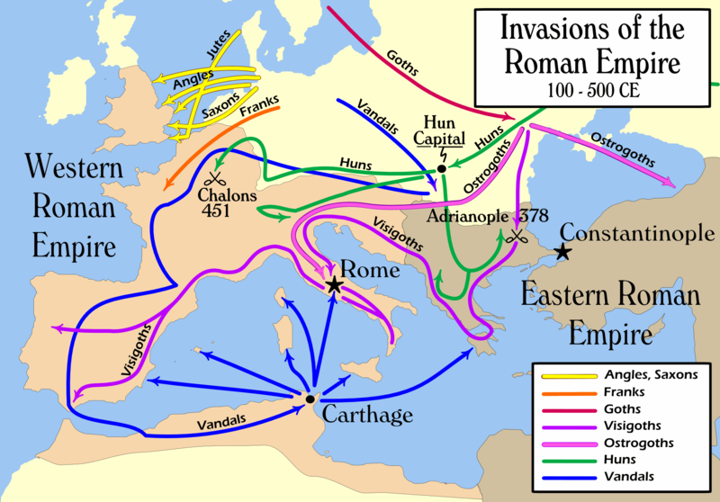
B. Germanic Tribes
Some Germanic tribes were looking for better land, however most were fleeing the Huns, a fierce group of warriors from Mongolia in Asia.
The Visigoths, fearing a Hun attack, asked the Roman government for protection. When the Roman’s let them settle inside the empire’s border, the Visigoths promised to be loyal to the empire and not attack them from the inside.

Slide 10
B. Germanic Tribes
The Romans did not treat the Visigoths fairly, though, charging them high prices for food and even enslaved some of their people.
The Visigoths rebelled and defeated the Roman legions, which brought more attacks on Roman territory.

Slide 11
B. Germanic Tribes
The Vandals also attacked Roman lands in Spain and Northern Africa before entering Rome and seizing valuables and burning buildings.
After the German General Odoacer seized control, no Roman emperor ever again ruled from Rome. From then on, foreign powers ruled what had been the Roman Empire. Historians often used this event to mark the end of the Western Roman Empire.

Slide 12
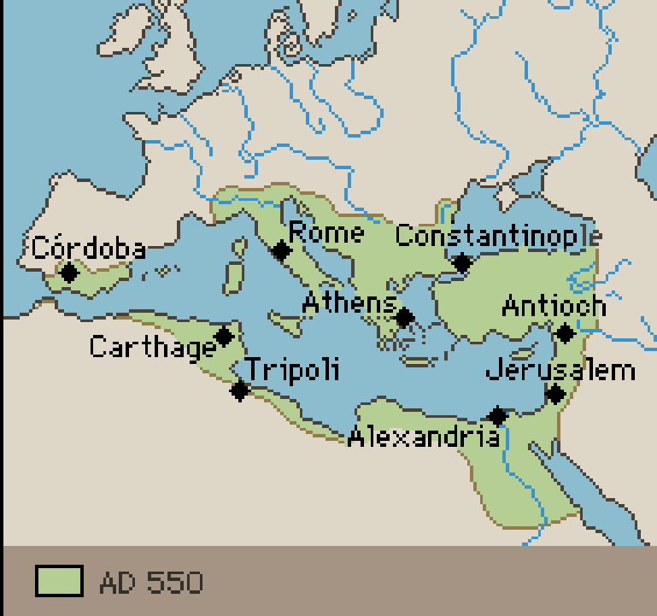
B. Germanic Tribes
Western Europe’s new Germanic rulers adopted Latin, Roman laws, and Christianity. Meanwhile, in the Eastern Mediterranean, the Eastern Roman Empire thrived. It became known as the Byzantine Empire and lasted for nearly 1000 more years.

Slide 13
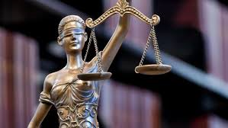
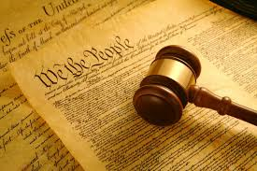
Rome’s Legacies
A. Rome’s Influence on Law and Government
Like the Romans, Americans believe that everyone is equal under the law and that a person is considered innocent until proven guilty.
The U.S. and several other countries are democratic republics and believe that a republic works best if all adult citizens vote, participate in government, and help to improve their communities.

Slide 14
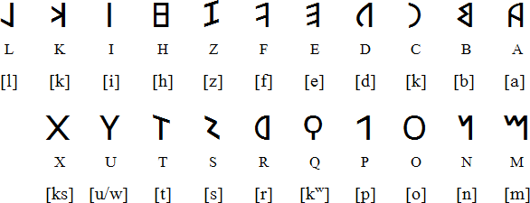
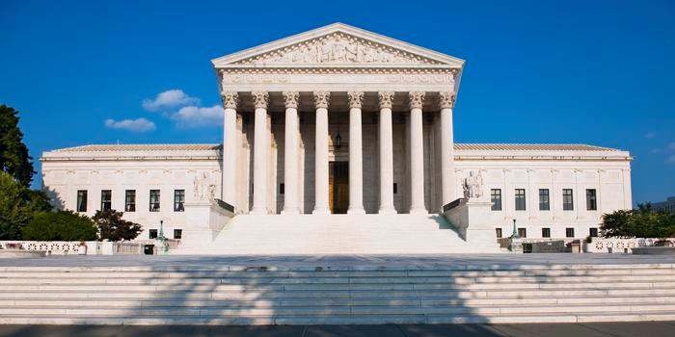
B. Rome’s Cultural Impact
Many Western countries use the Latin alphabet and many English words have Latin roots.
The Romans also continue to influence the literature we read and enjoy, while current architecture and construction owes much to the Ancient Romans.

Slide 15
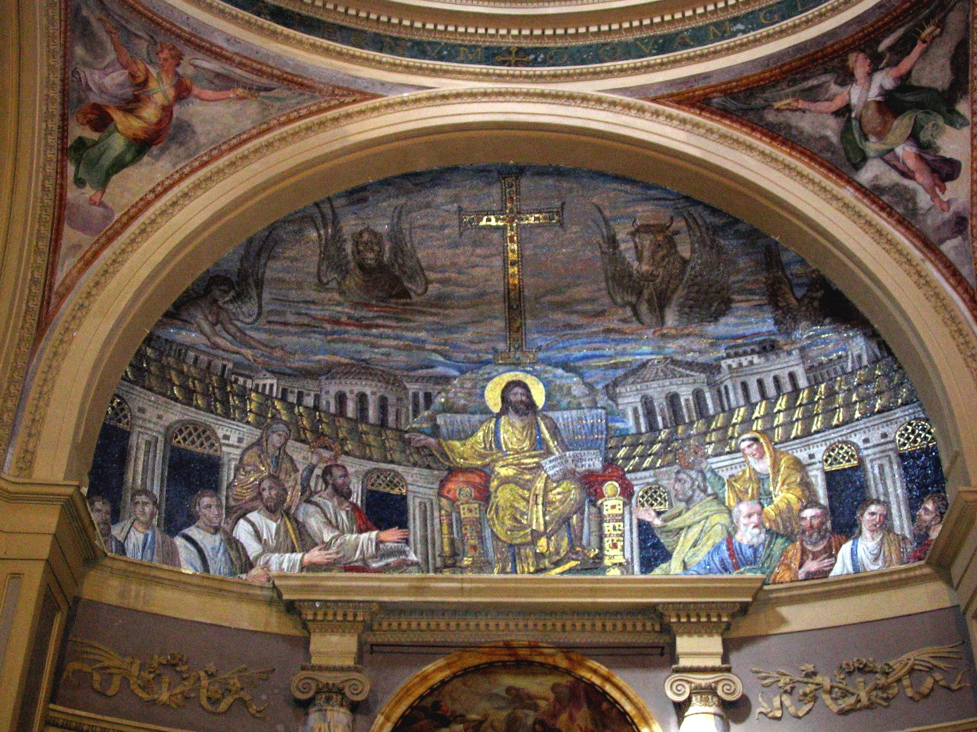
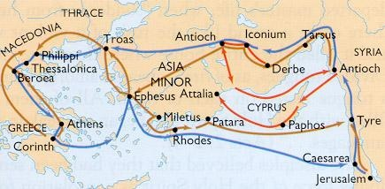
C. Ancient Rome and Christianity
Christianity, a major world religion, began in the eastern part of the Roman Empire and was adopted by Rome’s emperors in the A.D. 300s.
The Roman road system allowed the early Christians to travel throughout the empire safely and quickly. Therefore, Christian ideas were easily shared with other groups of people.

