Slide 1
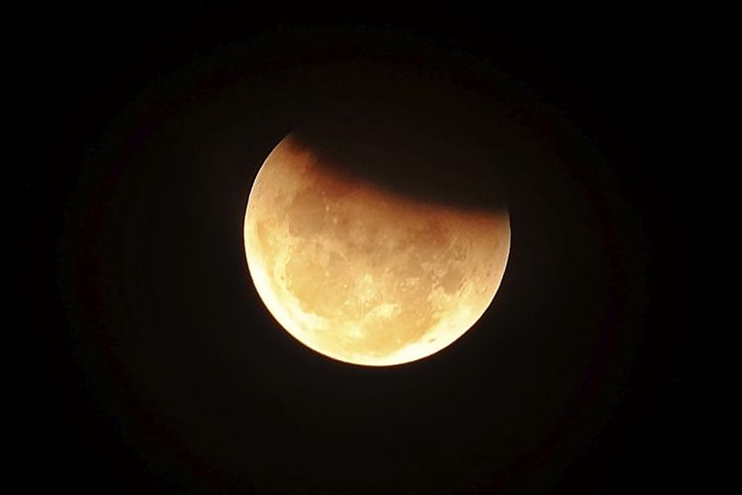
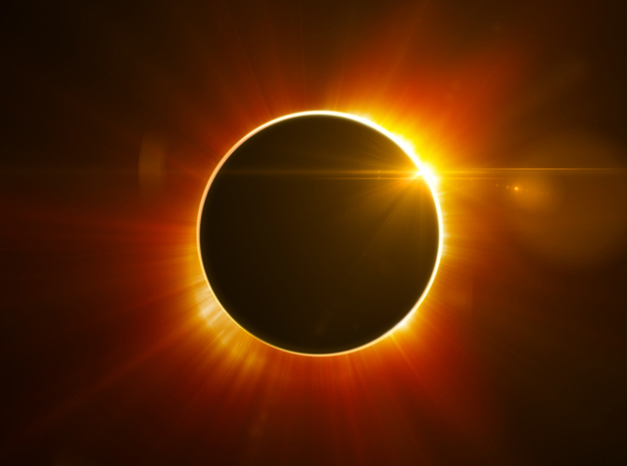
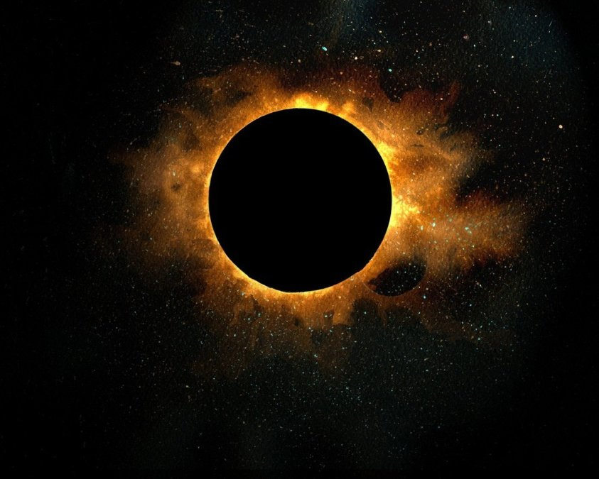
Eclipses

Slide 2
Time to Brainstorm!
Head your paper in your notebook with “Eclipses”
Brainstorm and list as many terms as you can related to eclipses-you may work with your group…..

Slide 3
Think, Pair, Share
Think about the following questions
What is an eclipse?
Are there different types of eclipses? If so, list them
Draw a picture showing the position of the Earth, the Sun and the Moon during a solar eclipse and a lunar eclipse.

Slide 4
Think, Pair, Share
Pair: With a partner (at your table), discuss the answers to the questions.
What is an eclipse?
Are there different types of eclipses? If so, list them
Draw a picture showing the position of the Earth, the Sun and the Moon during a solar eclipse and a lunar eclipse.

Slide 5
Think, Pair, Share
Share: With your group, discuss the answers to the questions and record in your notebook (do this in pencil so that you can correct it later):
about the following questions
What is an eclipse?
Are there different types of eclipses? If so, list them
Draw a picture showing the position of the Earth, the Sun and the Moon during a solar eclipse and a lunar eclipse.

Slide 6
Video:
While watching the video, think about the questions.
PBS Physics Girl Eclipses:
https://florida.pbslearningmedia.org/resource/solar-eclipse-lunar-eclipse-physicsgirl-video-1003/whats-the-difference-between-a-solar-and-lunar-eclipse-physics-girl/#.WZXTsIWcFok

Slide 7
Revise your notes
Once again, discuss the questions with your group and revise your answers in your notebook.

Slide 8
Reading
Read TB pgs. 793-795 (Holt Earth Science)
Add key information to your notes
Highlight and define any key terms

Slide 9
Eclipse Safety
Eclipses can damage the tissue in the back of the eye (retina). You will damage your eyes looking at a solar eclipse!
Watch the safety videos:
https://www.youtube.com/watch?v=8csVr2yFJUw&feature=youtu.be
https://www.bing.com/videos/search?q=nasa+eclipse+safety+video&view=detail&mid=499F149B840B7F50BB1C499F149B840B7F50BB1C&FORM=VIRE

Slide 11
What do we know?
Go to the BrainPOP site, do the BP quiz together!
Quiz covering eclipses is on Tuesday!

