Slide 1
Class of 2029!
WELCOME TO THE
LAWTON CHILES HIGH SCHOOL
TIMBERWOLF PACK

Slide 2
Guidance and Counseling Department
Mrs. Natalie Garner A - De
Mrs. Sarah Bender Dh - Je
Ms. Alice Mathis Jh - Mi
Mrs. Natalie Ferrera Mo - Rod
Mrs. Brigitte Robinson Roe – Z
Mrs. Shaila Behara
Mrs. Kanwal Majid, Registrar

Slide 3
Graduation Options
A four-year, minimum of 24-credits standard program, or
18 credit ACCEL
Standard 24 Credit Graduation Requirements
English – 4 credits
Math – 4 credits (to include Algebra I and Geometry)
Science – 3 credits (to include Biology)
Social Studies – 3.5 credits ( World History, Personal Finance, United States History, Economics and United States Government)
Health Opportunities in Physical Education (HOPE) – 1 credit
Fine Art or DOE Approved Practical Art – 1 credit
Electives – as needed for a total of 24 credits (7.5 credits)
Earn a 2.0 cumulative unweighted GPA
Testing Requirements: Reading – Passing Grade 10 ELA or achieve a Concordant score; Math - Passing Algebra 1 EOC or achieve a Concordant score.
Must take End Of Course Exams (EOC) for Algebra I, Geometry, Biology and US History. EOCs are 30% of the grade for these courses.
Notes:
Chiles is a great place to be. We have a wide a wide range offerings. so many things to offer every student: We have vocational programs to include engineering, graphic arts, web design, culinary arts, and more. We offer fine arts programs drama, chorus, band and arts clubs, sports and so much more.

Slide 4
Course Progressions
9th grade progression –
REQUIRED COURSES
English I
Math
Science
World History
HOPE
9th grade Pre-AP/AP Accel
REQUIRED COURSES
English I
Math
Science
HOPE
World History Honors – Pre-AP or AP Accel program
AP World History or AP Human Geography- AP Accel program
In addition, with prerequisites (Chemistry Honors and Algebra II Honors), have the option to enroll in AP Biology or AP Environmental Science.
Notes:
Guidance counselors do presentations at the middle schools with “your” students. We meet with 8th grade teachers each year to discuss accurate placement into 9th grade courses. Course request forms are pretty detailed.
Make good choices. Try to find a balance. If your student is taking honors course, know that hey earn .5 extra quality point in their weighted GPA and they have to earn it. The rigor has to be there. Often a difference for students who have not had to work hard to be successful in school.

Slide 5
Pre-AP Program
Pre-AP
2025 Program Requirements
3.20 GPA
For the 2024-2025 school year it is required that you score a level 3 or higher on the FAST/ELA to be eligble to participate in this program.
Notes:
Students qualifying for the AP ACCEL strand must have a cumulative middle school Grade Point Average of 3.20 or higher and a Reading Developmental Score of 1828 or higher (OR an 80% in reading on a norm referenced test.
A second way of qualifying is to have a Cumulative GPA of 3.20 - A reading Developmental Score of 1775 or higher AND a Math DDS of 2080 or higher
The equavalent on the norm referenced test would be a 77% in Rd and 95% in Ma
If the student does not meet the criteria by the middle of the 8th grade year, the students 2010 test scores and final GPA can be evaluated based on the criteria of 3.20 GPA – Reading DDS of 1987 or higher or 80% in Rd on a norm referenced test.

Slide 6
AP Accel Program
AP Accel
2025 Program Requirements
3.9 GPA or higher
For the 2024-2025 school year it is required that you score a level 4 or higher on the FSA/ELA to be eligible to participate in this program.
For more information please contact our Pre AP and AP Accel coordinator, Mrs. Kat Quick at quickk@leonschools.net
Notes:
The ACCEL Plus requirements are higher:
A 3.90 cumulative GPA with a Reading DDS of 1945 or higher or 93% on a norm referenced test
For summer qualification the GPA remains the same, with the Reading developmental score of 2073 or higher or 93% on a norm referenced test.

Slide 7
Bright Futures Scholarships
Academic Scholars Award – Pro-rated per hour tuition coverage at a Florida post secondary institution.
Requirements: 3.5 weighted* GPA (16 required academic credits) and
Qualifying SAT or ACT – TBD junior year and 100 hours of community service hours and/or work hours. (Forms and Guidelines available on Chiles website – Guidance link)
  Florida Medallion Scholars Award – Pro-rated per hour tuition coverage at a Florida post secondary institution.
  Requirements: 3.0 weighted* GPA (16 required academic credits) and
Qualifying SAT or ACT – TBD junior year and 75 hours of community service hours and/or 100 hours of combined community service and work hours. (Forms and Guidelines available on Chiles website – Guidance link)
  16 required academic credits include
      4 English
      4 Math (Algebra IA and Algebra IB= 1 math for BF)
      3 Science
      3 Social Science
      2 Foreign Language (in the same language)
Notes:
Earn hours as early as summer after 8th grade.

Slide 8
Bright Futures Scholarships (con’t)
Florida Gold Seal Vocational Scholars Award –(100% of program of study up to 72 credit hours in AS, AAS, CCC or PSAV's; 60 credits hours in ATD's.)
Requirements:
3.0 weighted* gpa (16 credits for graduation) and 3.5 gpa in 3 credit vocational program and 30 hours of volunteer community service or 100 hours of paid work hours. (Forms and Guidelines available on Chiles website) and qualifying score on one of the following college placement tests on PERT, SAT, or ACT per BF required scores (TBD)
Gold Seal Vocational Programs:
Digital Media I DCT I
Digital Media II DCT II
Digital Media III DCT III
Culinary Arts I (take in 10th grade only) Culinary Arts II Criminal Justice I
Culinary Arts II Criminal Justice II
Criminal Justice III
Digital Information Tech Digital Design I
Web Design I Digital Design II
Web Design II Digital Design III
Basic Healthcare worker- HSC 0003V (juniors only
Nurse Aide and Orderly- HCP0121V (seniors only)
Adv. Home Health Aide- HCP0332V (seniors only)

Slide 9
NCAA Requirements
If you are planning to compete athletically at the college level there are
certain academic eligibility and core-course requirements that must be met.
Full Qualifier must: Complete 16 core courses
Ten of the 16 core courses must be completed before the seventh semester (senior year) of high school.
  Seven of the 10 core courses must be English, math or science.
  Once a student-athlete begins the 7th semester, they may not repeat or replace any of these courses.
Meet the competition the required f grade-point average and ACT/SAT score as required by school you are applying to.
Graduate from high school.
Must complete the Initial Eligibility Clearinghouse application after junior year.
Must have a minimum 2.3 GPA in 16 core academic courses.
  Core courses:
        4 credits in English
        3 credits in math (minimum Algebra I, II and Geometry)
        2 credits in social science
        2 credits in science
        1 additional credit in English, math or
        science
        4 additional years of English, math, science, foreign language, social science, comparative religion or philosophy.
PLEASE visit the NCAA CLEARINGHOUSE WEBSITE FOR FURTHER INFORMATION! www.ncaaclearinghouse.net

Slide 10

Attendance is very important!
Students who are successful attend class and are on time.
A student with unexcused absences totaling four (4) shall be assigned a grade of “F” for that 9 week marking period for that class!!
A student with unexcused absences and/or tardies will not be able to exempt exams.
Tardiness
A student with four (4) tardies will be required to attend in-school suspension or Saturday school.
Students with Attendance issues must speak to Mr. Paul Lambert, Assistant Principal of Attendance to work out a plan.

Slide 11
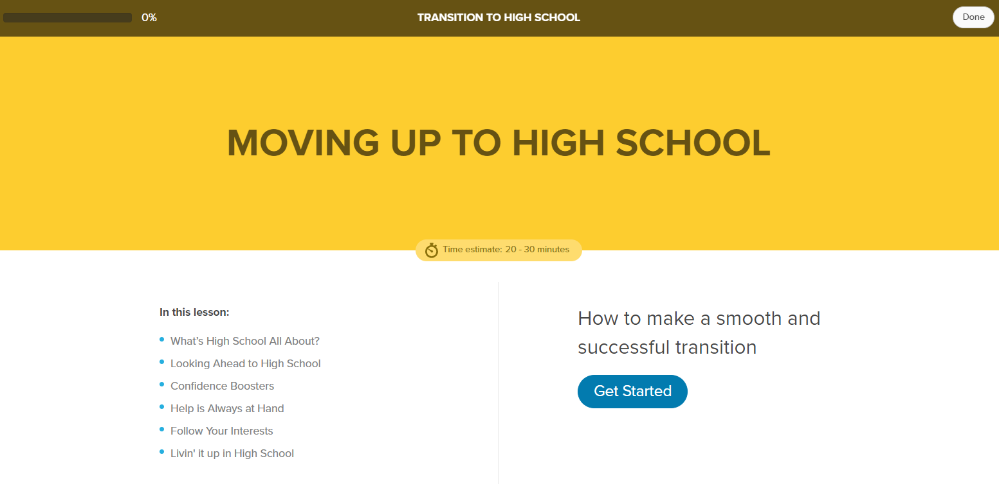
Xello – Pathways to Success
Xello is Florida's official k-12 career planning and work-based learning tool.
Xello empowers every student to design a personalized plan for the future.
Xello is available on your ClassLink
Access “Moving Up to High School” through your Xello on Class Link.

Slide 12
Online Course Information
Options for completing an online course:
Course can be a semester or yearlong course.
Course can be taken in middle school as long as it is a high school credit course.
Course may be taken via Leon County Virtual School (LCVS) or Florida Virtual School (FLVS).
Course may be a credit-recovery as long as the student earns high school credit through online learning.
LCVS – No cost to student. Program run by Leon County Schools
www.leongoesvirtual.net.
FLVS - No cost to student. Statewide, year-round program. Students can register at any time. Review www.flvs.net for details and registration.
Students must request approvals from their current School Counselor for online courses. Once registered, students must have their parent email their School Counselor requesting approval of the course.

Slide 13
Registration Forms
All students must submit a Course Registration Form.
All students must indicate a choice of six periods.
Your current teachers will help select your academic level.
Alternate course choices are very important! Give full and half credit alternate choices. If you don’t provide alternate choices, we may pick classes for you.
Please follow our progression guide for proper placement in core and elective classes:
http://lawtonchileshighschool-ap.weebly.com/coursesprogressions.html (progression guide for departments and course descriptions)
Or go to www.leonschools.net/chiles –Parents and students- Advanced Placement- Courses and Progressions.
More course information can also be found at each Department’s site at www.leonschools.net/chiles Department- (i.e. Science)- Resources
*School Counselor emails:
Natalie Garner - A-De garnern@leonschools.net
Sarah Bender - Dh-Je benders@leonschools.net
Alice Mathis - Jh-Mi mathisa@leonschools.net
Natalie Ferrera - Mo-Rod ferreran@leonschools.net
Brigitte Robinson - Roe-Z robinsonb2@leonschools.net

Slide 14
Directions for completing course request forms:
Fill in the squares and/or triangles in front of the courses you would like to take next year.
  = .5 credit (need two to equal one full credit).
  = 1.0 credit
Make certain that all selections equal a total of 6 credits
Teacher signatures are required for courses that have a box before them.
  : no signature needed Art 2D 1
teacher signs in the box Art 2D 2
If you are taking a class online (such as HOPE) please write in “taking online” next to the course name. This will NOT count as one of your 6 classes and will have to be taken outside of the 6 period day. Chiles does not have any virtual hold labs for online classes or study halls.
Parent signature is required if you are taking an AP course or any college level course. This gives permission for course content.

Slide 15
Registration and Dates to Remember
Chiles Curriculum Fair- Chiles Gym - February 20, 2025
Chiles Gymnasium from 6:00pm-7:30pm. Come out and see what programs we have to offer and meet teachers! 8th grade Parent Night is immediately prior to Curriculum Fair at 5:30 p.m.
Hours for Chiles High School are: 7:30a.m. (1st period begins) until 1:50pm (through 6th period)
Possible optional 7th period pending funding.
All students must submit a completed Course Registration Form or we will choose classes for you!
Upcoming in August – Freshman Orientation at Chiles HS on the Friday prior to start of school

