Slide 1
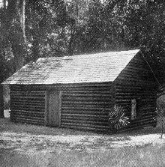
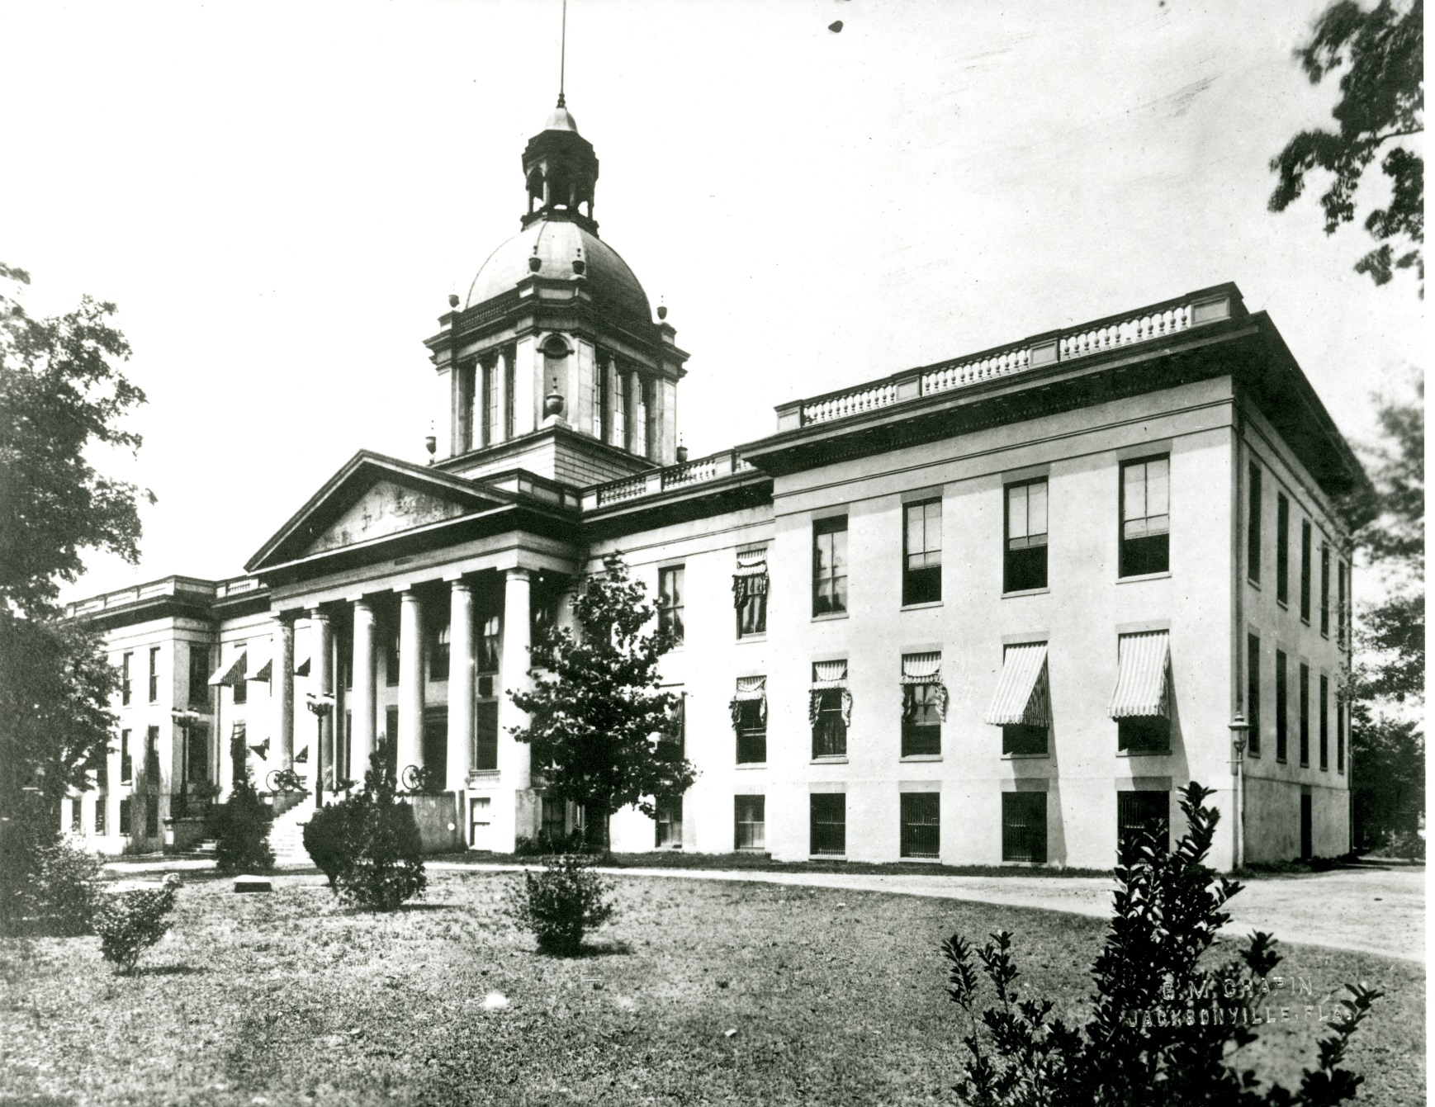
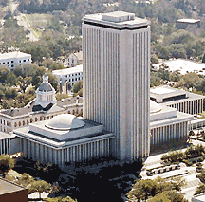
FLORIDA’S CAPITOL BUILDINGS
1822 – Present Day

Slide 2
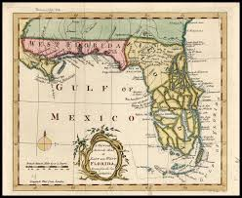

OUR STORY BEGINS IN 1822…
Florida became a territory, combining the colonies of West Florida and East Florida.
The capital of West Florida was Pensacola. The capital of East Florida was St. Augustine. For two years, the cities took turns hosting government business.
Because travel between the two cities took almost 20 days and was quite dangerous, it was decided that Tallahassee, located in the middle, would become the new capital city.
Did you know?
Tallahassee is a Creek Indian word meaning “old fields.” The city is located near an early 19th century Creek Indian (Seminole) town.

Slide 3
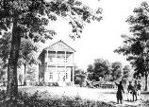
1824
The Capitol buildings of Florida over the years reflect the growth of
the area.
The first meetings of the territorial government in Tallahassee were held in this log cabin.
In 1826, a two-story Capitol building was started but never completed because of lack of funds.

Slide 4
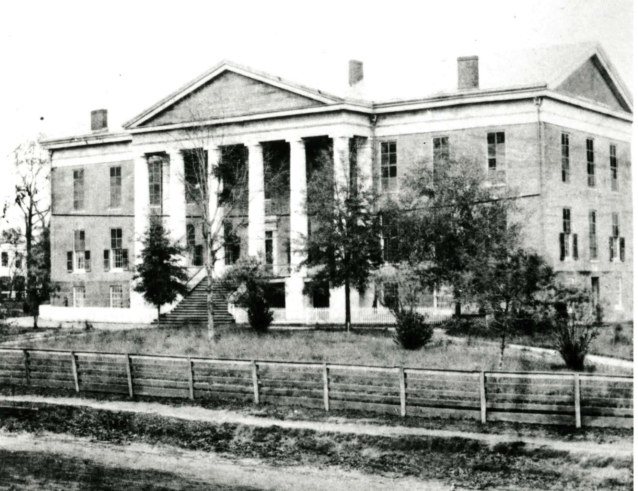
1845
On March 3, 1845,
Florida became the 27th State
in the Union.
Its first official governor, William Mosely, was sworn in at this newly built Capitol. Its brick walls still stand today.
In 1845, this building had no running water and no electricity.
The Capitol remained virtually unchanged throughout the Civil War (1861-1865).

Slide 5
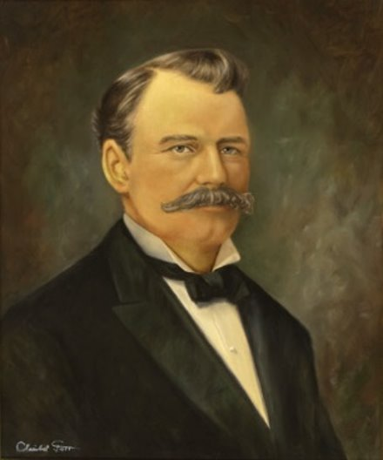
1902
Governor William Sherman Jennings, Florida's 18th governor (1901-1905),
was instrumental in renovating the Capitol.
He formed the Capitol Improvement Commission and brought electricity, heat, and other major renovations to the building.
Did you know?
He is said to have been friends with Thomas Edison.

Slide 6
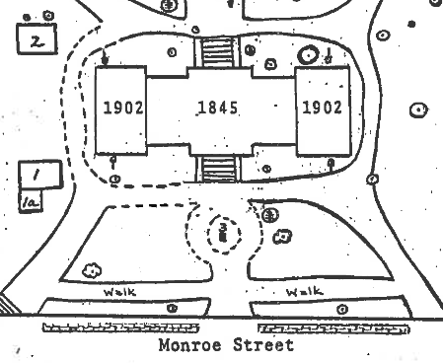
1902
1845
1902
Running water was installed in 1891, and then in 1902,
two wings (buildings) and a dome were added to the original building.

Slide 7
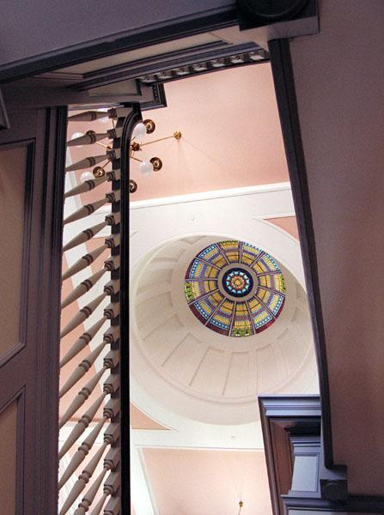
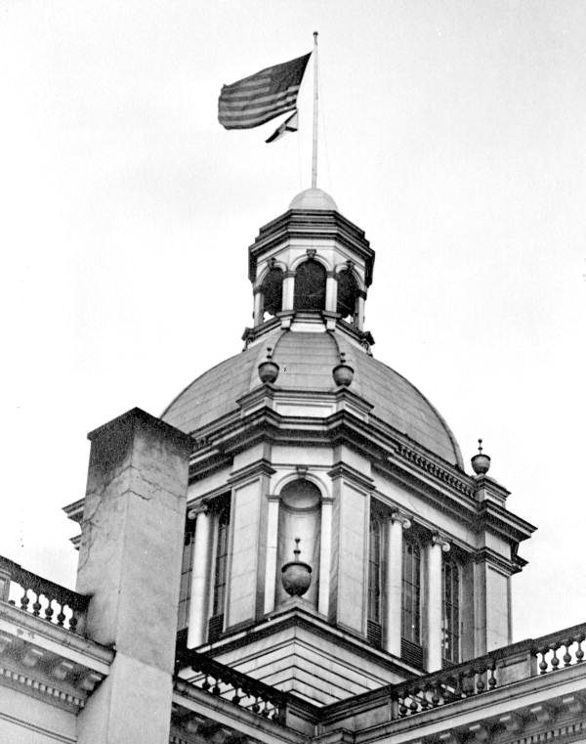
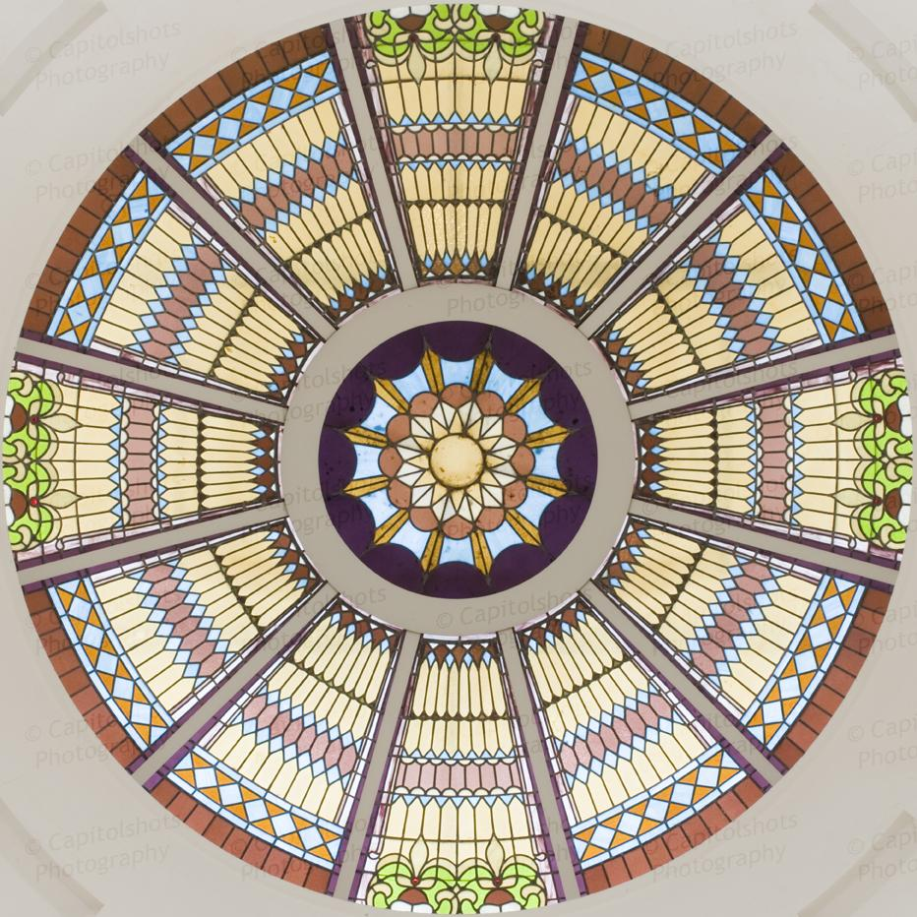
1902
​The inside of the dome features an art glass dome made of hundreds of pieces of stained glass.​ It is 136 feet from the floor and allows light into the building.
The dome is one of the most distinctive features that architect Frank P. Milburn added to Florida's Capitol.
When completed, it was described as "beautiful and graceful."

Slide 8
1902
In addition to the wings and the dome, the Capitol underwent renovations to modernize it.

Slide 9
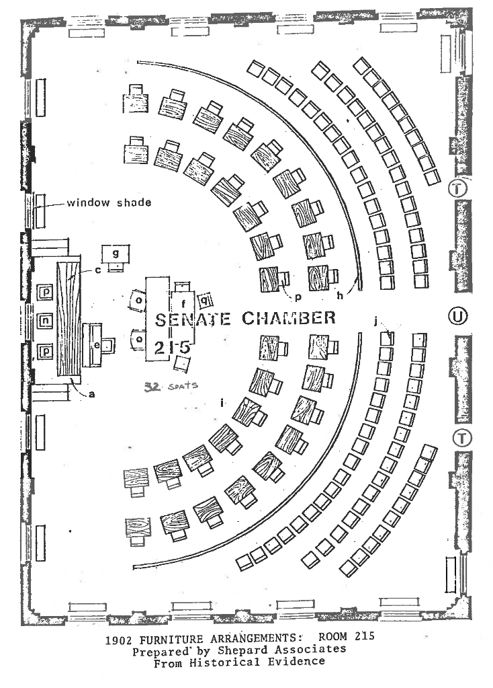
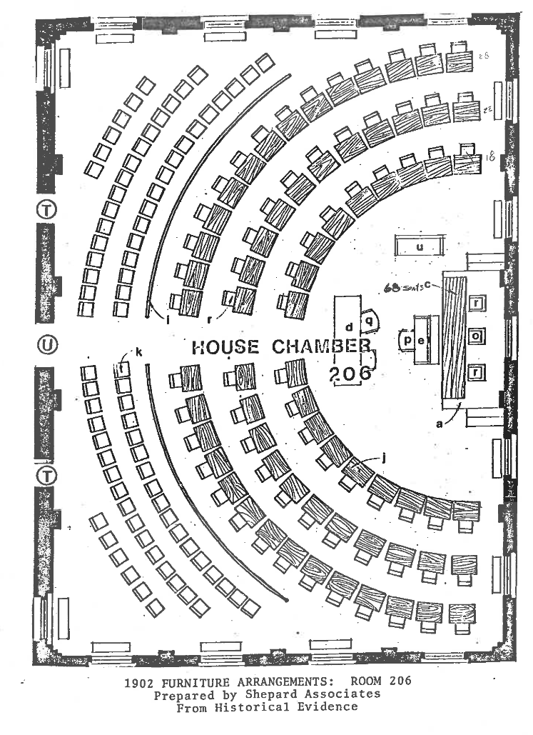
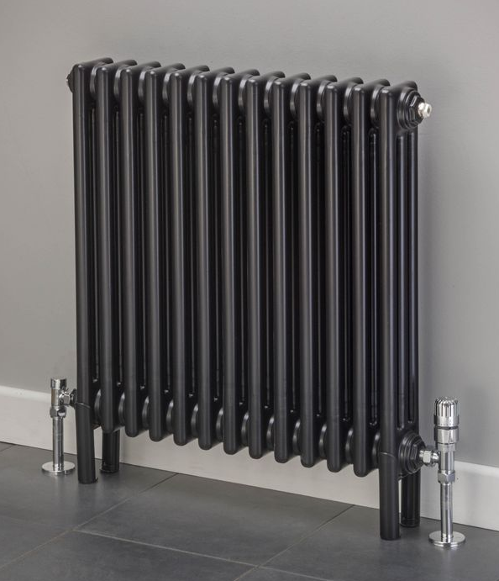
1902 RENOVATIONS
Heating
Until 1902, heat for the Capitol was provided by 24 brick fireplaces: four in House Chamber, two in the Senate Chamber, and one in each of the other rooms, except for the lobby area on each floor.
Gov. Jennings ordered a complete steam heating system using radiators to heat the rooms.

Slide 10
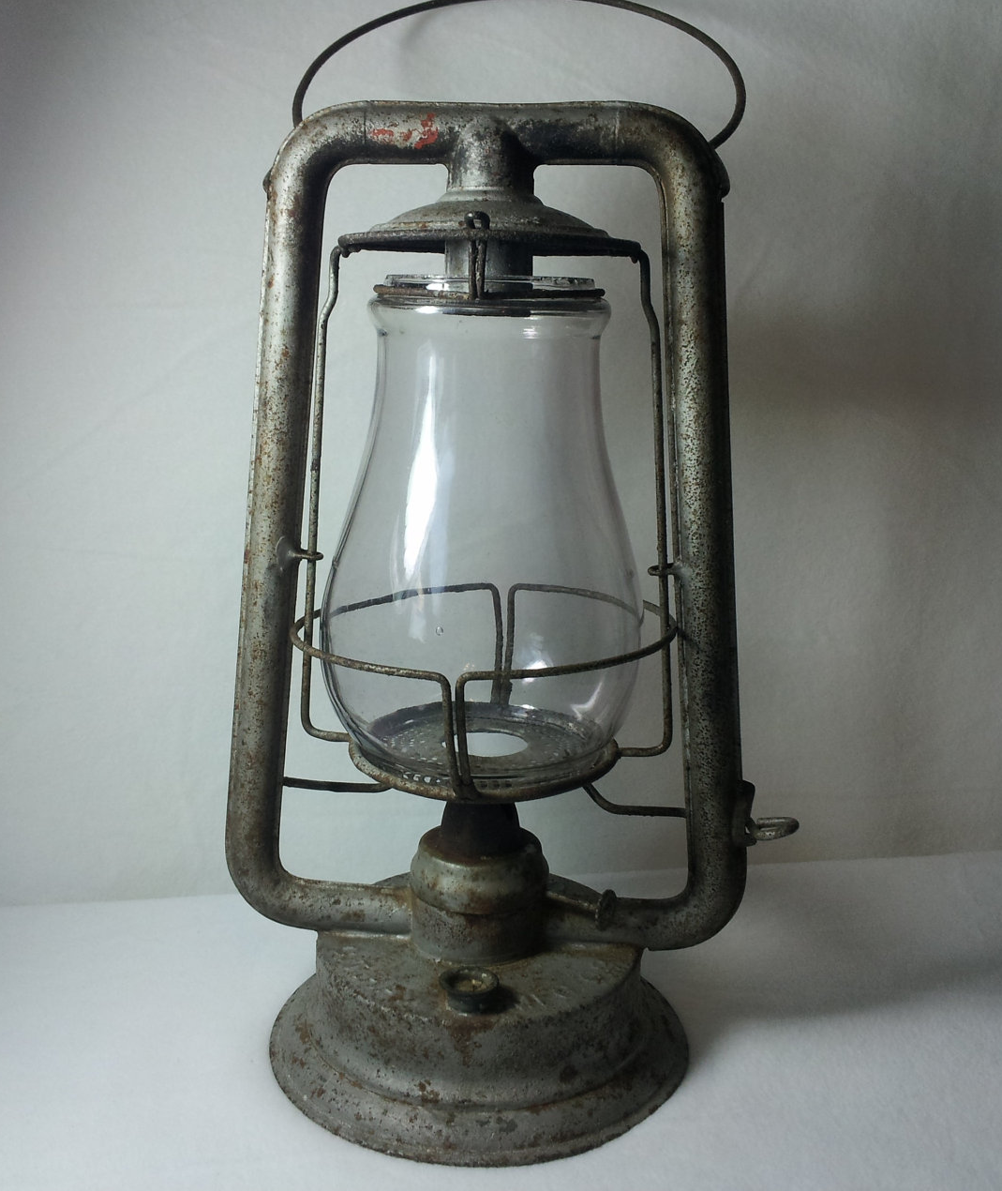
1902 RENOVATIONS
Electricity & Lighting
Tallahassee's City Electric Plant was built around the same time that renovations were being done in the 1902 Capitol.
Gov. Jennings ordered a combination of gas and electric systems to light the building so there would be uniform lighting over large areas of the rooms.
Did you know?
Before electricity, kerosene lamps and gas lanterns were used. Only a small area could be lit.

Slide 11
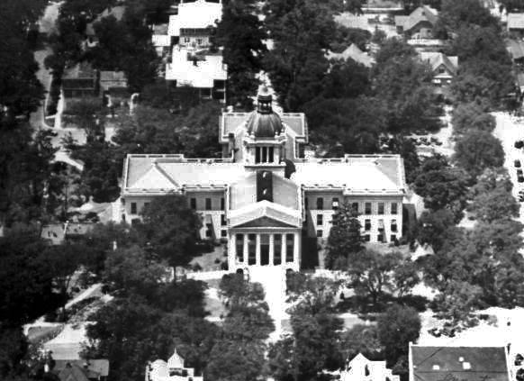
1922
Florida’s government grew.
Two more wings were added to the Capitol, and the interior was remodeled.

Slide 12
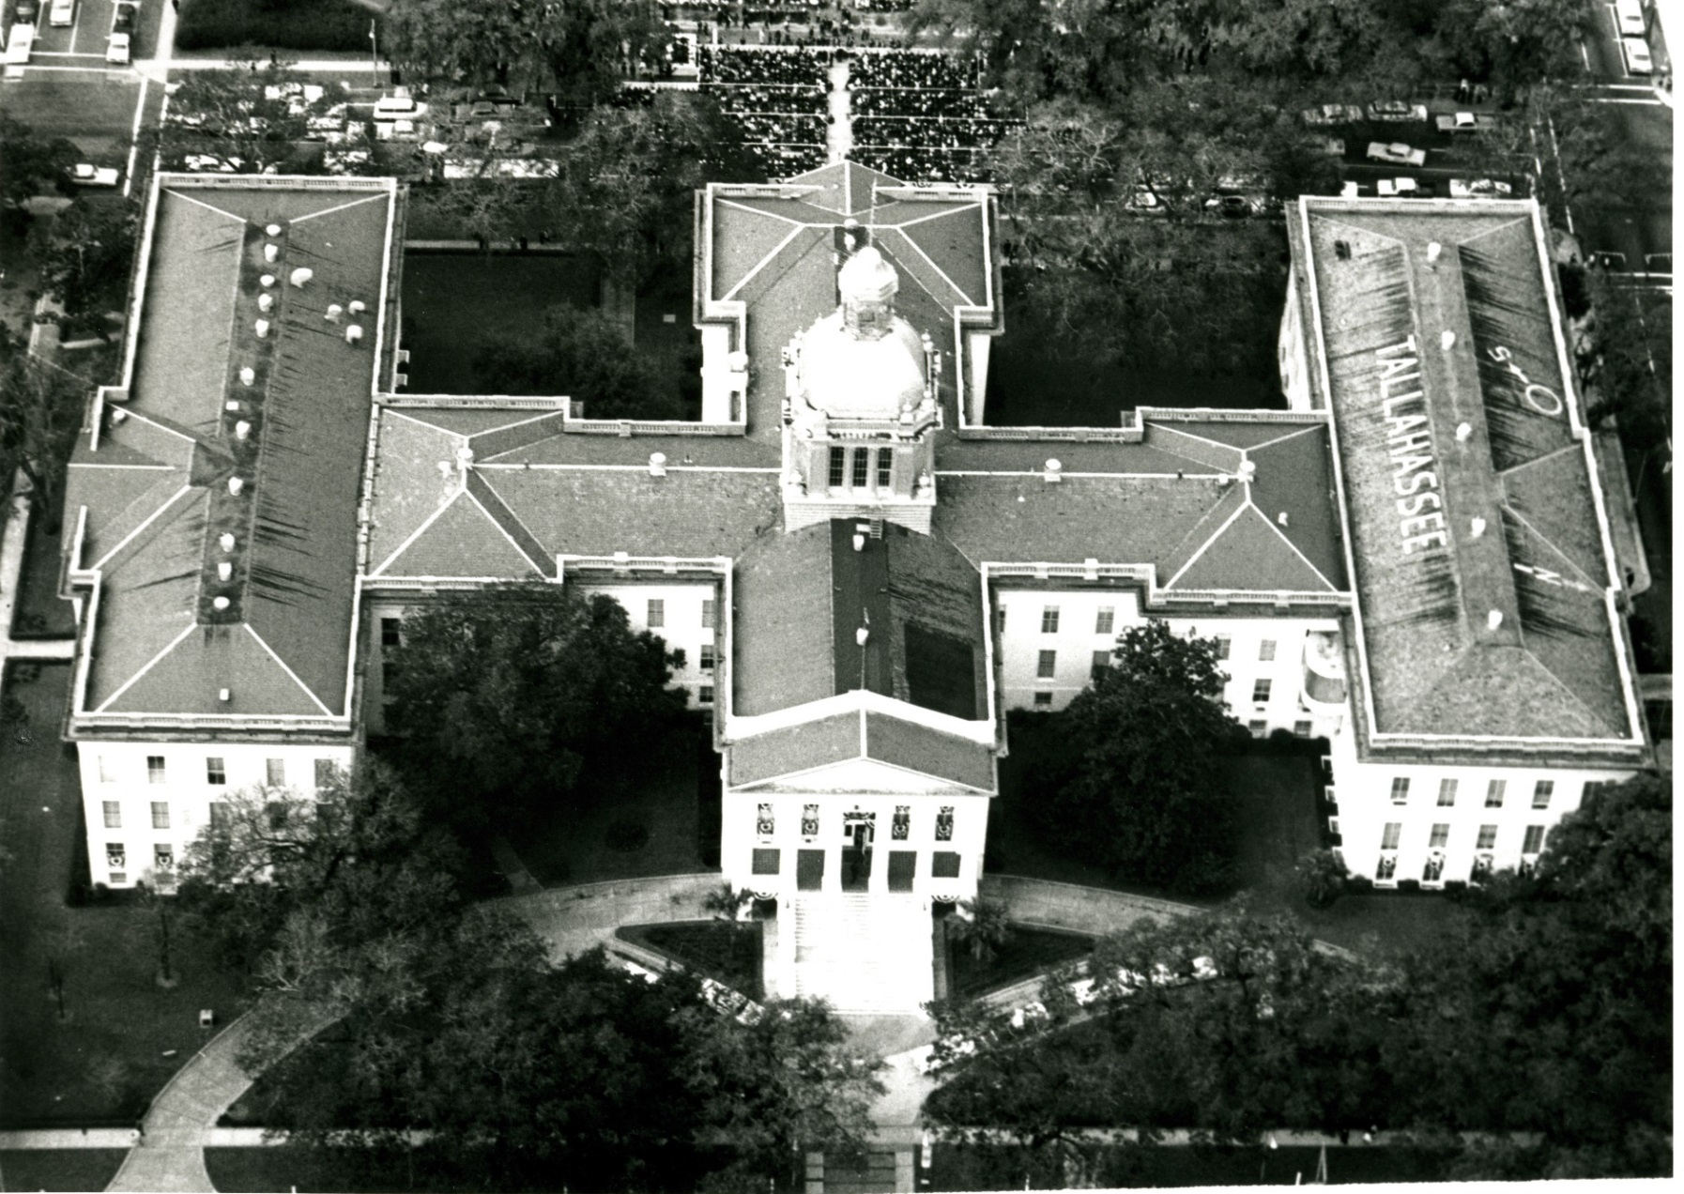
1947
During the late 1930s, work began on new Senate and House wings, but because of World War II (1939-1945) they were not completed until 1947. Resources for the building were used for the war instead.
Did you know?
Can you find the “air marker” on the roof of the Capitol building? This helped train pilots during the war. An Air Force base was nearby.

Slide 13
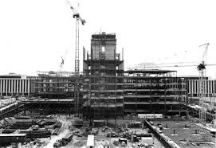
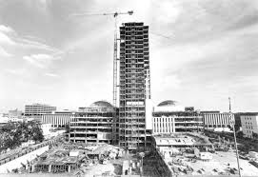
1977
After WWII, Florida’s population and government expanded. The Interstate highway system was developed, and air conditioning brought many families to Florida. The Capitol gets air conditioning, and it’s decided that Florida’s government needs an even bigger Capitol building.
Did you know?
When the New Capitol was completed, the Old Capitol was slated for demolition!

Slide 14
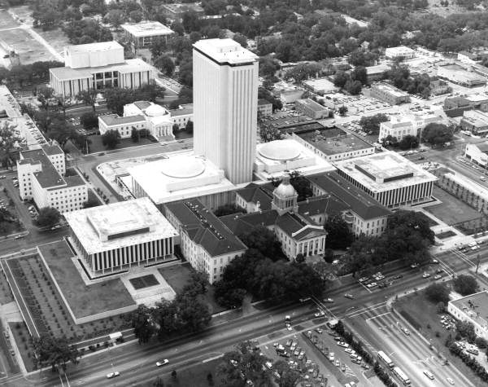
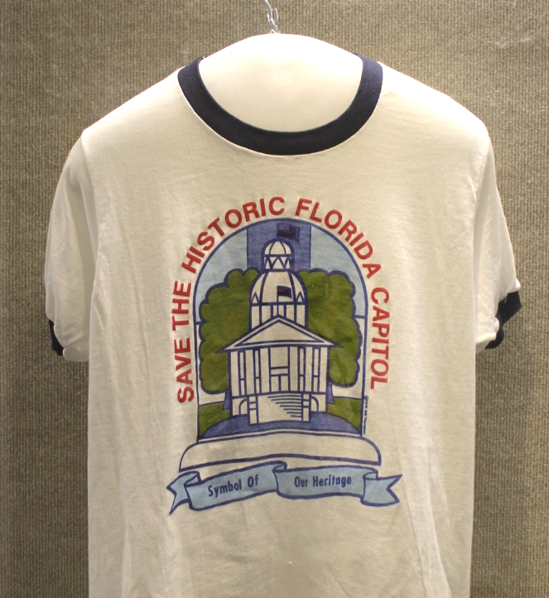
1978
Floridians protested the demolition of the old Capitol.
The Secretary of State and the people of Florida rallied together to save the building.
Florida’s legislature agreed to save the old Capitol and gave $7 million to restore it to its 1902 appearance.

Slide 15
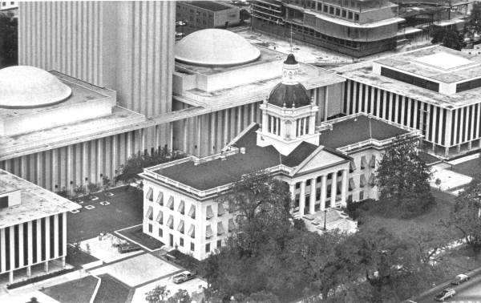
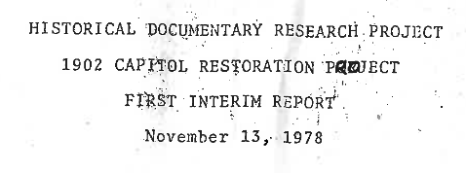
1977-1982
Previous additions to the old Capitol were removed to make space between the old and new buildings.
The old Capitol was restored to its 1902 appearance and reopened as the Florida Historic Capitol Museum.

Slide 16
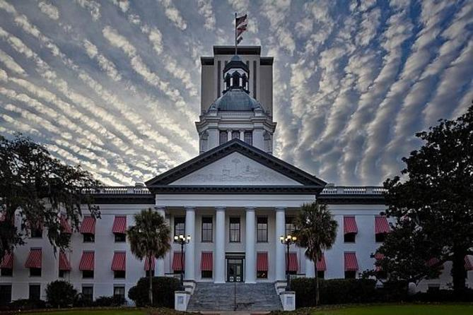
TODAY
Both buildings
still stand.
Florida’s government operates business in the new Capitol.
The Florida Historic Capitol Museum houses more than 250 artifacts from Florida’s history, which are on display for visitors.

