Slide 1
Journalism 1

Slide 2
Today’s Agenda
Bellringer
Syllabus
Discussion of Class Format
What is journalism? What is news?
Writing Tabloid News
BELLRINGER-
What is journalism?
What is “the news”?
Who determines what is news?
What is the biggest news story right now?

Slide 3
Today’s Agenda
Bellringer
Turn in syllabi
Discussion of Class Format
What is journalism and the news?
Ethics and the Law in Media
Deciding ethics for yourself
BELLRINGER-
What are the rules of your moral code?
Your moral code is the set of unwritten rules you choose to live by. This is not what others tell you to do, but your choices about what behaviors/actions are okay or not okay.

Slide 4
Journalism 1
JOURNALISM
School Newspaper
Yearbook
School
Social Media
Weekly Bulletin Broadcast

Slide 5
Class format
Bellringer- Mon/Tues-Reading Newspaper Articles (15 minutes)
Wed/Thrs- Journalistic Writing Prompt
Learning and practicing new skills and concepts (30 minutes)
Types of journalism, editing your writing, how to take photos
Individual Work Period (45 minutes)
Interview sources, write articles, design yearbook pages, edit and tag photographs, revise with Seep or Emily

Slide 6
Today’s Agenda
Bellringer
How to interview sources for an article
Individual Work- Craft questions and interview sources to prepare for writing an article
BELLRINGER- Use your notes from last class
Label each of the following senarios as ethical or not ethical. Then label which “ethics rule of thumb” applies to the situation.
1.
2.
3.
4.
5.

Slide 7
Possible interview topics
New Staff
Wakulla Springs
Beginning of the Year
Club sign up / new clubs
Summer Reading
New Students
Off Campus Lunch (safety?)
Senior News
New attendance policy
Intensives
College Visits
Wellness / Healthy Decisions Day

Slide 8
Today’s Agenda
Bellringer
What is news?
How to write a basic news article
Individual Work- Write a news article using the inverted pyramid
BELLRINGER-
Write a well-developed 1 paragraph response to the following question-
Do newspapers have a vital role in modern society or should other forms of media replace them? Explain your reasoning.

Slide 9
What is the news?
Standard news articles cover basic current events
Answer the 5W1H for events around the world
Different from feature articles
How are they organized?
I. Lead sentence
Grab and hook your reader right away.
II. Introduction
Which facts and figures will ground your story? You have to tell your readers where and when this story is happening.
III. Opening quotation
What will give the reader a sense of the people involved and what they are thinking?
IV. Main body
What is at the heart of your story?
V. Closing quotation
Find something that sums the article up in a few words.
VI. Conclusion (optional—the closing quote may do the job)

Slide 11
What is the news?
What is the inverted pyramid?
What types of stories are written in this style?
When do we deviate from this style?

Slide 12
Today’s Agenda
Bellringer
What is a feature article?
Individual Work- Interviews, Writing News Article, Revising News Article
DUE WEDNESDAY- News Article 1st Draft
BELLRINGER-
Write a well-developed 1 paragraph response to the following question-
Would you spend 15 years in solitary confinement if you would receive 50 million dollars upon your release? You would have no human contact but unlimited books, games, food, etc.

Slide 13
What is a feature article?
Standard news articles cover basic current events – 5W+1H
Featured articles are windows into the human experience
Non-fiction
focus on an event or individual, what is most interesting not most important
Sometimes called ‘puff pieces’ often arts or lifestyle sections
giving the reader a chance to more fully understand some interesting dimension of that subject.
Not necessarily current

Slide 14
How is a feature article written?
a feature lede can use description or an anecdote to set up the story
Taking more time to tell a story means using more space, which is why features are usually, though not always, longer than hard news articles
Feature articles also include more of the elements that are used in traditional storytelling - description, scene-setting, quotes and background information
Can be told topically or chronologically
news have no room for opinions, feature stories can be opinionated
news are somewhat shallow, features go in-depth
news are formal, features can be flashy, informal

Slide 15
Types of feature articles
News behind the news stories
Personality sketch/profile
Science and technology story
Human appeal story
Historical and cultural features
How-to and what-to-do features
Business and development
Lifestyle
Entertainment
Hobby
Career
Seasonal
Travel
Insider look

Slide 16
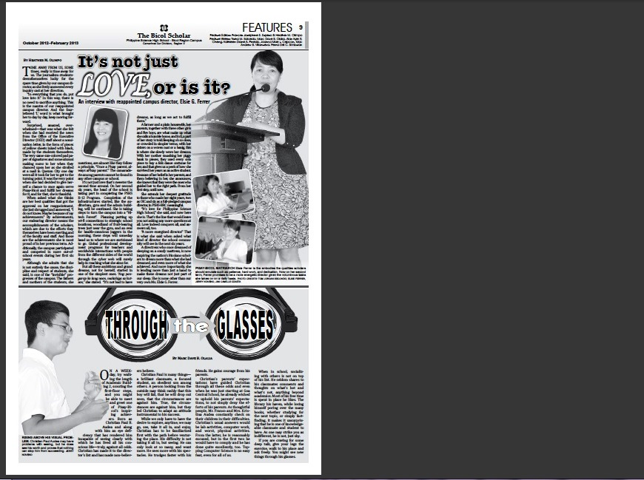
50
Feature Page
WINTER
Template
Profiles

Slide 17
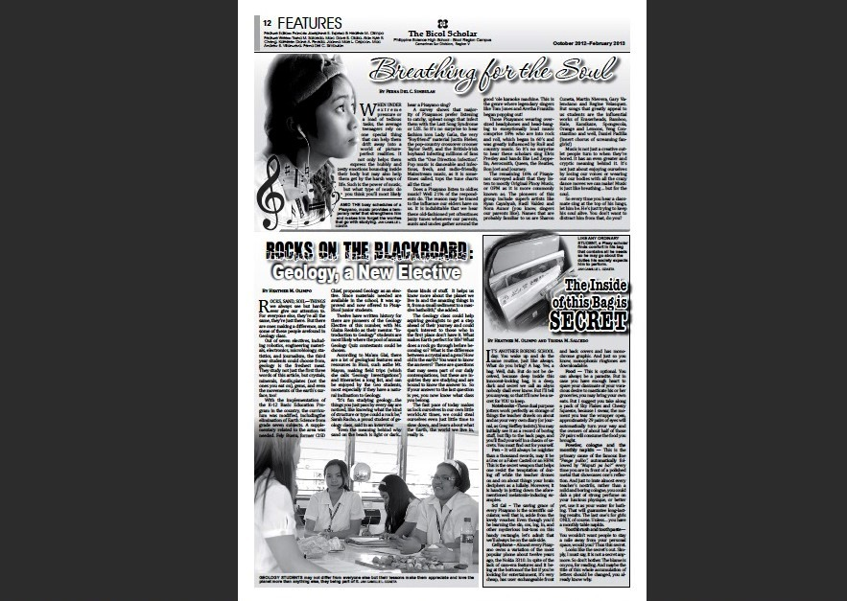
51
Feature Page
WINTER
ENTERTAINMENT
Template

Slide 18
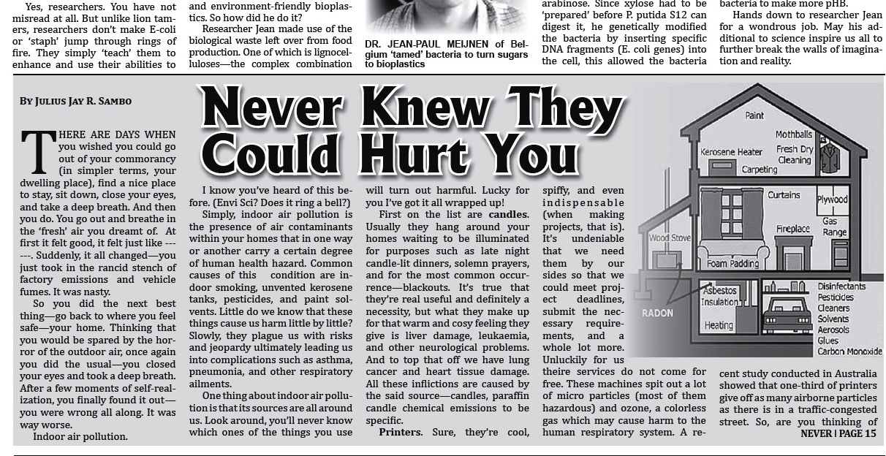
52
Feature Page
WINTER
Informative Features
Template

Slide 19
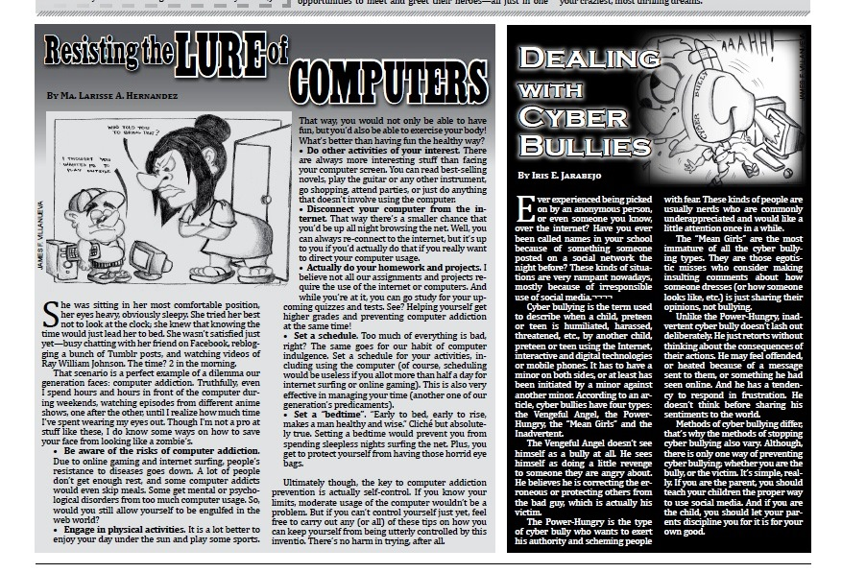
53
Feature Page
WINTER
Template
Advice Features

Slide 20
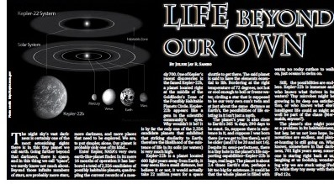
54
S&T Section
WINTER
Science News/Feature
Template

Slide 21
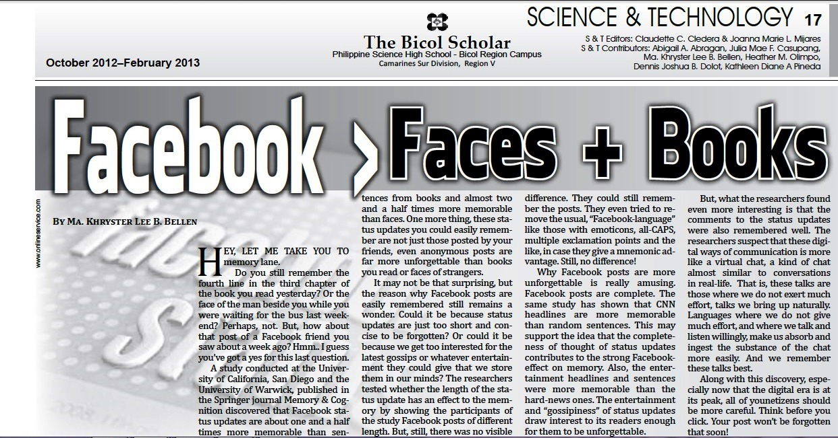
55
S&T Section
WINTER
Science Research
Template

Slide 22
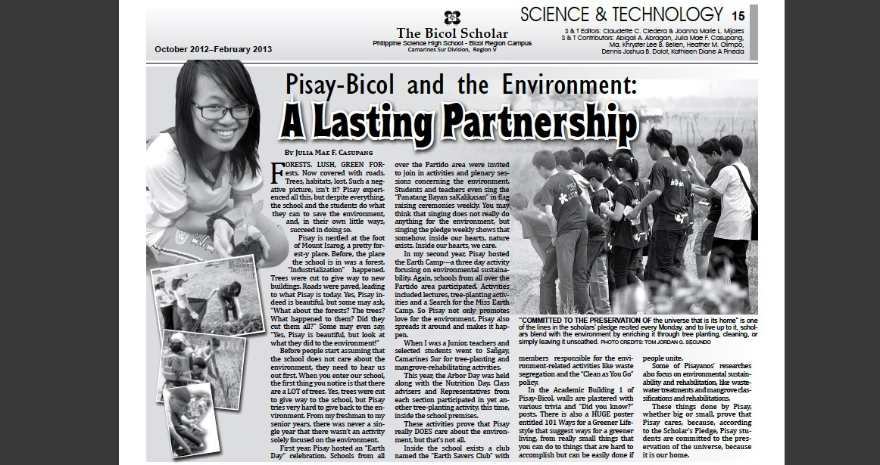
56
S&T Section
WINTER
Environmental Science
Template

Slide 23
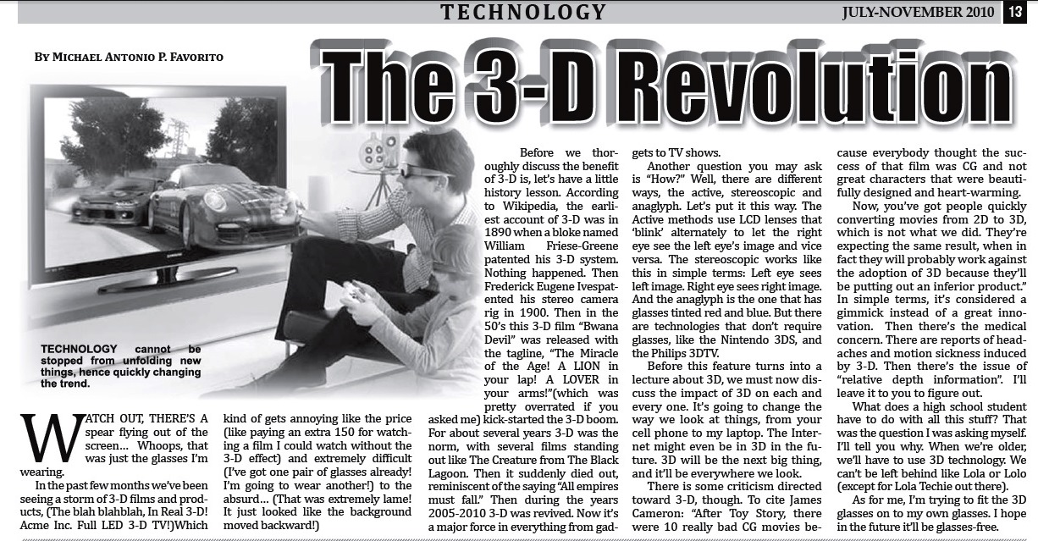
57
S&T Section
WINTER
Technology
Template

Slide 24
58
S&T Section
WINTER
Template
Health

Slide 25
58
S&T Section
WINTER
Education
Template

Slide 26
Today’s Agenda
Bellringer
Turn In News Article
Tone and Voice
Feature Ideas and Planning DUE: Wed. Sept. 6
Individual Work
Research, plan, and write a feature article
revise news article with editors (Seep and Emily)
Intro to broadcast journalism.
BELLRINGER-
Write a well-developed 1 paragraph response to the following prompt-
Describe the best or worst day of your life.

Slide 27
What are tone and voice?
Tone-is an attitude of a writer toward a subject or an audience. Tone is generally conveyed through the choice of words or the viewpoint of a writer on a particular subject.
Examples of tone: formal, informal, serious, comic, sarcastic, sad, and cheerful or it may be any other existing attitudes
Voice-it is an author’s individual writing style or point of view. When a writer imparts his personality to that piece of writing.
Examples of voice: the author’s personality or style of speaking and writing

Slide 28
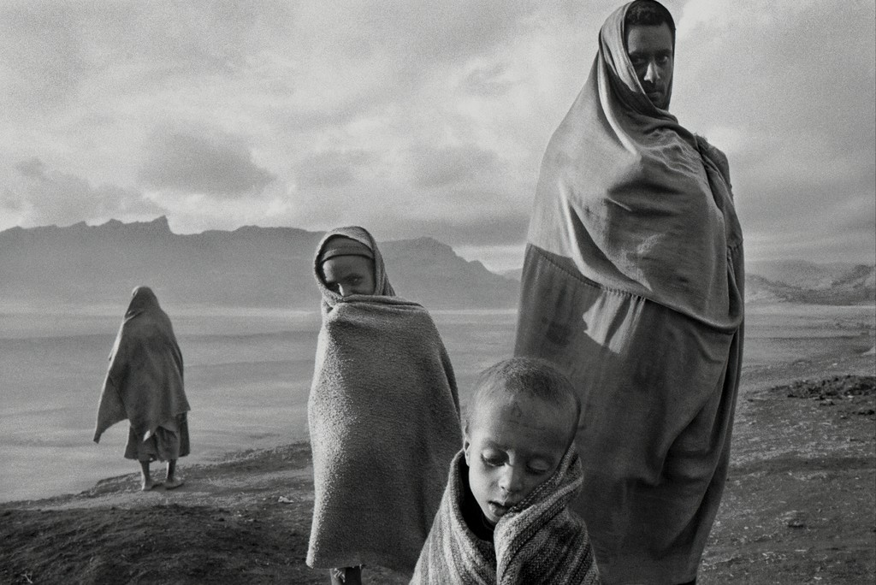
What is the tone of the photograph?

Slide 29
What is the tone of the photograph?

Slide 30
What is the tone of the photograph? Describe the ‘voice’ of the children

Slide 31
Today’s Agenda
Bellringer
Turn In Feature Article
Elements of an Editorial
Independent Work
Research, plan, and write an editorial or opinion DUE: Thrs. Sept. 14
Finish feature article if necessary and turn in
Intro to broadcast journalism
BELLRINGER-
Write a well-developed 1 paragraph response to the following prompt-
If you could change one thing in the world, what would it be? Why? What would be the effects of your change?

Slide 32
Editorials and Opinions
What is an editorial?
How long is it typically?
4 types of editorials-
v Editorials of argument and persuasion take a firm stand on a problem or condition. They attempt to persuade the reader to think the same way. This editorial often proposes a solution or advises taking some definite action.
v Editorials of information and interpretation attempt to explain the meaning or significance of a situation or news event. There is a wide variety of editorials in this category, ranging from those which provide background information to those which identify issues.
v Editorials of tribute, appreciation or commendation praise a person or an activity.
v Editorials of entertainment have two categories. One is the short humorous treatment of a light topic. The second is a slightly satirical treatment of a serious subject. (Satire is the use of sarcasm or keen wit to denounce abuses or follies. While it ridicules or makes fun of a subject it has the intent of improving it.)

Slide 33
Editorials and Opinions
List the 7 rules for writing an editorial and include any necessary information.
1.
2.
3.
4.
5.
6.
7.

Slide 34
Today’s Agenda
Bellringer
Turn In Editorial Article
Elements of a cultural essay or culture section
Independent Work
Research, plan, and write a culture piece DUE: Wed. Sept 20
Finish Editorial if necessary and turn in
Use computer to research and create design ideas for the newspaper
BELLRINGER-
Design our newspaper!
Jot down or sketch some ideas
What will our title be?
What will our motto be?
What will our logo look like?
What will our layout look like?

Slide 35
Culture
Can be called entertainment, culture, style
Most articles in this section are written as features
Can cover a variety of topics, such as:
Television (entertainment)
Movies (entertainment)
Music (entertainment)
People (entertainment)
Horoscopes (entertainment)
Crosswords (entertainment)
Comics (entertainment)
Advice columns (entertainment)
Health (culture)
Education (culture)
Cooking (culture)
The arts (culture)
Literary work (Culture)
Technology (culture)
Science (culture)
Fashion (style)
Pop culture (style)

Slide 36
Reviews in Culture-
How to write a large work review (i.e. album, movie, book, tv series) in this order:
The important information should come up front-is the album/movie/book/show good? A good review makes the reviewer's opinion absolutely clear!
Don't quote more than a few choice lyrics/phrases/lines and don't analyze everything in detail. Make your points with one or two good examples.
Think about
is it meaningful?
what is the quality of the product or performance?
the work as a whole vs. outstanding parts of the work
Originality
Compare the artist’s current work with past work or with other artists in the same genre.
Provide background information on the artist(s), but don’t make that the focus of the article (that would be a feature).

Slide 37
Today’s Agenda
Bellringer
Basics of Photography
Independent Work
Research, plan, and write a culture piece DUE: Wed. Sept 20
Finish Editorial if necessary and turn in
Use computer to research and create design ideas for the newspaper
BELLRINGER #9-
Write a well-developed 1 paragraph response to the following prompt-
Write about what you didn’t do this weekend.

