Slide 1
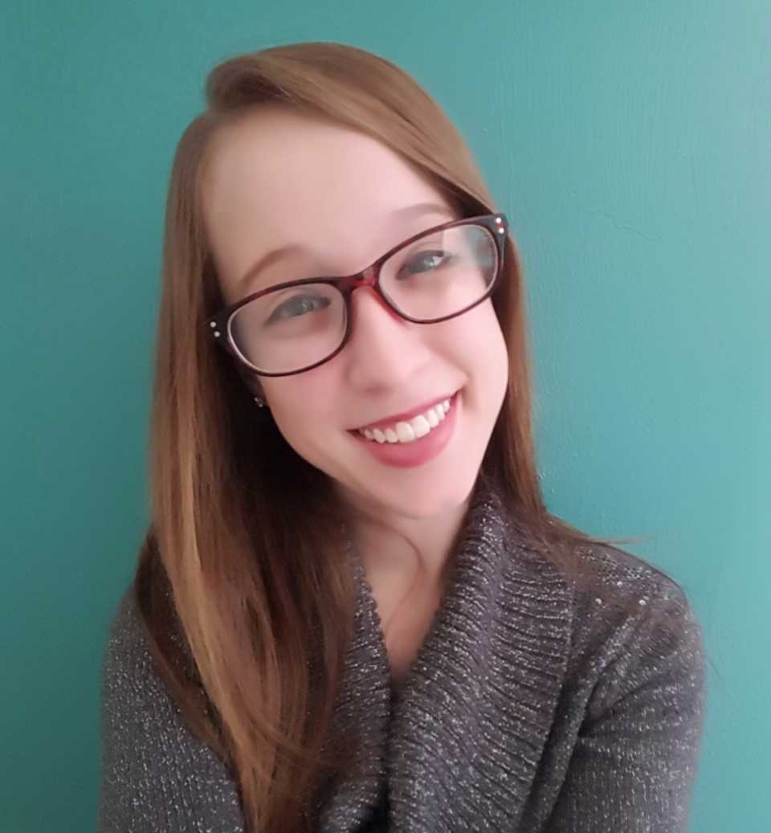
I am so looking forward to being your kindergarten teacher this year! I can’t wait to watch you learn and grow! Let’s work hard and have a great year! ☺
Ms. Savanna Lyle
This is my second year working as a kindergarten teacher at Sealey. I graduated from Flagler college with a degree in Elementary Education after interning at Sealey in first grade! I attended Sealey Elementary from kindergarten through fifth grade and I am so happy to be teaching where I went to school!
Email: lyles@leonschools.net
Phone #: 850-488-5640
The best way to contact me is through Class Dojo! Be sure to connect to our class!
Drinks: Water and Coke
Candy: Reese’s cups & Twix
Colors: Blue and Rainbow!
Restaurants: Chick-fil-a & Moe’s
Store: Target!!
Extras: FSU football & animals

