Slide 1
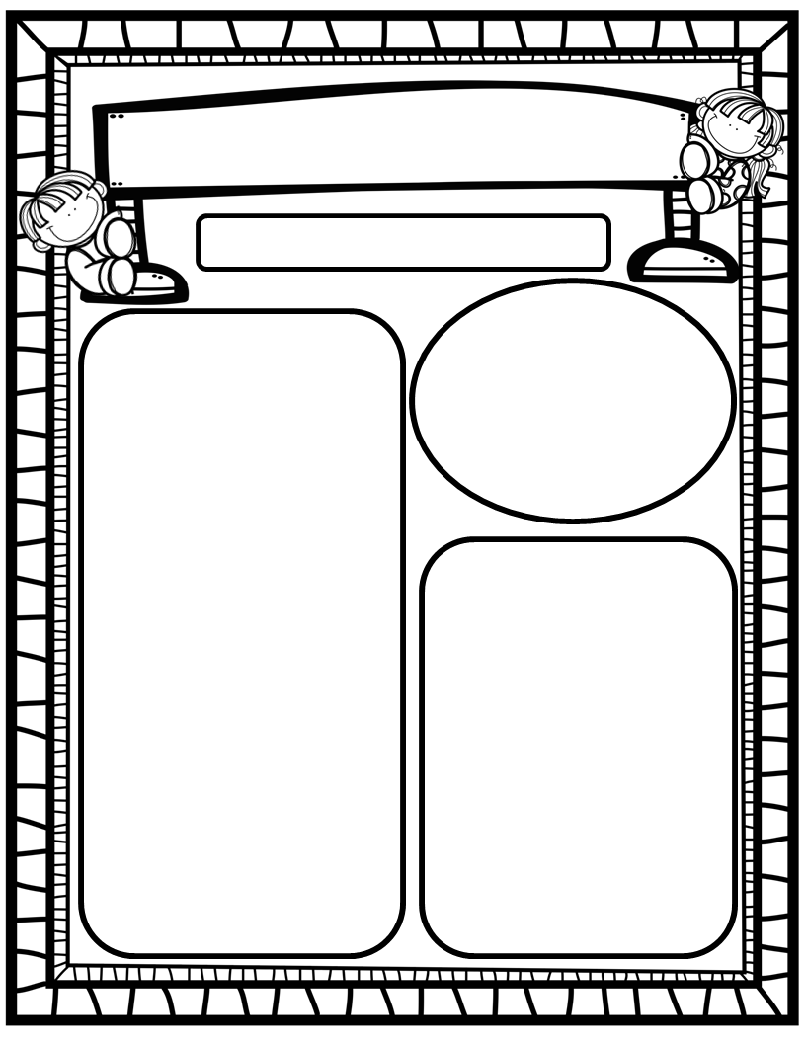
Toucan Weekly Blast
August 19th, 2024
We Are Learning About…
Reading: We will review the letters of the alphabet with a focus on letter sounds. We will ask and answer questions about characters, setting and story events to help us understand stories better. We will learn that we are all READERS because there is more than one way to read a book! ☺
Writing: We will focus on printing and tracing upper and lowercase letters, as well as our first names!
Math: We will begin GoMath Ch. 1: Recognize, Count and Write Numbers 1-5! We will explore math tools!
Science: We will learn about what a scientist is and the tools they use to observe the world around us!
Social Studies: We will practice I-Care Rules. We will also begin the following Character Trait Lessons: Attentiveness, Obedience, Responsibility!
Homework:
Read to and with your child each night and record books on Reading Rally Log!
Talk with your kiddos about what they are learning by going over their weekly papers and behavior grades with them!
Important Dates:
August 4: Happy Birthday, Hannah! ☺
August 19: Happy Birthday, Leo! ☺
August 29: Open House, 6:00-6:25pm

