Slide 1
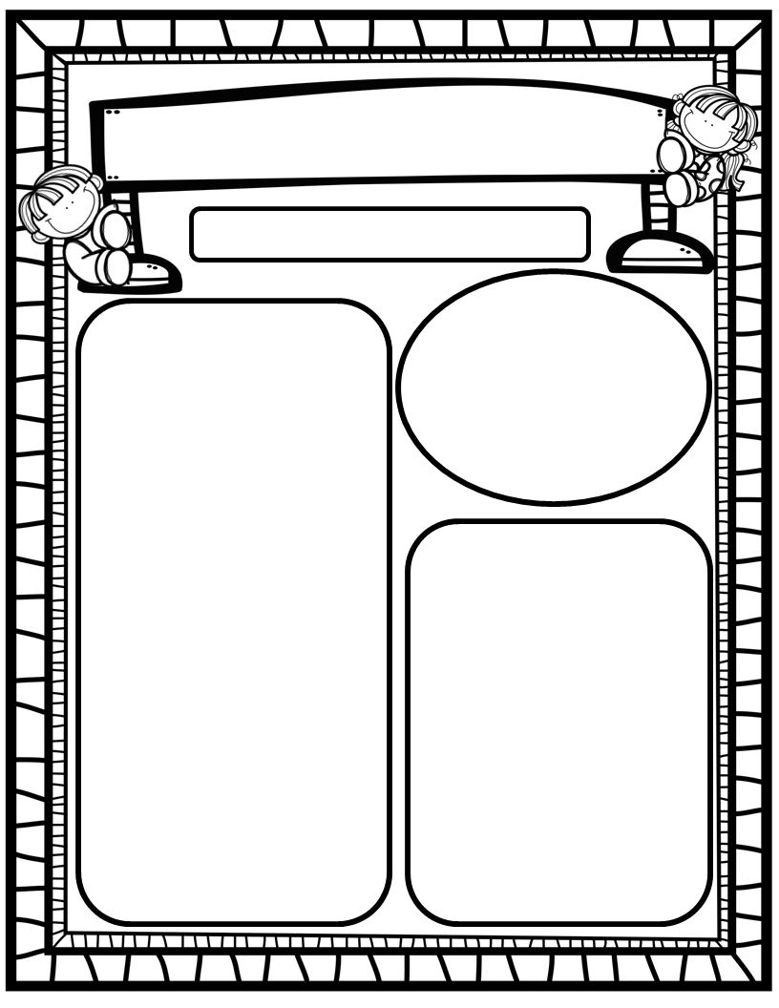
The Purple Press
September 8th, 2025
Homework:
Read to and with your kiddos each night and record progress on Beanstack Tracking Sheet/Explore Beanstack digitally!
Practice HFW’s: the, I, and
GoMath Home Practice for Chapters 1 & 17
Talk with your kiddos about what they are learning by going over their weekly papers and behavior grades with them!
We Are Learning About…
Reading: We will focus on the letter Pp (sounds, mouth formation, words that begin with sound), VC/CVC words, and HFW and. We will identify main topic and key details in texts we read. We will look at pictures to solve tricky words. EQ: How can we observe apples?
Writing: We will focus on printing and tracing upper and lowercase Pp, as well as our first names!
Math: We will finish GoMath Ch. 17: 2D Shapes.
Science: We will learn about our 5 senses/science tools and how we utilize them to observe and explore apples.
Social Studies: We will practice I-Care Rules. We will learn what it means to show Kindness!. We will explore apples, Johnny Appleseed and why he is historically significant. We will also take time to learn about the importance of Patriot Day/September 11th (with kiddo-friendly terms and conversations).
Important Dates:
September 9: Skate World Family Share Night
September 11: Patriot Day-Wear Red, White and Blue
September 12: About Me Doll Due;
September 15: Hispanic Heritage Month Begins
September 17: Constitution Day
September 18: PTO-7pm
September 23: K Fee Due (more info to come ☺)

