Slide 1
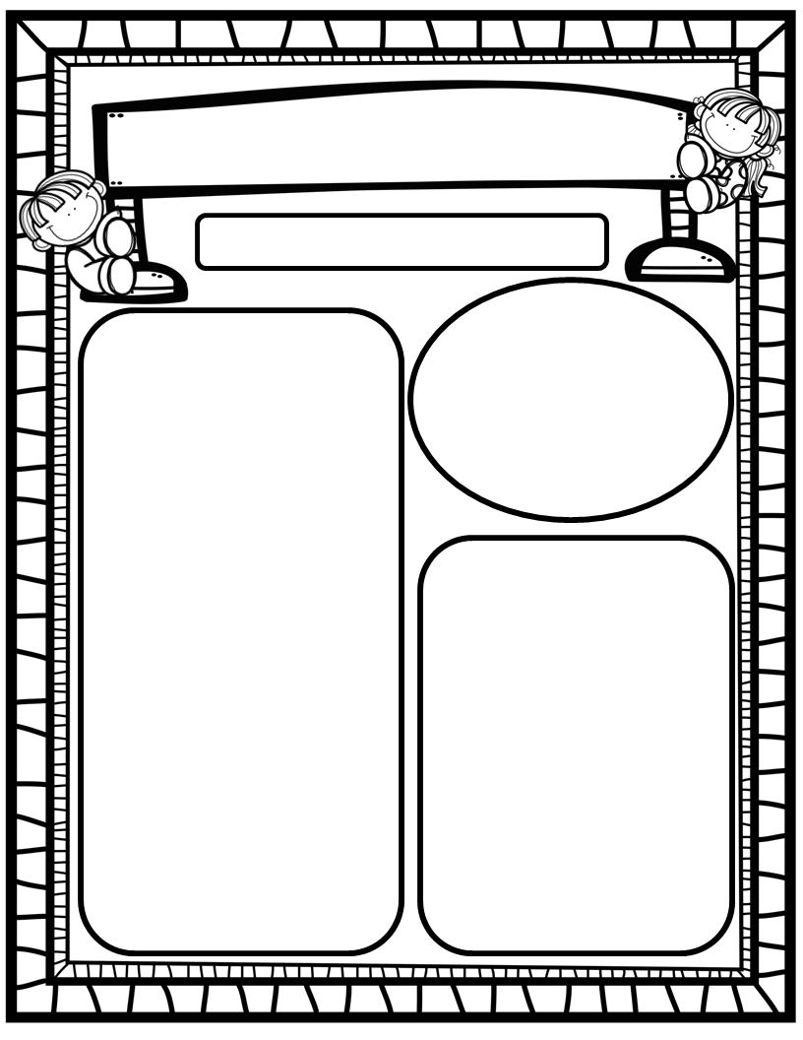
The Purple Press
October 6th, 2025
We Are Learning About…
Reading: We will focus on the letters Cc and Dd(sounds, mouth formation, words that begin and end with sound), and HFW said. We will identify characters, setting and story details when we read fiction. We will identify main topic and key details when we read nonfiction. We will look at pictures to help us solve tricky words. EQ: How do some animals move from place to place?
Writing: We will focus on printing and tracing upper and lowercase Cc and Dd, as well as stretchy-spelling words!
Math: We will finish GoMath Ch. 2: Count, Write and Represent Numbers through 5!
Science: We will wrap-up learning about our 5 senses, process skills, and how we utilize them to observe and explore the world around us!
Social Studies: We will practice I-Care Rules. We will learn what it means to show Attentiveness! We will continue learning why we celebrate Hispanic Heritage Month! We will also begin to focus on standing up to bullies in honor of October being Bully-Prevention Month!
Homework:
Read to and with your kiddos each night and record progress on Beanstack Tracking Sheet/Explore Beanstack digitally!
Practice HFW’s: the, I, and, a, is, as, said
GoMath Home Practice for Chapter 2
Talk with your kiddos about what they are learning by going over their weekly papers and behavior grades with them!
Important Dates:
October 10: End of 1st 9 weeks/Beanstack Celebration/Pumpkin Family Projects due
October 13: Beg. of 2nd 9 weeks/Teacher Planning Day-No School
October 14: Fall Picture Day (more info to come)
October 16: SAC/PTO, 6pm/7pm
October 22: Report Cards
October 24: Movie Night
October 27-31: Red Ribbon Week
October 24: Fall Craft Celebration items due if you signed up
October 31: Fall Craft Celebration, 8:45-10:45 (wear orange and black)

