Slide 1
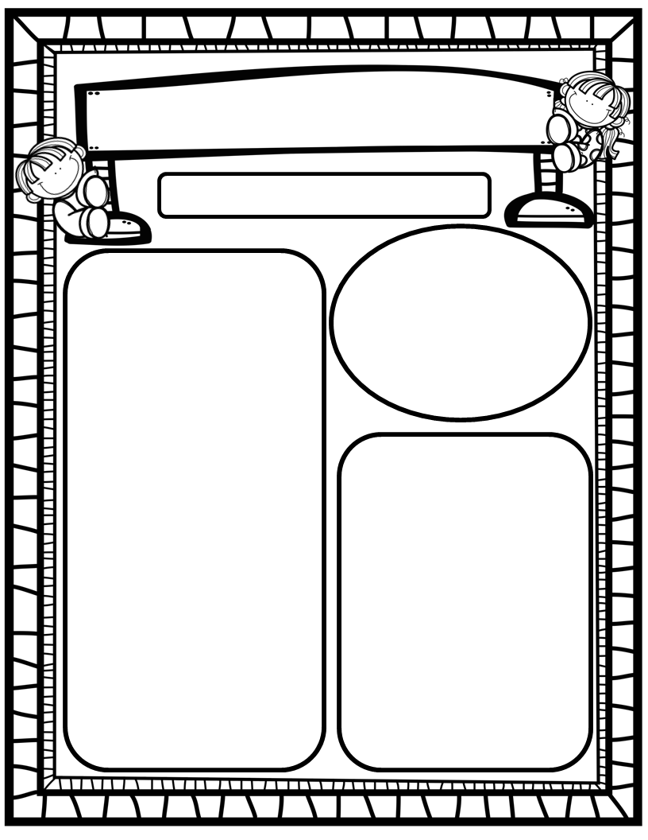
The Purple Press
April 21st, 2025
Homework:
Read to and with your child each night and complete Reading Rally Log!
Practice HFW’s: the, I, and, a, is, as, said, to, do, of, see, he, be, me, from, was, you, have, what, your, want, go, no, so, goes, says, she, we, they, their, were, talk, walk, could, would, should, or, for, where, there, who, by, my
Sight Word Pouches
Go Math Home Practice for Ch. 17
UFLI Home Practice Pages
Go over Weekly Work and discuss
We Are Learning About…
Reading: We will focus on the long vowels Aa and Ii along with silent/bossy e (spelling pattern a_e/mane, i_e/pipe), as well as HFW’s who, by, my. We will identify main topic and key details in texts we read. We will look at pictures, get our mouths ready, and use digraph chunks to help us stretchy-snake tricky words faster. EQ’s: How can rainy weather help Earth?
Writing: We will focus on printing and tracing upper and lowercase letters, as well as using stretchy-spelling and sight words to write complete sentences.
Math: We will begin Ch. 18: 3-Dimensional Shapes.
Science: We will continue learning about what plants need, and how they grow and change. We will continue our greenhouse experiment.
Social Studies: We will continue to practice I-Care Rules. We will practice what it means to be Resilient. We will also explore how to take care of our Earth (RRR) in recognition of Earth Day.
Important Dates:
April 22: STAR Math PM3
April 22: Earth Day ☺
April 23-30: PTO Online Silent Auction
April 25: Final Scholastic Book Order Due
April 26: HRES “Flight Fest” Carnival (please sign up to help at our class booth)

