Slide 1
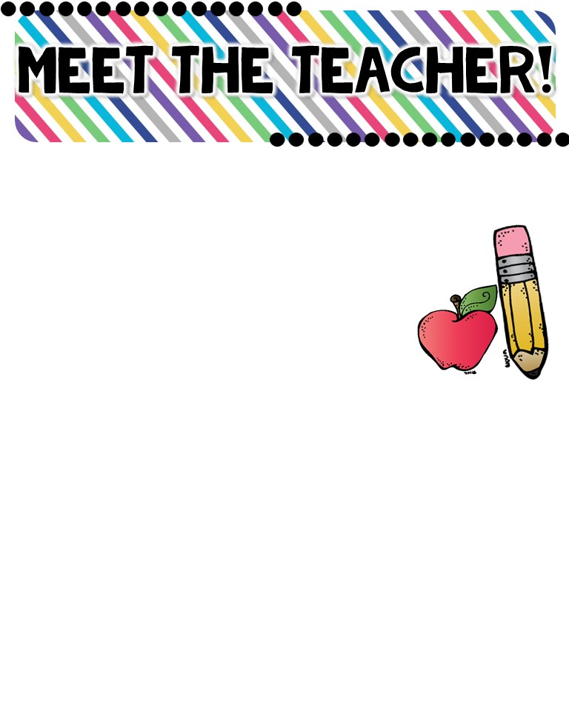
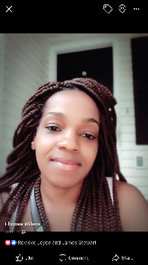
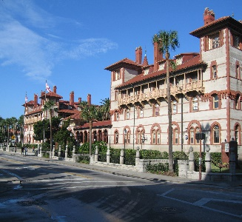
Ms. Ebonee Wilson
The Basics!
Hello Families: My name is Ms. Ebonee Wilson!! I am very delighted to be your child’s 1st Grade teacher. I enjoy traveling and spending quality time with my friends and family. I have four lovely children of my own and I’m proud to say that all of them have attended Sealey! This will be my 6th year teaching and my seventh year working at Sealey Elementary. I am excited to make this my best year yet!
MY CHILDHOOD!
I grew up in Tallahassee, although, I was born in Avon Park, Florida. I attended Caroline Brevard Elementary School 1-5. I attended Fairview and Swift Creek in Middle School. I graduated from Lincoln High School, Go Trojans!!!
MY FAVORITES!
MY EDUCATION!
Birthday: April 12th Color: Purple or Teal
Drink: Sprite or Coke
Season: Fall
Sports: Football
Team: Gators
Fast Food: Zaxby’s
Hobby: Reading
Store: Target/Staples
Dessert: Publix Cupcakes/ Banana Pudding
Candy: Twix
Restaurant: Buffalo Wild Wings
Flower: Carnations
In May of 2012, I graduated with a Bachelors of Science in Elementary Education K-5 from Flagler College and Exceptional Student Education K-12. I plan to attend Florida State in the very near future to pursue my Masters.
CONTACT ME!
Email: wilsone1@leonschools.net
School Phone Number: (850)488-5640
Dojo Messenger is the best way to contact me !!

