Slide 1




Financial Aid Overview
2023-2024 High School Students
2024-2025
Postsecondary Year
Notes:
Welcome to the financial aid overview presentation. This presentation is specifically for high school students graduating in the 2022-2023 academic year and then enrolling in a post secondary institution for the 2023-2024 academic year.
It is brought to you by the Office of Student Financial Assistance, a division of the Florida Department of Education.
Upon completion of this presentation you will gain a better understanding of the overall financial aid process for all post secondary institutions.
My name is Pedro Hernandez, Outreach Director, here at the Office of Student Financial Assistance. It is my pleasure to guide you through this process.

Slide 2

Financial Aid has its own language and acronyms:
COA
FSS
SAI
FAFSA
FSA ID
IRS DRT
FFAA
FAO
ED
FLDOE
OSFA
Notes:
A major and critical lesson is to know that : Financial aid has its own language and acronyms. We will explain these as we move through the presentation. However, If at any point throughout the process you do not understand a term, concept or acronym, always ask for clarification.
In Financial Aid language , Let us review the following :
COA means “cost of attendance.”
SAR means “student aid report.”
EFC means “expected family contribution.”
FAFSA means “Free Application for Federal Student Aid.”
FSA ID means “Federal Student Aid Identification.”
IRS DRT means “ IRS Data Retrieval Tool”
FFAA means “Florida Financial Aid Application.”
FAO means “Financial Aid Office.”
USDOE means “United States Department of Education.”
FDOE means “Florida Department of Education.”
OSFA means “Office of Student Financial Assistance.”

Slide 3

Agenda
What is financial aid?
Where do I find financial aid?
How and When do I apply?
Who can help me?
Notes:
The goal of this session is to understand of the entire financial aid process. This will be accomplished by reviewing the following four questions:
What is financial aid?
Where do I find financial aid?
How and when do I apply?
Who can help me?
After this brief yet comprehensive review, you will be able to better understand the entire financial aid process and make informed decisions pertaining to funding a postsecondary education.

Slide 4
What is Financial Aid?
Monies received from Four Sources (4): Federal, State, Institutional or Private
  Monies are also categorized as:
    Gift aid
    Self-help
    Need-based
    Merit-based
  Can cover direct or indirect costs
Notes:
Let us begin by answering the first question: what is financial aid?
Financial aid is defined as monies received from the (4) major sources federal, state, institutional or private resources.
Federal aid includes funding such as the Pell Grant, Federal student loans, and federal work study.
State financial aid offers a variety of state-funded scholarships and grants that are administered by the FDOE/OSFA and subject to change each year during legislative session.
Institutional aid are monies offered directly from the postsecondary school.
Private resources include a variety of scholarships from various groups such as local employers, national organizations, and community groups.
It is important to research and apply for each of these resources.
Financial Aid May also viewed into the following different categories:
Gift aid – this is free money that DOES NOT require repayment as long as the student meets the parameters outlined for each grant or scholarship. Students should always consult with a financial aid administrator prior to making any schedule changes to determine what repercussions the schedule changes will have on their financial aid awards.
Self help – this can be as easy as taking part of your earnings as applying it toward your college expenses. Students should check with their employer (or potential employers) regarding any tuition assistance or reimbursement programs being offered. Student loans are also considered as a form of “self” help, but should only be used as a last resort.
Need-based – monies awarded based on the applicant’s Free Application for Federal Student Aid (FAFSA). Therefore, it is important to complete your FAFSA as soon as possible. While the Pell Grant is an entitlement program, other need-based monies are awarded on a first-come, first-serve basis.
Merit-based – merit-based monies are available through a variety of avenues that we will discuss throughout today’s presentation. For example, Bright Futures is a merit-based program.
College costs include tuition, fees, and books, along with other expenses such as: transportation, food, housing, clothing and computer costs. Cost of attendance can vary from institution to institution, so check your college’s website for additional information. Financial aid monies can be used toward all items included within the cost of attendance.

Slide 5
What is Financial Aid?
Monies received from Four Sources (4): 1. Federal Aid:
  Pell Grants (Gift Aid)(Need Based)
  FSEOG (Gift Aid)(Need Based)
  Work Study Programs (Self-Help Aid)
  Student Loans (Self-Help Aid)
    Student (Subsidized/Unsubsidized)
    Parent
Notes:
Let us begin by answering the first question: what is financial aid?
Financial aid is defined as monies received from the (4) major sources federal, state, institutional or private resources.
Federal aid includes funding such as the Pell Grant, Federal student loans, and federal work study.
State financial aid offers a variety of state-funded scholarships and grants that are administered by the FDOE/OSFA and subject to change each year during legislative session.
Institutional aid are monies offered directly from the postsecondary school.
Private resources include a variety of scholarships from various groups such as local employers, national organizations, and community groups.
It is important to research and apply for each of these resources.
Financial Aid May also viewed into the following different categories:
Gift aid – this is free money that DOES NOT require repayment as long as the student meets the parameters outlined for each grant or scholarship. Students should always consult with a financial aid administrator prior to making any schedule changes to determine what repercussions the schedule changes will have on their financial aid awards.
Self help – this can be as easy as taking part of your earnings as applying it toward your college expenses. Students should check with their employer (or potential employers) regarding any tuition assistance or reimbursement programs being offered. Student loans are also considered as a form of “self” help, but should only be used as a last resort.
Need-based – monies awarded based on the applicant’s Free Application for Federal Student Aid (FAFSA). Therefore, it is important to complete your FAFSA as soon as possible. While the Pell Grant is an entitlement program, other need-based monies are awarded on a first-come, first-serve basis.
Merit-based – merit-based monies are available through a variety of avenues that we will discuss throughout today’s presentation. For example, Bright Futures is a merit-based program.
College costs include tuition, fees, and books, along with other expenses such as: transportation, food, housing, clothing and computer costs. Cost of attendance can vary from institution to institution, so check your college’s website for additional information. Financial aid monies can be used toward all items included within the cost of attendance.

Slide 6
What is Financial Aid?
Monies received from Four Sources (4): 2. State Aid:
  Benacquisto(Gift Aid)(Merit Based)
  Bright Futures Scholarship (Gift Aid)(Merit Based)
    Academic/Medallion/Gold Seal/CAPE
  Work Study Programs (Self-Help Aid)
  Effective Access to Student Education
  Many More +
Notes:
Let us begin by answering the first question: what is financial aid?
Financial aid is defined as monies received from the (4) major sources federal, state, institutional or private resources.
Federal aid includes funding such as the Pell Grant, Federal student loans, and federal work study.
State financial aid offers a variety of state-funded scholarships and grants that are administered by the FDOE/OSFA and subject to change each year during legislative session.
Institutional aid are monies offered directly from the postsecondary school.
Private resources include a variety of scholarships from various groups such as local employers, national organizations, and community groups.
It is important to research and apply for each of these resources.
Financial Aid May also viewed into the following different categories:
Gift aid – this is free money that DOES NOT require repayment as long as the student meets the parameters outlined for each grant or scholarship. Students should always consult with a financial aid administrator prior to making any schedule changes to determine what repercussions the schedule changes will have on their financial aid awards.
Self help – this can be as easy as taking part of your earnings as applying it toward your college expenses. Students should check with their employer (or potential employers) regarding any tuition assistance or reimbursement programs being offered. Student loans are also considered as a form of “self” help, but should only be used as a last resort.
Need-based – monies awarded based on the applicant’s Free Application for Federal Student Aid (FAFSA). Therefore, it is important to complete your FAFSA as soon as possible. While the Pell Grant is an entitlement program, other need-based monies are awarded on a first-come, first-serve basis.
Merit-based – merit-based monies are available through a variety of avenues that we will discuss throughout today’s presentation. For example, Bright Futures is a merit-based program.
College costs include tuition, fees, and books, along with other expenses such as: transportation, food, housing, clothing and computer costs. Cost of attendance can vary from institution to institution, so check your college’s website for additional information. Financial aid monies can be used toward all items included within the cost of attendance.

Slide 7
What is Financial Aid?
Monies received from Four Sources (4): 3. Institutional Aid:
  Academic (Gift Aid)(Merit Based)
  Major/Specific Study (Gift Aid)(Merit Based)
Notes:
Let us begin by answering the first question: what is financial aid?
Financial aid is defined as monies received from the (4) major sources federal, state, institutional or private resources.
Federal aid includes funding such as the Pell Grant, Federal student loans, and federal work study.
State financial aid offers a variety of state-funded scholarships and grants that are administered by the FDOE/OSFA and subject to change each year during legislative session.
Institutional aid are monies offered directly from the postsecondary school.
Private resources include a variety of scholarships from various groups such as local employers, national organizations, and community groups.
It is important to research and apply for each of these resources.
Financial Aid May also viewed into the following different categories:
Gift aid – this is free money that DOES NOT require repayment as long as the student meets the parameters outlined for each grant or scholarship. Students should always consult with a financial aid administrator prior to making any schedule changes to determine what repercussions the schedule changes will have on their financial aid awards.
Self help – this can be as easy as taking part of your earnings as applying it toward your college expenses. Students should check with their employer (or potential employers) regarding any tuition assistance or reimbursement programs being offered. Student loans are also considered as a form of “self” help, but should only be used as a last resort.
Need-based – monies awarded based on the applicant’s Free Application for Federal Student Aid (FAFSA). Therefore, it is important to complete your FAFSA as soon as possible. While the Pell Grant is an entitlement program, other need-based monies are awarded on a first-come, first-serve basis.
Merit-based – merit-based monies are available through a variety of avenues that we will discuss throughout today’s presentation. For example, Bright Futures is a merit-based program.
College costs include tuition, fees, and books, along with other expenses such as: transportation, food, housing, clothing and computer costs. Cost of attendance can vary from institution to institution, so check your college’s website for additional information. Financial aid monies can be used toward all items included within the cost of attendance.

Slide 8
What is Financial Aid?
Monies received from Four Sources (4): 3. Private Aid:
  School (Gift Aid)(Merit Based)
    High School/Post-Secondary Institutions
  Employment
    Student/Parents
Notes:
Let us begin by answering the first question: what is financial aid?
Financial aid is defined as monies received from the (4) major sources federal, state, institutional or private resources.
Federal aid includes funding such as the Pell Grant, Federal student loans, and federal work study.
State financial aid offers a variety of state-funded scholarships and grants that are administered by the FDOE/OSFA and subject to change each year during legislative session.
Institutional aid are monies offered directly from the postsecondary school.
Private resources include a variety of scholarships from various groups such as local employers, national organizations, and community groups.
It is important to research and apply for each of these resources.
Financial Aid May also viewed into the following different categories:
Gift aid – this is free money that DOES NOT require repayment as long as the student meets the parameters outlined for each grant or scholarship. Students should always consult with a financial aid administrator prior to making any schedule changes to determine what repercussions the schedule changes will have on their financial aid awards.
Self help – this can be as easy as taking part of your earnings as applying it toward your college expenses. Students should check with their employer (or potential employers) regarding any tuition assistance or reimbursement programs being offered. Student loans are also considered as a form of “self” help, but should only be used as a last resort.
Need-based – monies awarded based on the applicant’s Free Application for Federal Student Aid (FAFSA). Therefore, it is important to complete your FAFSA as soon as possible. While the Pell Grant is an entitlement program, other need-based monies are awarded on a first-come, first-serve basis.
Merit-based – merit-based monies are available through a variety of avenues that we will discuss throughout today’s presentation. For example, Bright Futures is a merit-based program.
College costs include tuition, fees, and books, along with other expenses such as: transportation, food, housing, clothing and computer costs. Cost of attendance can vary from institution to institution, so check your college’s website for additional information. Financial aid monies can be used toward all items included within the cost of attendance.

Slide 9
College Costs
COA=Cost of Attendance varies from:
    Institution to institution
    In State vs. out of state
    On campus vs. off campus
COA= Direct Costs + Indirect Costs
Net Price Calculator
  Requirement for every institution
Notes:
The cost of attendance (COA) varies from institution to institution. There are also variances between in-state and out of state schools and whether the student lives on campus or off campus. It is important to take this into consideration when researching at your options.
Cost of attendance traditionally includes both direct and indirect costs.
Direct Costs include tuition and fees.
Indirect costs include items such as books, food, transportation, housing, and computer.
A Great Resource to utilize: Net Price Calculator
Every school is now required to have a Net Price Calculator available.
You can use the Net Price Calculator to assist in analyzing your COA-Cost of Attendance at a specific school.

Slide 10
College Costs
Public 2-year college (tuition and fees, in-state) - $3,770
Public 4-year college (tuition and fees, in-state) - $10,560
Public 4-year college (tuition and fees, out of state) - $27,020
Private 4-year college (tuition and fees) -
$37,650
Source: The College Board
Notes:
As we outlined on the previous slide, college costs include both direct and indirect costs.
Let us briefly review the average direct cost which is only tuition and fees per year at different types of institutions.
According to the College Board: The Average Yearly Tuition and Fees,
Nationally, In Florida Your specific school Direct Cost will be lower than the national average.
(read slide)

Slide 11
Where do I Find Financial Aid? Financial Aid Applications:
Free Application for Federal Student Aid FAFSA
Florida Financial Aid Application FFAA
College Scholarship Service Profile CSS Profile
Institutional Applications
Private Scholarships
Source: The College Board
Notes:
As we outlined on the previous slide, college costs include both direct and indirect costs.
Let us briefly review the average direct cost which is only tuition and fees per year at different types of institutions.
According to the College Board: The Average Yearly Tuition and Fees,
Nationally, In Florida Your specific school Direct Cost will be lower than the national average.
(read slide)

Slide 12
Free Application for Federal Student Aid (FAFSA)
Federal government is largest source of student aid; FAFSA distributed and processed by the U.S. Department of Education
  Manual or electronic options
  2024-25 FAFSA opens After December 1
Must be completed ANNUALLY (per academic year) to be evaluated for financial aid
www.fafsa.gov
Notes:
Where does one find financial aid? One essential step is completing the Free Application for Federal Student Aid (FAFSA).
While filing the FAFSA is not required, it is used by many institutions to determine need based financial aid provided by the school for FEDERAL/STATE/Institutional Programs!!
Please note that the first letter in the acronym FAFSA stands for FREE. Please make sure you are using the correct website: FAFSA.gov. or StudentAid.gov There are other websites that can assist you in completing the FAFSA for a fee. You do not need to pay someone to assist you in this process.
Three ways to submit the FAFSA:
On-line using your FSA ID to electronically sign the application –Highly Recommended
Submit information online and print signature page to be submitted by mail
Print out the entire PDF application from website and submit with signatures by mail
The 2023-24 application becomes available October 1. and not earlier!!
Applicants will use their 2021 tax information to complete the FAFSA. (Review your institution’s website to determine the priority deadline as deadlines vary from institution to institution. Also, please note that it is highly advisable to complete the application electronically and to utilize the IRS data retrieval tool.
It is recommended to file a FAFSA each year a student attends a postsecondary institution.

Slide 13
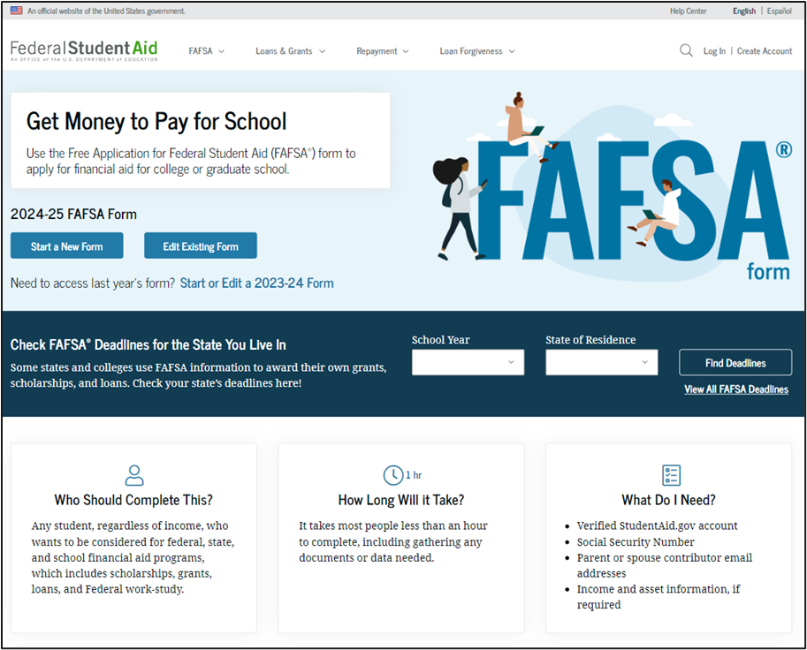
FAFSA.GOV
Help
Notes:
This is a screenshot of www.fafsa.gov. The reason that we show this screen shot is to ensure you are accessing the FREE website. If you feel that you need assistance in completing this application, there are built-in help resources available online. You can also reach out to a member of OSFA’s Outreach Services team, your high school counselor or a financial aid professional at your institution. We can all help you at no cost.

Slide 14
Getting Started
Gather important data
Monitor priority deadlines
  State and institutional deadlines vary
Confirm FAFSA dependency versus independency requirements
  Dependent students are required to include parental information
  Independent students are not required to include parental information
Search for school codes
Plan to sign and submit online using the Federal Student Aid (FSA) ID and FSA Password
Notes:
When completing the FAFSA, students will need to have their SSN, Alien Registration Numbers (if applicable), prior prior year tax returns or earning statements, untaxed income records, current bank statements, current business and investment records accessible.
Monitoring the various deadlines is an integral part of the financial aid process. For example, the state of Florida offers need-based programs that include a FAFSA priority deadline of May 15th. Institutions also have their own FAFSA priority deadline and you can check their website for the specifics.
The FAFSA may require parental information. Students will find out their dependency status by answering a few questions at the beginning of the application process.
If there are extenuating circumstances and students cannot provide parental information, they need to speak to a financial aid administrator regarding a Dependency Override. Dependency Overrides are for extenuating circumstances only, and are not applicable to parents who are unwilling to assist or living on their own!!
Students can search for school codes directly within the FAFSA application and can request up to 10 institutions to receive their information.
Students and parents will need to apply for their own FSA ID username and password. This FSA ID is used to sign the FASFA and utilize the IRS Data Retrieval Tool. Signing and submitting the FAFSA via this electronic format greatly expedites the process. Parents, if you have a FSA ID, either from your own FAFSA or in conjunction with another child, you will use that same FSA ID again. NOTE: a SEPARATE e-mail address is connected with each FSA ID. A parent’s e-mail address cannot be used with the student ID and vice versa.

Slide 15

Who is a Parent?
A legal parent includes a biological or adoptive parent, or a person that the state has determined to be your parent (for example, when a state allows another person’s name to be listed as a parent on a birth certificate).
Grandparents, foster parents, legal guardians, older brothers or sisters, widowed stepparents, and aunts and uncles are not considered parents unless they have legally adopted you.
Notes:
Read slide
Parents’ Marital Status – often there is confusion regarding the marital status of parents and how to report a parent on the FAFSA.
If the parents’ marital status is:
Never Married: include the parent that you lived with most during the last 12 months. If you did not live with one parent more than the other, provide information about the parent who provided more financial support during the last 12 months or during the most recent year that you actually received support from a parent.
Unmarried and both parents living together: include both of your parents
Married: include both of your parents
Remarried (after being widowed or divorced): include the parent and stepparent
Divorced or separated: include the parent that you lived with most during the last 12 months. If you did not live with one parent more than the other, provide information about the parent who provided more financial support during the last 12 months or during the most recent year that you actually received support from a parent
Widowed: include the parent who is living

Slide 16
Parent Marital Status
Never Married
Unmarried but living together
Married
Remarried
Divorced or separated
Widowed
Notes:
If the parent’s marital status is:
Never Married: include the parent that you lived with most during the last 12 months. If you did not live with one parent more than the other, provide information about the parent who provided more financial support during the last 12 months or during the most recent year that you actually received support from a parent.
Unmarried and both parents living together: include both of your parents
Married: include both of your parents
Remarried (after being widowed or divorced): include the parent and stepparent
Divorced or separated: include the parent that you lived with most during the last 12 months. If you did not live with one parent more than the other, provide information about the parent who provided more financial support during the last 12 months or during the most recent year that you actually received support from a parent.
If the parents’ marital status is:
Widowed: include the parent who is living

Slide 17
FASFA Submission Summary (FSS)
Provides basic information about federal student aid eligibility
Received (after you submit the FAFSA) via email within 3-5 days if you provided an email address
  Received via mail within 7-10 days if you did not provide an email address
Correct errors, if needed
Will contain (SAI)
  Assists institutions in the financial aid award packaging process
Cost of attendance less expected family contribution = financial need
Notes:
Once you submit your FAFSA you will receive a SAR (Student Aid Report)
It is important to ensure that the SAR is received and reviewed according to these timeframes. If the SAR is not received, the student must investigate why it has not been received. It may be in a spam folder, it may have not processed correctly due to an error, etc. When the student receives their copy of the SAR, the institution(s) will receive an electronic version referred to as an ISIR.
If corrections need to be made, the student should work with a financial aid administrator to determine who will make the corrections (student or school). If a student needs to make corrections, they will do so online at www.fafsa.gov.
The institution will review the SAR for accuracy and begin the financial aid award process. The EFC is used to award need-based aid. As outlined on the slide, cost of attendance – expected family contribution = financial need. An institution will begin layering a financial aid package in an effort to cover the entire cost of attendance. As the cost of attendance can vary from institution to institution, it is important that students and families apply for all federal, state, institutional and local resources in an effort to assist the institution in building a strong financial aid package.

Slide 18
Additional Information
Contact institution to determine award disbursement process
Contact institution for special circumstances or professional judgment needs
Contact institution to determine what other types of aid applications are available
Use student loans as a LAST RESORT
Notes:
Students must contact their institution to determine the award process. For example, one institution may email the student. Another may require the student to log-in to a student portal and check their status online. The student must monitor the process closely! Otherwise, they may miss out on key deadlines or funding.
If students and families complete the FAFSA and are concerned that the form does not reflect their current situation, they may contact a financial aid administrator to discuss their specific needs. Professional judgment and/or Professional Judgement are optional and schools have the direct authority in this area.
Students can also contact the institution to determine what other aid applications are available. An institution may have a foundation department that has a separate application and funding process that students may want to apply for. Additionally, department chairs may have access to not only institutional funds, but may also have access to other industry-based resources students can apply for.
Lastly, student loans are often included in the initial award process. Students have a right and responsibility to determine if they should accept, decline or reduce any student loan or loans being offered. Students should borrow conservatively. It’s important to live frugally while in college. If a student does not borrow conservatively and live frugally, he/she will struggle throughout student loan repayment.

Slide 19
Additional Information
Verification Process
Offer of Financial Aid
Communication with the Post Secondary Institution
Formula: COA-SAI-OFA = Financial Need
  Scholarships/Grants (Institutional/Federal/State)
  Florida Prepaid-529 Plans (Check with your Institution)
  Federal Loans: Student/Parent
    Subsidized (USDOE pays interest – in school)
    Unsubsidized (Student responsible interest)
      Subsidized/Unsubsidized (Principal + interest begins after graduation or not enrolled for 6 months)
  Private Loans
Notes:
Students must contact their institution to determine the award process. For example, one institution may email the student. Another may require the student to log-in to a student portal and check their status online. The student must monitor the process closely! Otherwise, they may miss out on key deadlines or funding.
If students and families complete the FAFSA and are concerned that the form does not reflect their current situation, they may contact a financial aid administrator to discuss their specific needs. Professional judgment and/or Professional Judgement are optional and schools have the direct authority in this area.
Students can also contact the institution to determine what other aid applications are available. An institution may have a foundation department that has a separate application and funding process that students may want to apply for. Additionally, department chairs may have access to not only institutional funds, but may also have access to other industry-based resources students can apply for.
Lastly, student loans are often included in the initial award process. Students have a right and responsibility to determine if they should accept, decline or reduce any student loan or loans being offered. Students should borrow conservatively. It’s important to live frugally while in college. If a student does not borrow conservatively and live frugally, he/she will struggle throughout student loan repayment.

Slide 20
Florida Financial Aid Application (FFAA) www.FloridaStudentFinancialAidsg.org
The Florida Financial Aid Application opens October 1* of the senior year
  Apply early - must be completed prior to August 31 of high school graduation year
One application is used for multiple programs, not just the Florida Bright Futures Scholarship Program
  Must log-in to check status, online notifications and award history
Notes:
Continuing with Where Do I Apply for Financial Aid question, let’s now discuss aid offered by the state of Florida.
Students often refer to the Florida Financial Aid Application (FFAA) as the “Bright Futures” application. It’s actually more than that! This one application assists OSFA in determine eligibility for a variety of state grants and scholarships that we will review over the next few slides. One common misconception is that students do not need to complete the application if they do not feel they will qualify for the Bright Futures Scholarship. This is NOT true. We encourage ALL students to complete the application and give OSFA the opportunity to determine their eligibility for all Florida grants and scholarships.
Another common misconception is that students do not need to complete the application if they are planning to attend school out of state. This is NOT true either. We encourage you to complete it anyway and have it as a backup should your plans change.
The FFAA opens October 1. Students may apply during their SENIOR year.
*Students graduating early and seeking funding for the spring term must submit the FFAA no later than December 31 of the students graduation year in order to be evaluated for and, if eligible, receive an award for the current academic year.
Students will want to check their account for application status, notifications, and award history.

Slide 21
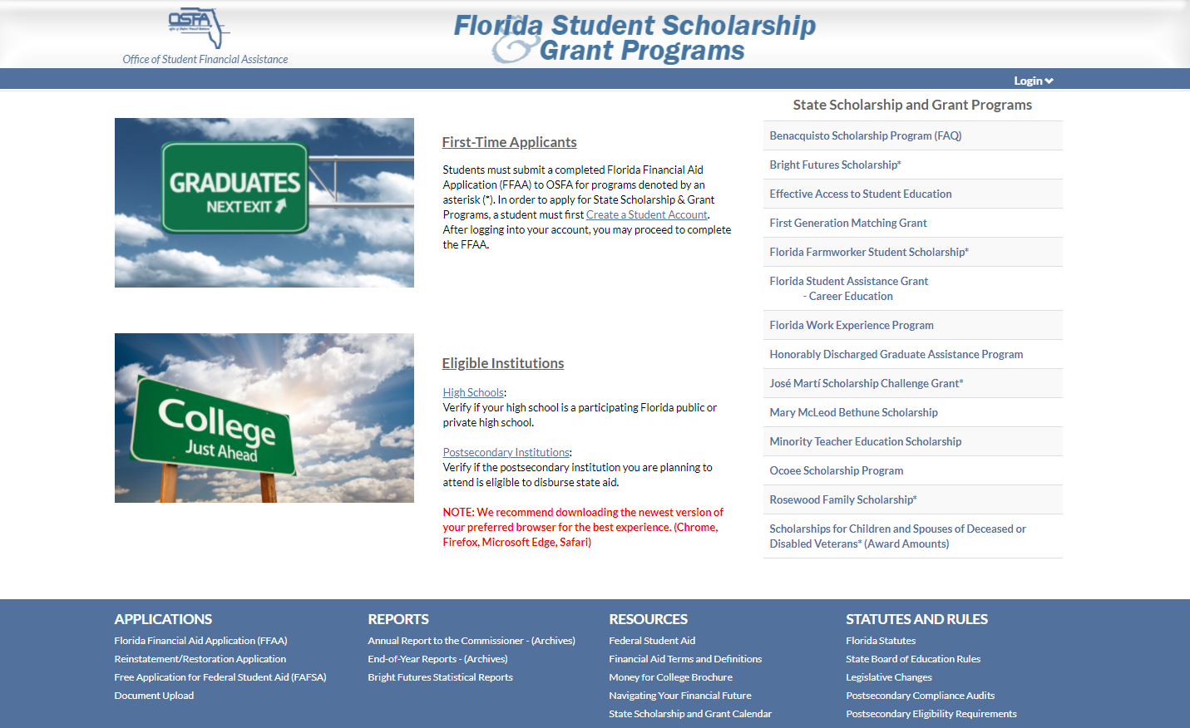
FFAA-Florida Financial Aid Application www.Floridastudentfinancialaidsg.org
Notes:
The next few slides contain screenshots of what the OSFA website looks like. If you look at the first screen, you will see the State Grants, Scholarships, and Applications link. By selecting the link, you will be taken to…(advance to next slide).

Slide 22
Need-Based Programs
Florida Student Assistance Grant (FSAG)
Florida Work Experience Program (FWEP)
Tuition Assistance Programs
William L. Boyd, Effective Access to Student Education Grant Program
Notes:
(Read slide and provide the information below for each scholarship and grant.)
FSAG - Florida’s largest need-based grant program provides assistance to degree-seeking, resident, undergraduate students who demonstrate financial need and are enrolled in eligible public or private postsecondary institutions. FAFSA is required by the deadline specified by the participating postsecondary institutions.
FWEP – Provides eligible Florida resident undergraduate students the opportunity to secure work experiences that complement their educational program and career goals.
Effective Access to Student Education Grant Program - Provides tuition assistance to full-time Florida undergraduate students who attend eligible private, non-profit Florida colleges or universities.

Slide 23
Merit-Based Programs
Bright Futures (BF)
  Student Handbook
  Chart of Eligibility and Award Criteria
Benacquisto Scholarship
Notes:
BF - Provides scholarships based on high school academic achievement and is Florida’s largest merit-based scholarship program. To be considered, students must submit a completed (error free) Initial Student Florida Financial Aid Application (FFAA) during their senior year of high school (after October 1st and prior to August 31). Students graduating mid-year must submit the completed FFAA by August 31st of their graduation year (prior to the spring term enrolled).
(PRESENTER: Print out Student Handbook and Chart of Eligibility and Award Criteria for additional speaking points during this part of the presentation in case specific questions are asked about this scholarship (i.e., test scores, community service hours, etc.)
Benacquisto–is a merit scholarship for Florida high school graduates who receive recognition as a National Merit® Scholar.
Eligible scholars will receive an award, which is equal to the institutional cost of attendance minus the sum of Bright Futures and the National Merit award. An initial application is not required.

Slide 24
Other
First Generation Matching Grant (FGMG)
Florida Farmworker Student Scholarship (FFSS)
José Martí Scholarship Challenge (JM)
Mary McLeod Bethune (MMB)
Minority Teacher Education Program Scholarship (MTES)
Rosewood Family Scholarship (RFS)
Scholarships for Children and Spouses of Deceased or Disabled Veterans (CSDDV)
Randolph Bracy Ocoee Scholarship Program
Florida Law Enforcement Academy Scholarship Program.
Money for College - Florida Scholarships and Grants
Notes:
FGMG - Provides grant funding to Florida resident, undergraduate students enrolled at state universities or Florida Colleges (also known as public community colleges), who demonstrate financial need, and whose parents have not earned baccalaureate degrees.
Jose Marti - Provides scholarship assistance to Hispanic-American students who meet scholastic requirements and demonstrate financial need. Applicants for undergraduate study must apply during their senior year of high school. To be considered, high school seniors must submit the FFAA by April 1st and a processed FAFSA by May 15th. Awards are made until the allocation has been depleted.
Please refer to the Jose Marti fact sheet online for specific requirements.
MMB – Provides scholarship assistance to undergraduate students who meet academic requirements, demonstrate financial need, and attend on of the following universities:
Bethune Cookman University
Edward Waters College
Florida Agricultural and Mechanical University
Florida Memorial University
MTES - Provides scholarship funding for African-American, Hispanic-American, Asian-American, and Native-American students who indicate the potential to become good teachers. To be considered, students must apply via the Florida Fund for Minority Teachers website at www.ffmt.org.
RFS – Provides scholarship assistance to a maximum of 50 direct descendants of Rosewood families affected by the incidents of January 1923.
CSDDV – Provides scholarship assistance for dependent children and spouses of Florida veterans who:
Died as a result of services connected injuries, diseases, or disability sustained while on active duty
Have a service connected 100% total and permanent disability
Are classified as a prisoner of war or missing in action by the Armed Forces of the U.S.
The Florida Department of Veteran’s Affairs will certify a veteran’s eligibility.

Slide 25
Private Scholarships
1.5 million scholarships worth 3.4 billion dollars
  Targeted search
Other resources
  College search
  Career planning
  And more!
www.fastweb.com
Notes:
Fastweb works by matching the information in your completed profile to scholarships contained in their database. Besides providing you with scholarships you actually qualify for, and eliminating the need to scour the web, Fastweb also provides advice on financial aid, college admissions, student life and tools such as financial aid calculators, discussion boards, and checklists.
TIP- Set up a separate email account solely for scholarship searches to prevent your personal inbox becoming inundated with information.

Slide 26
Navigating your Financial Future (NyFF) www.navigatingyourfuture.org
Financing higher education
Managing day-to-day money
Career planning
School/Life management
Resources available at no cost
www.navigatingyourfuture.org
Notes:
OSFA offers free resources and guidance through the Navigating Your Financial Future website. Please visit www.NavigatingYourFuture.org to see all of the free brochures, online trainings, financial calculators and more.

Slide 27
Review: Action Items
Federal – Financial Aid (FAFSA)
  Monitor December 1, 2023 and afterward as FAFSA application opening date
  Create FSA ID and passwords now
State – Financial Aid (FFAA)
  Mark October 1, 2023 as application opening date
  Ensure meeting requirements:
    Bright Futures
    Graduation
    Private scholarships – apply, apply, apply!
    CSS Profile –If Institution Requires
    Additional Required Institution Applications
Notes:
In conclusion, let’s review what we’ve discussed and create an action plan for you.
(Read slide.)
Reminder:
Students graduating early and seeking funding for the spring term must submit the FFAA by August 31 PRIOR TO the intended graduation date. There are NO EXCEPTIONS to this application deadline. If a student does not graduate mid-year as planned and wishes to apply as an end-of-year graduate, the student must submit a new FFAA after the new application opens on October 1.

Slide 28
Who can help me?
US Department of Education:
  800-433-3243/StudentAid.gov
Colleges/Universities/Tech
  Financial Aid Offices
High Schools/organizations:
  Financial Aid workshops/trainings
Notes:
If you need assistance or further information, please do not hesitate to contact us. We are here to help!
Thank you for attending this presentation. We hope you have a successful transition into postsecondary education.

Slide 29
Office of Student Financial Assistance (OSFA) Contacts
Email:
osfa@fldoe.org
Telephone:
1-888-827-2004
OSFA Director Outreach Services:
  Pete Hernandez | 850.245.1821 | Pedro.Hernandez@fldoe.org
Notes:
If you need assistance or further information, please do not hesitate to contact us. We are here to help!
Thank you for attending this presentation. We hope you have a successful transition into postsecondary education.

