Slide 1
6.3 Trig Functions of Angles
Part 1

Slide 2
So P = (x, y) is a point on the terminal side of theta. Using the Pythagorean theorem, r =
P
P (x, y)
opposite
r
y
hypotenuse
Q
O
x
Q
adjacent
O

Slide 3
P (x, y)
r
y
So:
O
x
Q

Slide 4
Ex Let (-8, -6) be a point on the terminal side of theta. Find all six trig functions of theta.
Q
-8
O
-6
r
P (-8, -6)

Slide 5
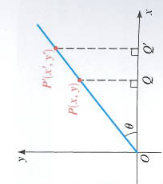
Quadrantal Angles – angles that are coterminal with the coordinate axis.
When the terminal side of an angle theta, that is in standard position , lies on the coordinate axes. (The angles for which either the x- or y-coordinate of a point on the terminal side of the angle is 0.)
Since division by 0 is undefined, certain trig functions are not defined for certain angles. EX is tan 90º degrees = y/x because x = 0.

Slide 6
EX

Slide 7
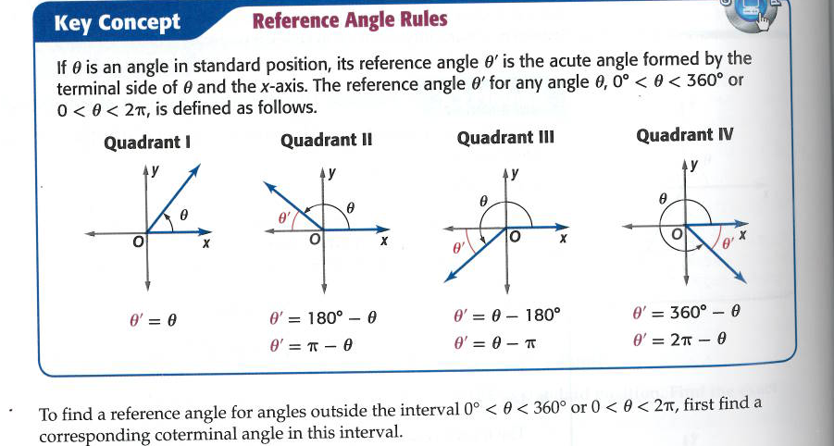
We see that the trig functions for angles that aren’t acute have the same value except possibly for the sign, as the corresponding trig functions of an acute angle. Let theta be an angle in standard position. The reference angle (theta bar) associated with theta is the acute angle formed by the terminal side of theta and the x-axis.

Slide 8
Ex Find the reference angle for: reference does not equal coterminal

Slide 9
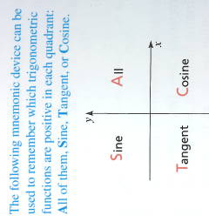
Evaluating Trig Functions at Any Angle
‘r’ is always positive because it is the distance from the origin to the point P(x, y). The position of the terminal side will determine whether the trig function is positive or negative.
Q I: all positive
Q2: (-x, y): sin, csc are +
Q3 (-x, -y): tan, cot are +
Q4 (x, -y): cos, sec are +

Slide 10
Ex Find the following:
Cos 135° =
tan 390 °
cos 60 °
tan 240 °

Slide 11
Evaluating Trig Functions for any angle:
Find the reference angle (theta bar) associated with the angle theta.
Determine the sign of the trig function of theta by noting the quadrant in which theta lies.
The value of the trig function of theta is the same, except possibly for the sign, as the value of the trig function theta bar.

Slide 12
Evaluate the Trig Functions using the Reference Angle.

Slide 13
Pg 495 #1-36
Homework

